Slide 1
Women’s Suffrage and the Mexican-American War
VUS.6e

Slide 2
Mexican-American War
With Manifest Destiny, America desired to move westward
Texas wishes to be free of Mexican rule and be annexed by America
American settlers in Texas claim independence from Mexico

Slide 3
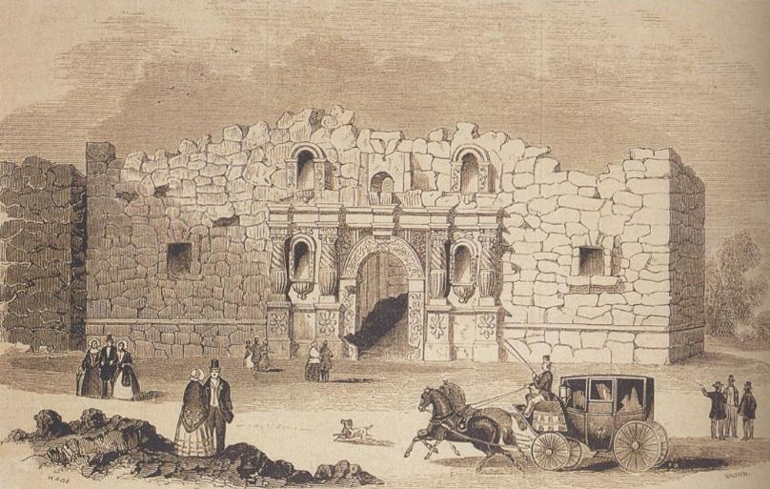
Mexican-American War
Alamo
A band of Texans fought to the last man against a vastly superior force.

Slide 4
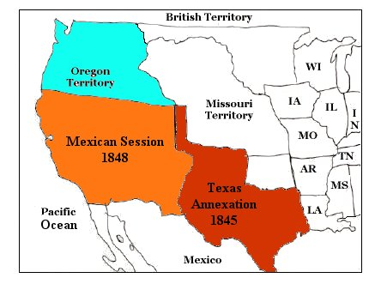
Mexican-American War
Texas Victory
The Texans’ victory over Mexico led to the end of the war and the annexation of Texas as a state

Slide 5
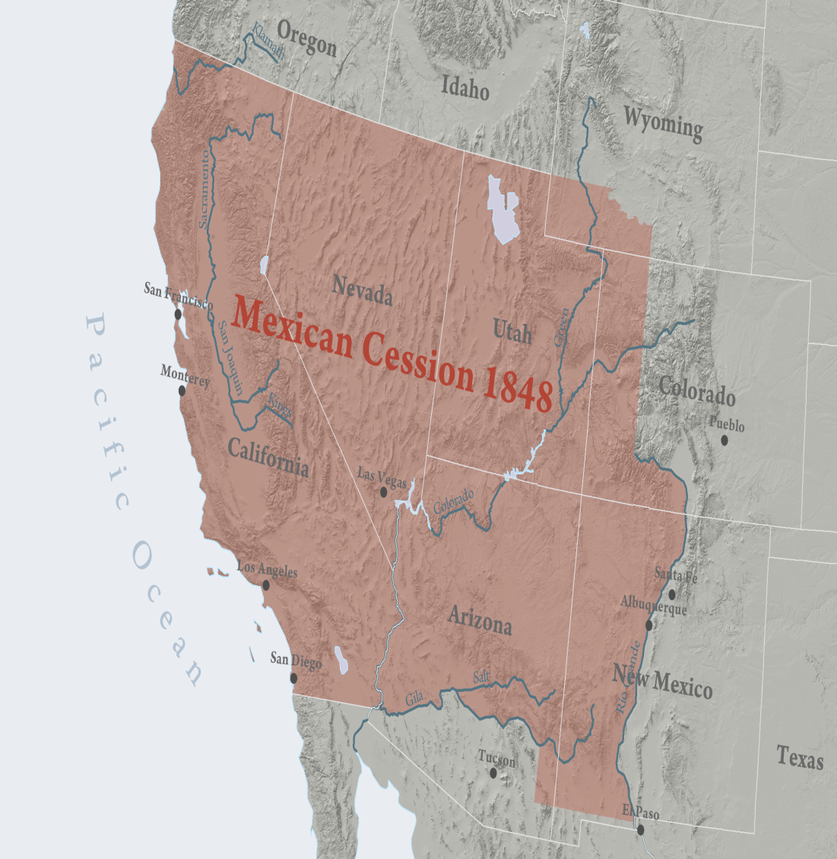
Mexican-American War
Treaty of Guadalupe Hidalgo and the Mexican Cession
U.S. gets southwestern United States

Slide 6
Women’s Suffrage Movement
At the same time the abolitionist movement grew, another reform movement took root
The movement to give equal rights to women.

Slide 7
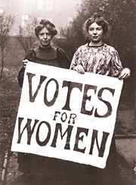
Women’s Suffrage Movement
Seneca Falls Declaration
Attempt by women to get social, civil, and moral rights

Slide 8
Women’s Suffrage Movement
Elizabeth Cady Stanton and Susan B. Anthony
Became involved in the women’s suffrage movement before the Civil War and continued with the movement after the war

Slide 9
