Slide 1
War and Country
VUS.4c&d

Slide 2
Differences Among Colonists
Patriots
Wanted complete independence from Great Britain
Inspired by Locke and Paine
Patrick Henry: “Give me liberty, or give me death!”
Provided troops for the American Army

Slide 3
Differences Among Colonists
Loyalists (Tories)
Remained loyal to Britain because of cultural and economic ties
Believed that taxation of the colonies was justified to pay for British troops to protect American settlers from Indian attack

Slide 4
Differences Among Colonists
Neutrals
The many colonists who tried to stay as uninvolved in the war as possible

Slide 5
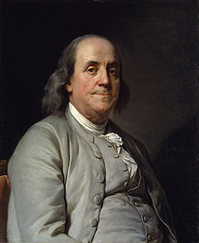
Factors Leading to Colonial Victory
Benjamin Franklin
Negotiated treaty with France
Treaty of Alliance

Slide 6
Factors Leading to Colonial Victory
The war did not have popular support in Great Britain

Slide 7
Factors Leading to Colonial Victory
Military
George Washington avoided any situation that would destroy his army
Various leaders kept the army together when defeat seemed inevitable

Slide 8
British General
General Charles Cornwallis

Slide 9
The War Ends
American and French army gather around Yorktown, Virginia
Both armies lay siege to General Cornwallis’ and his men
French navy prevents the British from escaping by sea
General Cornwallis surrenders

