Slide 1
The War of 1812
VUS.6b&c

Slide 2
Building Toward War
James Madison spent the first three years of his presidency trying to avoid war through peaceful negotiations
Great Britain simply did not respect the United States as a sovereign nation.

Slide 3
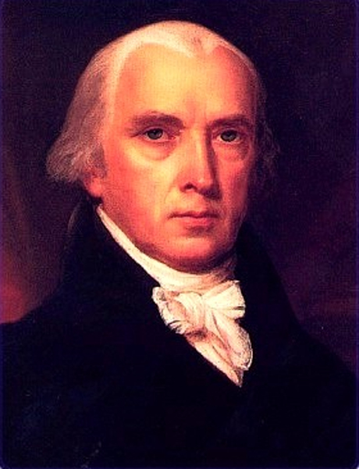
James Madison
4th President of the United States
Supported aggressive trade measures against Great Britain
Asked for a declaration of war

Slide 4
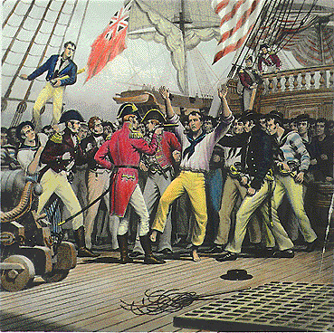
Causes of the War
Impressment
Britain took American sailors off of American ships and forced them to serve in the British navy

Slide 5
Causes of the War
British Forts
Despite the Jay Treaty, the British were still in forts on American soil
This was especially true in the west

Slide 6
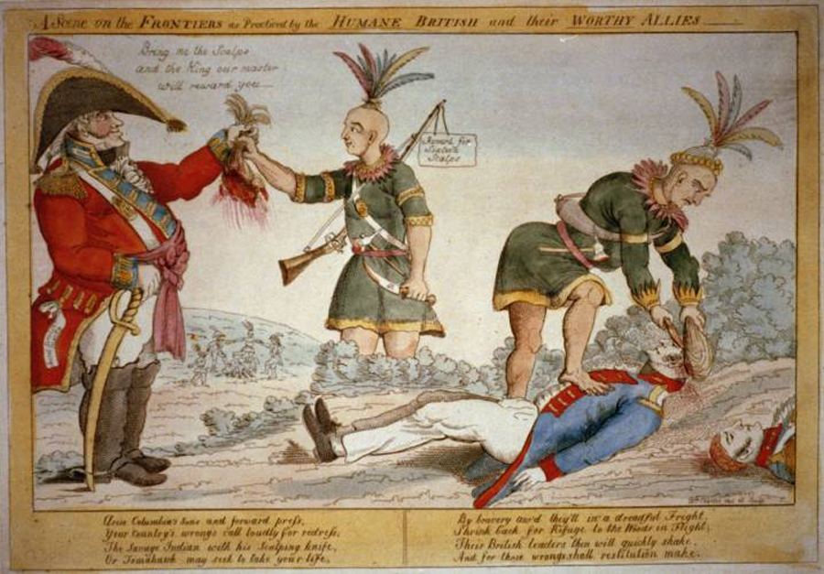
Causes of the War
Native Americans
Britain was supplying Indians with weapons and telling them to attack Americans

Slide 7
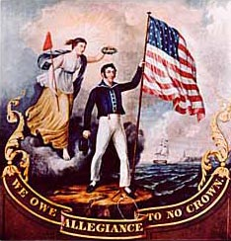
Causes of the War
Many Americans wanted more territory
War Hawks – Wanted Canada and Florida

Slide 8
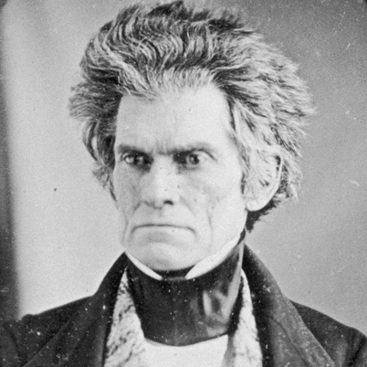
Henry Clay - Kentucky
John C. Calhoun –
South Carolina

Slide 9
Opposition to War
Federalists opposed “Madison’s War”
Talked of secession (New England)
Leaving the country and starting their own country
Proposed constitutional amendments
None were put into effect

Slide 10
American Problems
America was unprepared militarily
Had a 12-ship Navy compared to Britain’s 800 ships
Financially unprepared
Too much paper money (not worth much)

Slide 11
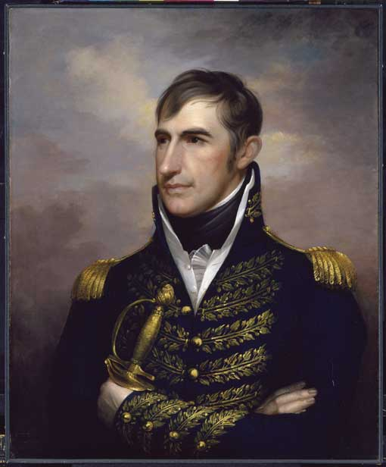
Battle of Tippercanoe
General William Henry Harrison – Governor of Indiana Territory
Natives fight against American troops (pushed by British)
Harrison wins, becoming a national hero

Slide 12
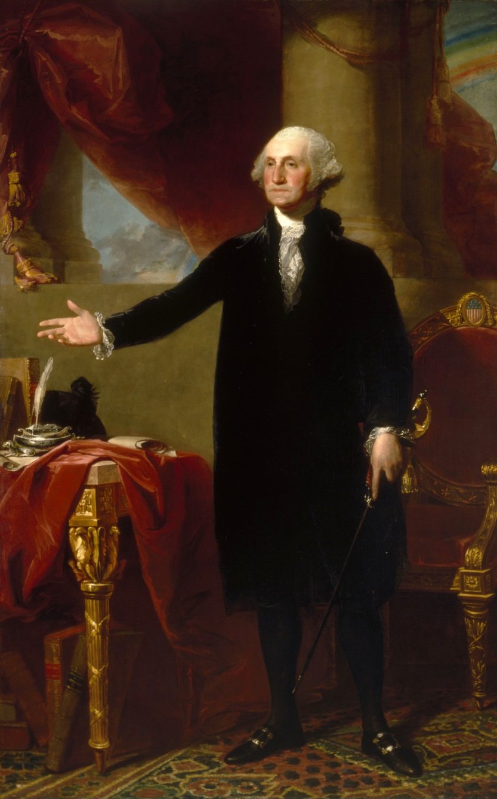
Burning of Washington
Britain occupies Washington, D.C.
The Capitol and White House are largely destroyed
While fleeing the White House, Dolly Madison (wife of President James Madison) cut out a large portrait of George Washington

Slide 13
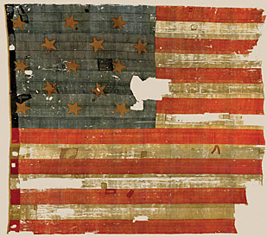
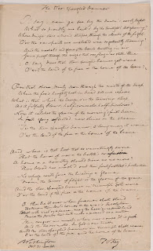
Fort McHenry
Baltimore
Withstood 25 hours of bombardment by the British Navy.
The following morning, the fort’s soldiers hoisted an enormous American flag
This inspired Francis Scott Key
“Star Spangled Banner”

Slide 14
Treaty of Ghent
Tired of war, Britain looks for an armistice (agreement to stop fighting)
This end of the war was basically a stalemate
Federalist Party was disbanded for being unpatriotic
Against the war
Boosted self-confidence in many Americans
Helped to boost the idea of expansionism

Slide 15
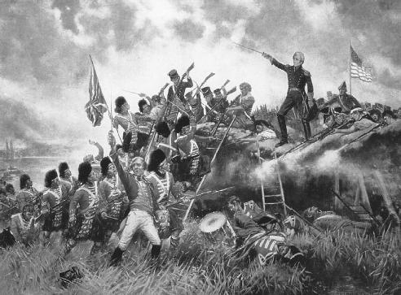
Battle of New Orleans
Unaware that a treaty had been signed, Britain attacks New Orleans
Defeated by future President Andrew Jackson
Boosted morale and left Americans feeling victorious

Slide 16
Land Gained through the War of 1812

