Slide 1
The Revolutionary Period
VUS.4a.c.

Slide 2
The Ideas of John Locke
The Enlightenment in Europe during the seventeenth and eighteenth centuries saw the development of new ideas about the rights of people and their relationship to their rulers.

Slide 3
The Ideas of John Locke
John Locke was an Enlightenment philosopher whose ideas, more than any others, influenced the American belief in self-government.
All people are free, equal, and have natural rights of life, liberty, and property that rulers cannot take away.

Slide 4
The Real John Locke

Slide 5
The Ideas of John Locke
All original power resides in the people, and they consent to enter into a social contract among themselves to form a government to protect their rights.
In return, the people promise to obey the laws and rules established by their government, establishing a system of ordered liberty.

Slide 6
The Ideas of John Locke
Government’s powers are limited to those the people have consented to give to it.
Whenever government becomes a threat to the people’s natural rights, it breaks the social contract, and the people have the right to alter or overthrow it.

Slide 7
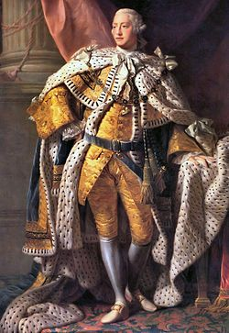
The Ideas of John Locke
Locke’s ideas about the sovereignty and rights of the people were radical and challenged the centuries-old practice throughout the world of dictatorial rule by kings, emperors, and tribal chieftains.

Slide 8
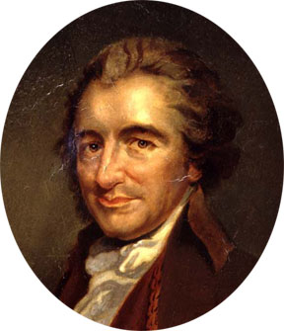
Thomas Paine and Common Sense
English immigrant who created a pamphlet called Common Sense
Challenged the rule of the American colonies by the King of England
Contributed to the growing sentiment for independence from Great Britain

