Slide 1
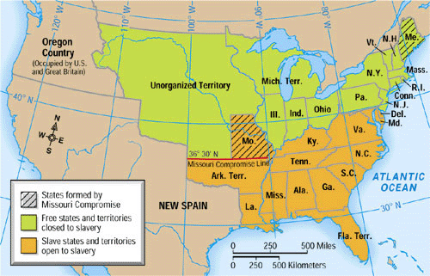
Missouri Compromise

Slide 2
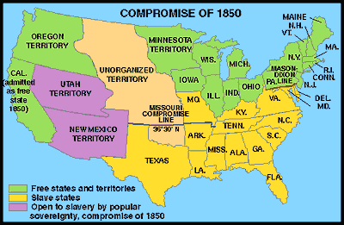
Compromise of 1850

Slide 3
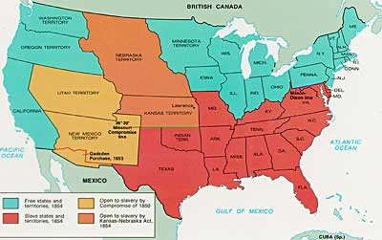
Kansas-Nebraska Act

Slide 4
The Civil War
Beginnings and Causes

Slide 5
What are the causes of the Civil War?
Sectional debate over tariffs, extension of slavery in the territories, and the nature of the Union (states’ rights)
Northern abolitionists v. southern defenders of slavery

Slide 6
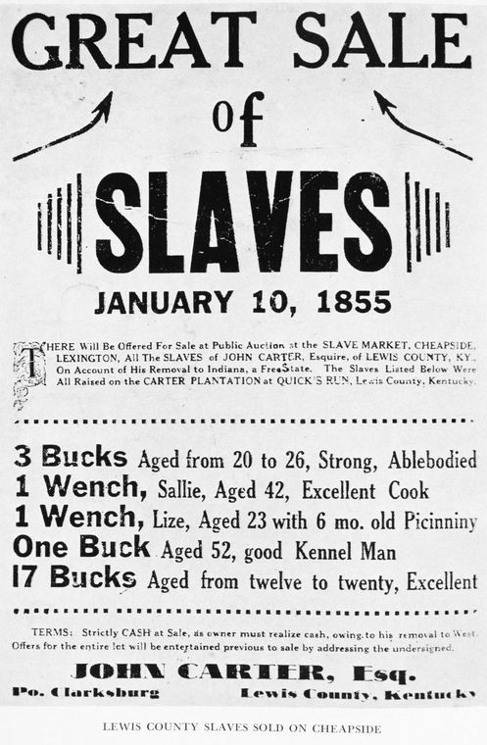

Slide 7
Dred Scott Decision
U.S. Supreme Court decision in the Dred Scott case
“It is no novelty to find the Supreme Court following the lead of the Slavery Extension party, to which most of its members belong. Five of the Judges are slaveholders, and two of the other four owe their appointments to their facile ingenuity in making State laws bend to Federal demands in behalf of "the Southern institution.“
- Editorial in the Albany, New York, Evening Journal, 1857

Slide 8
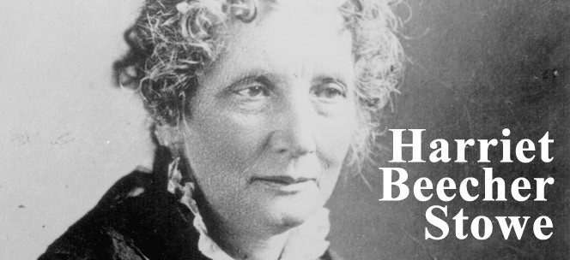
Uncle Tom’s Cabin
Publication of Uncle Tom’s Cabin by Harriet Beecher Stowe

Slide 9
What are the causes of the Civil War?
Ineffective presidential leadership in the 1850s
A history of failed compromises over the expansion of slavery in the territories
President Lincoln’s call for federal troops in 1861

Slide 10
Tensions Heat Up
Election of Abraham Lincoln (1860)
Northern Republican (Illinois)
Opponent of Slavery
January 1861
South Carolina, seeing the election as a threat to their way of life, votes to secede from the Union
Led to the secession of six more states:
Mississippi, Florida, Alabama, Georgia, Louisiana, and Texas
Virginia, Arkansas, Tennessee, and North Carolina threatened to follow

Slide 11
Lincoln’s Inauguration
The new president said he had no plans to end slavery in the southern states where it already existed
Would not, however, accept secession.
Hoped to solve the national crisis without warfare.

Slide 12
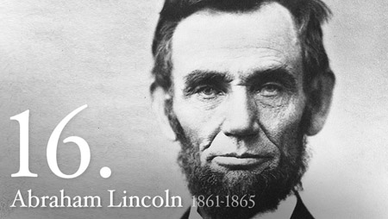
“America will never be destroyed from the outside. If we falter and lose our freedoms, it will be because we destroyed ourselves.”

Slide 13
Ft. Sumter: Opening confrontation of the Civil War
Lincoln orders supplies to be send to Fort Sumter
Federal fort in the Confederate States
Alerted South Carolina in advance to avoid fighting
South Carolina troops repelled the ships with the supplies from the bay, causing fighting to begin.
This sparked the first shots and beginning of the Civil War

Slide 14
Essential Understandings
The Civil War put constitutional government to its most important test as the debate over the power of the federal government versus states’ rights reached a climax.
The survival of the United States as one nation was at risk, and the nation's ability to bring to reality the ideals of liberty, equality, and justice depended on the outcome of the war.

