Slide 1
The Civil Rights Movement – Brown v. Board of Education
VUS.14a

Slide 2
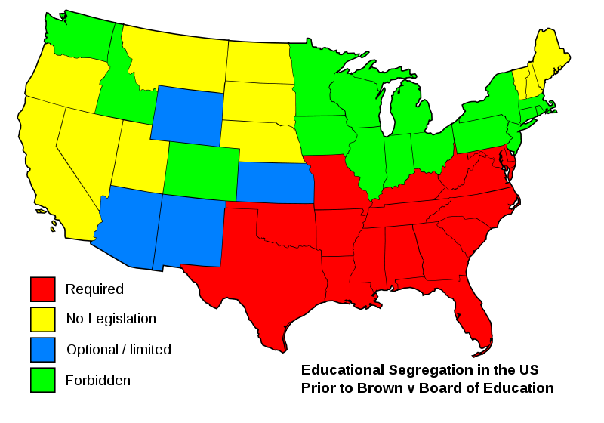
Brown v. Board of Education of Topeka
Race relations in the United States had been dominated by racial segregation
Held over by Plessy v. Ferguson
This was extremely prevalent in public schools during the time between Reconstruction and the Civil Rights Movement

Slide 3
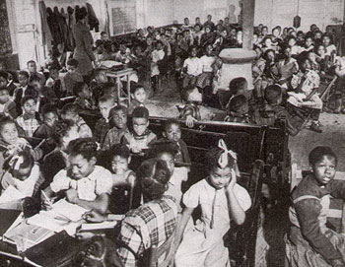
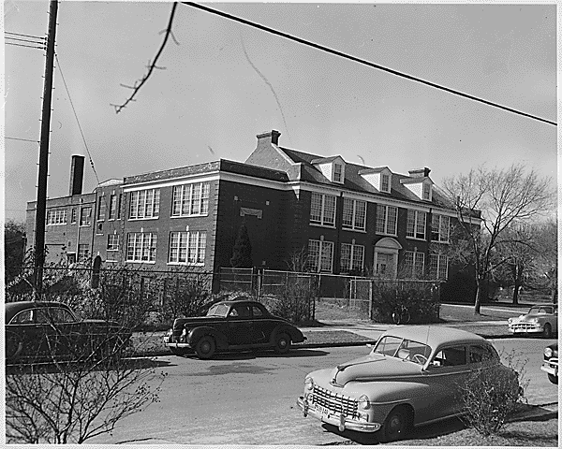
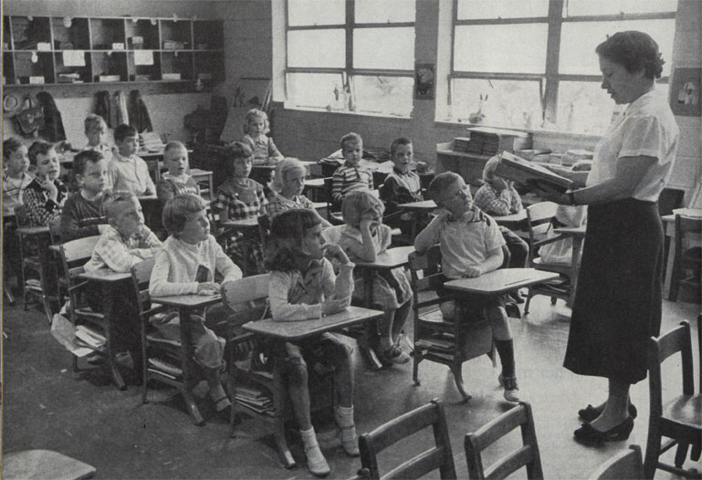
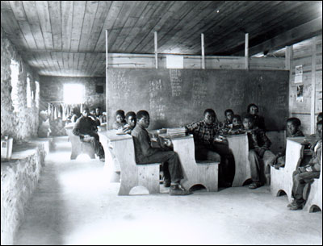
Brown v. Board of Education of Topeka
Public Schools showcased the most apparent disregard for equality in the United States

Slide 4
Brown v. Board of Education of Topeka
The Supreme Court decided to hear this case, along with 4 others from:
South Carolina
Delaware
Washington, D.C.
Virginia (Davis v. County School Board of Prince Edward County)

Slide 5
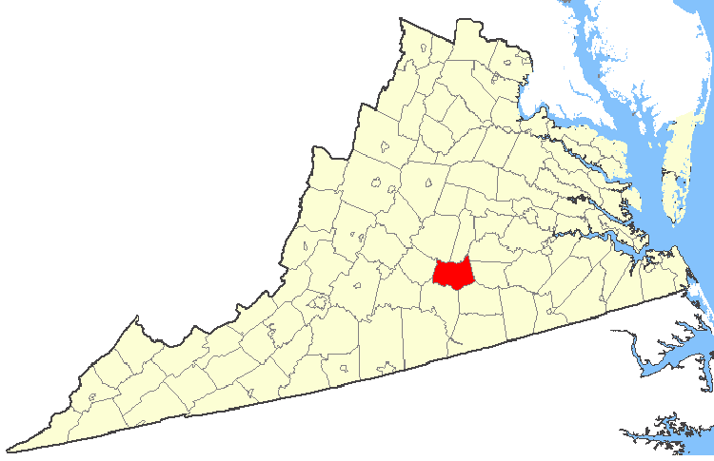
Brown v. Board of Education of Topeka
The Davis Case
Barbara Rose Johns – 16 year old
Junior at all-black Moton High School in Farmville
Across town was an exclusively white school

Slide 6
Brown v. Board of Education of Topeka
The Davis Case
Johns noticed the massive inequality of resources and facilities
When parents complained to the all-white school board, tar paper buildings were quickly erected to “fix” the problem

Slide 8
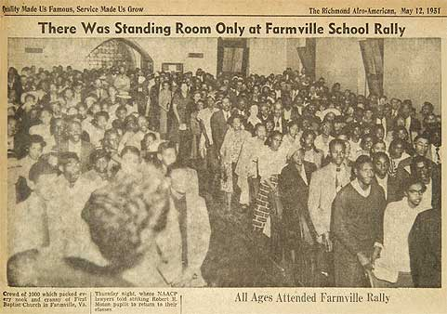
Brown v. Board of Education of Topeka
The Davis Case
Johns gathered other students and together created a protest movement
Gathered support from the NAACP

Slide 10
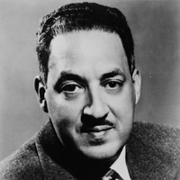
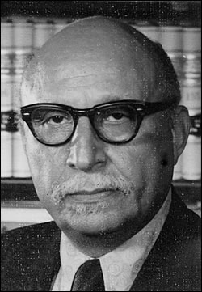
Brown v. Board of Education of Topeka
NAACP Involvement
Thurgood Marshall – Legal Defense Team Leader
Oliver Hill – Legal Defense Team in Virginia

Slide 11
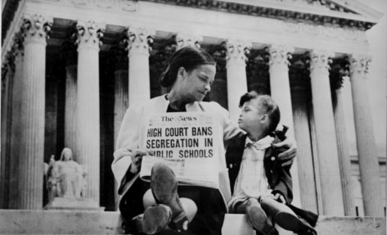
Brown v. Board of Education of Topeka
Supreme Court Decision
Unanimously agreed that segregation in public schools is unconstitutional
Overturned Plessy v. Ferguson
“Separate but equal is inherently unequal”

Slide 12
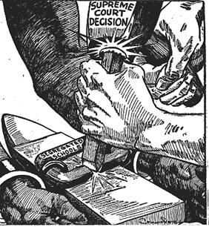

Slide 13
Virginia’s Response
Massive Resistance
Virginia Senator Harry S. Byrd
Aimed to prevent desegregation by cutting off funding for any school choosing to integrate
Private academies are established where tuition is paid for if white parents did not want to desegregate
White flight from urban schools became massive

Slide 15
The Civil Rights Movement – Marches and Landmark Decisions
VUS.14b

Slide 16
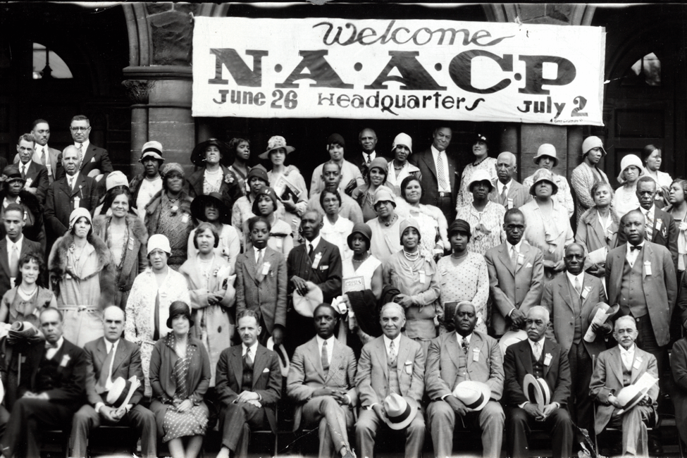
NAACP – National Association for the Advancement of Colored People
Challenged Segregation in the court system

Slide 17
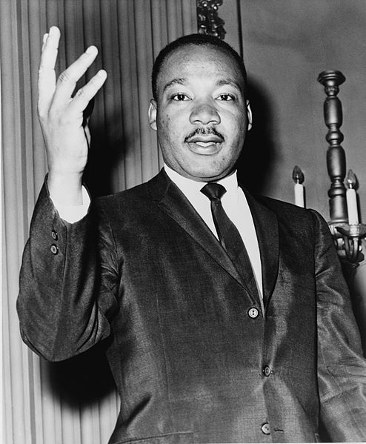
Martin Luther King, Jr.
American preacher and leader of the African American Civil Rights Movement
Responsible for leading non-violent direct actions

Slide 18
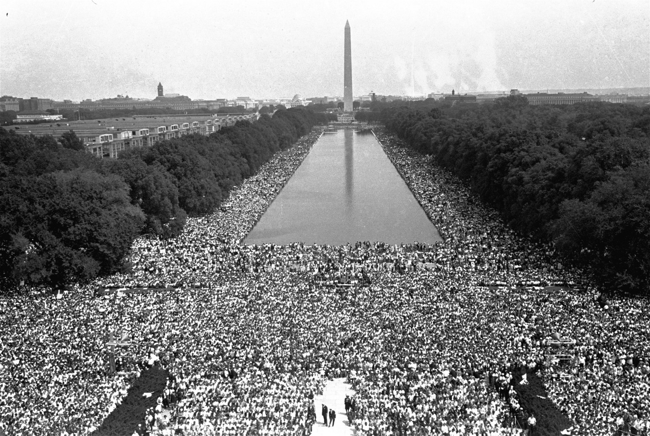
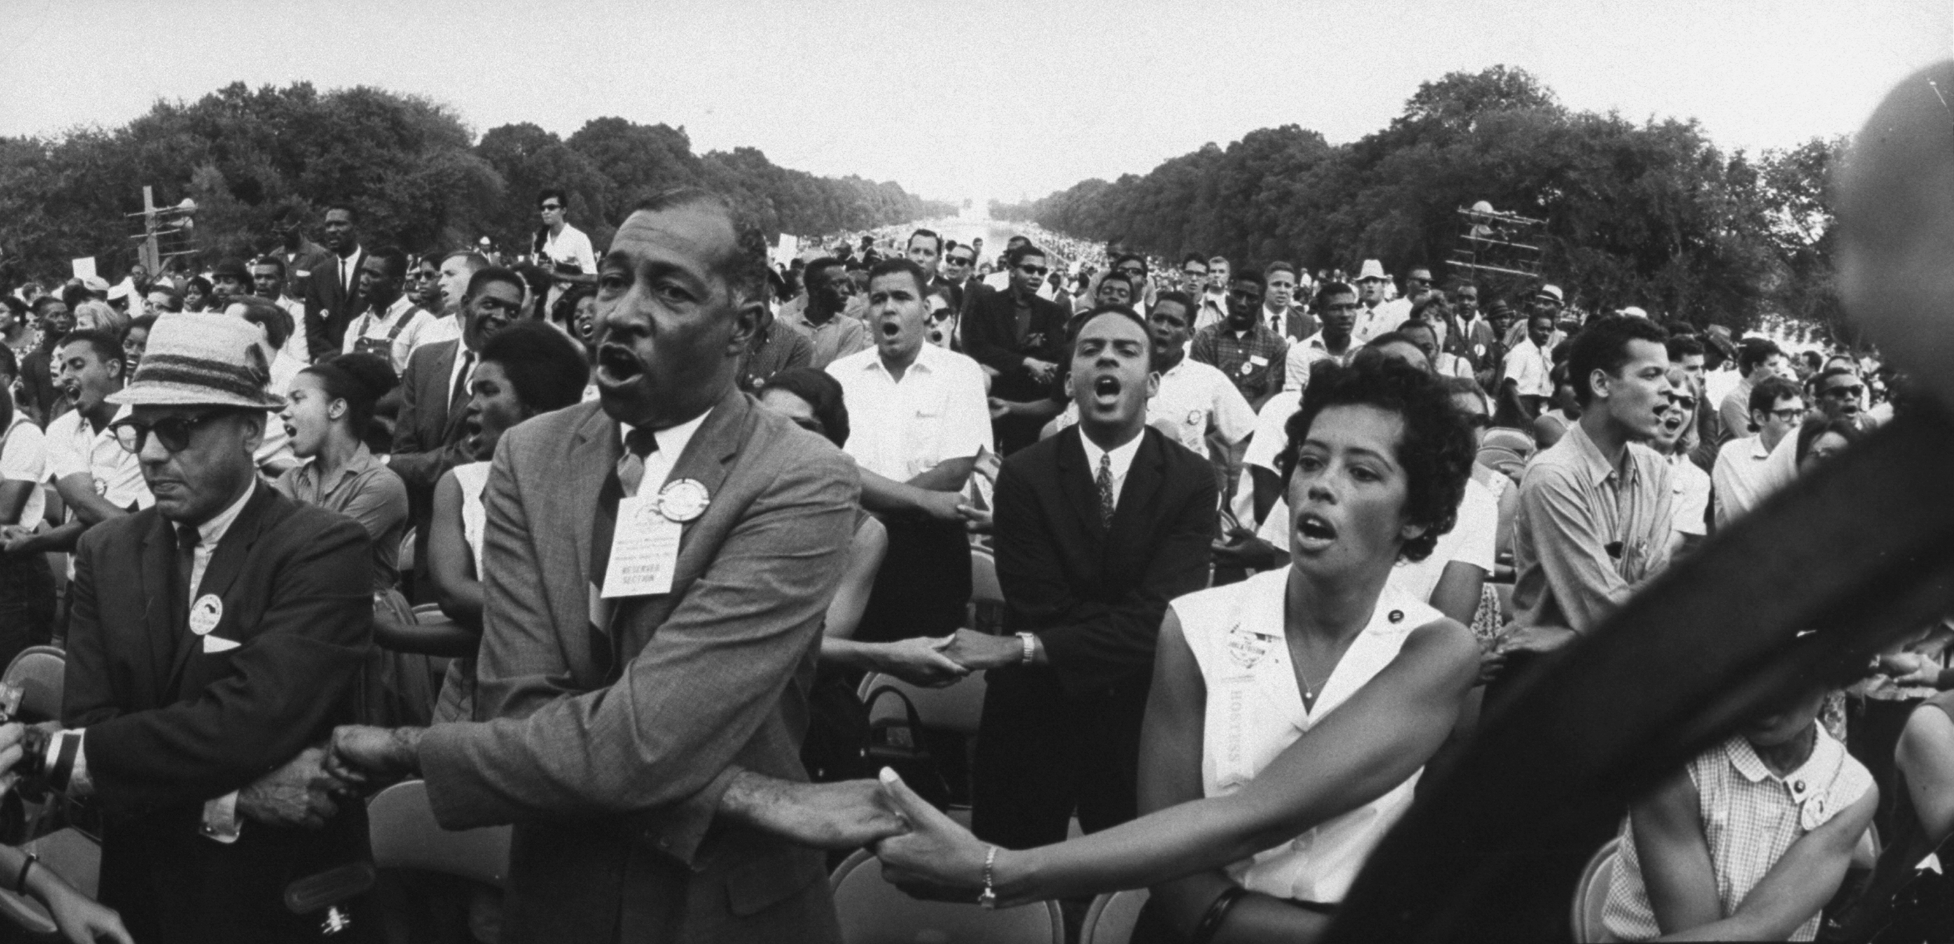
1963 March on Washington
MLK gives his “I have a dream” speech
Helped to influence public opinion to support civil rights legislation
Demonstrated King’s vision of non-violent, mass protests

Slide 19
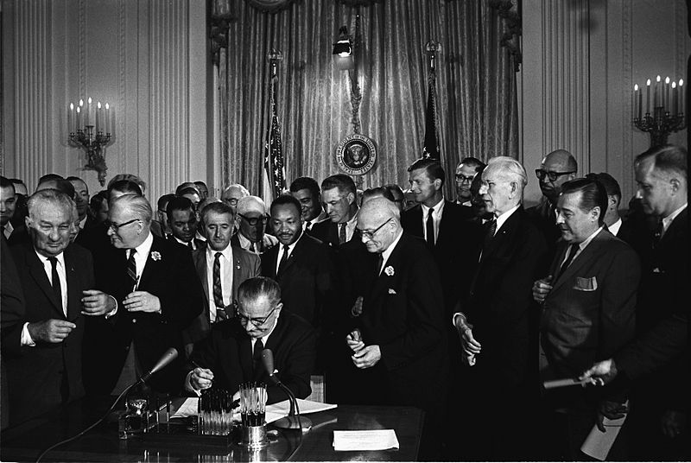
Civil Rights Act of 1964
The act prohibited discrimination based on race, color, religion, gender, or national origin.
The act desegregated public accommodations.
President Lyndon B. Johnson played an important role in the passage of the act.

Slide 20
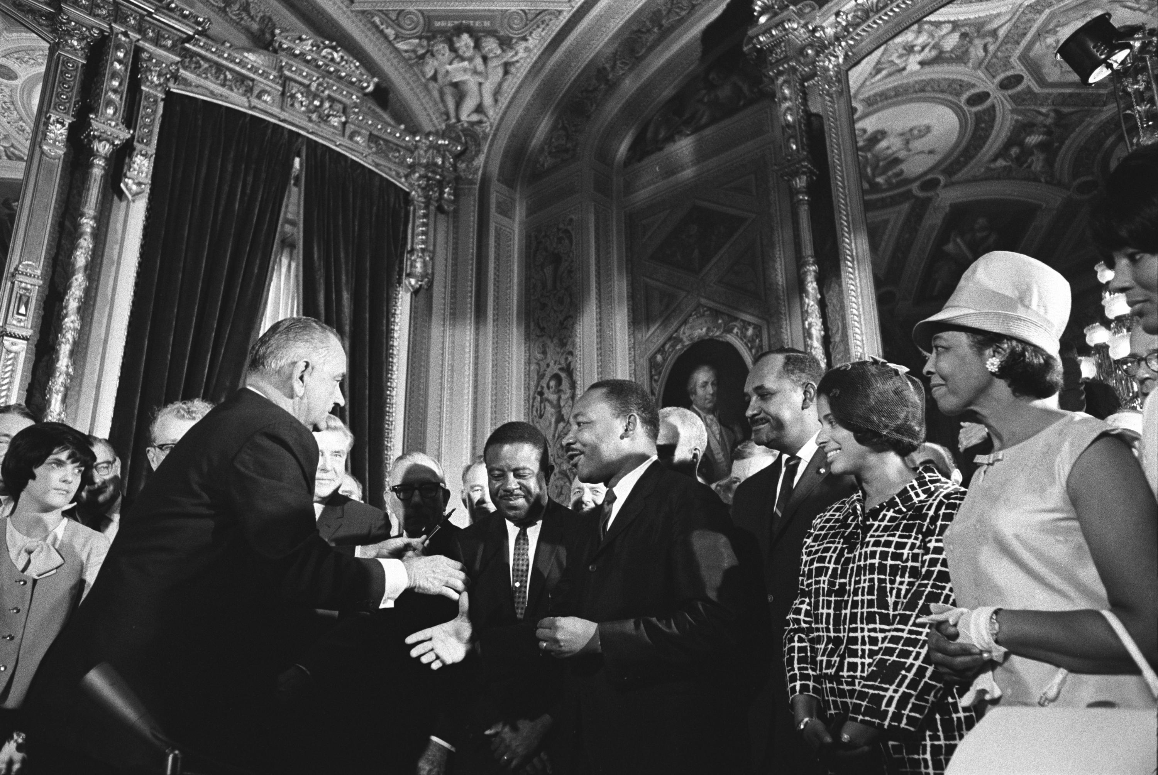
Voting Rights Act of 1965
The act outlawed literacy tests.
Federal registrars were sent to the South to register voters.
The act resulted in an increase in African American voters.
President Johnson played an important role in the passage of the act.

Slide 21
Social, Cultural, and Political Developments in Recent Decades
VUS.15

Slide 22
Space Program
In the early 1960s, President Kennedy pledged increased support for the American space program.
The race to the moon continued through the 1960s.
U.S. astronaut John Glenn was the first American to orbit the Earth.
In 1969, American astronaut Neil Armstrong was the first person to step onto the moon’s surface. He proclaimed:
“That’s one small step for a man; one giant leap for mankind.”

Slide 23
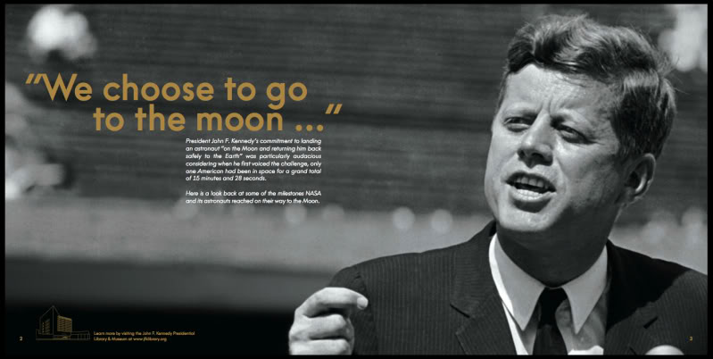
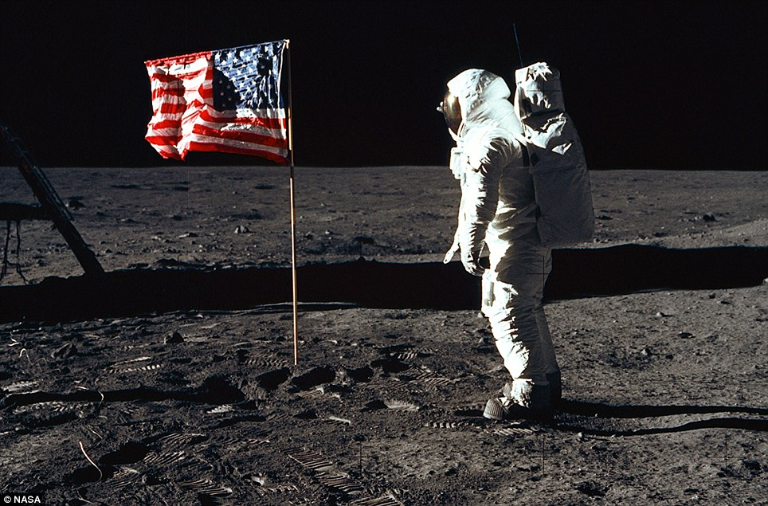

Slide 24
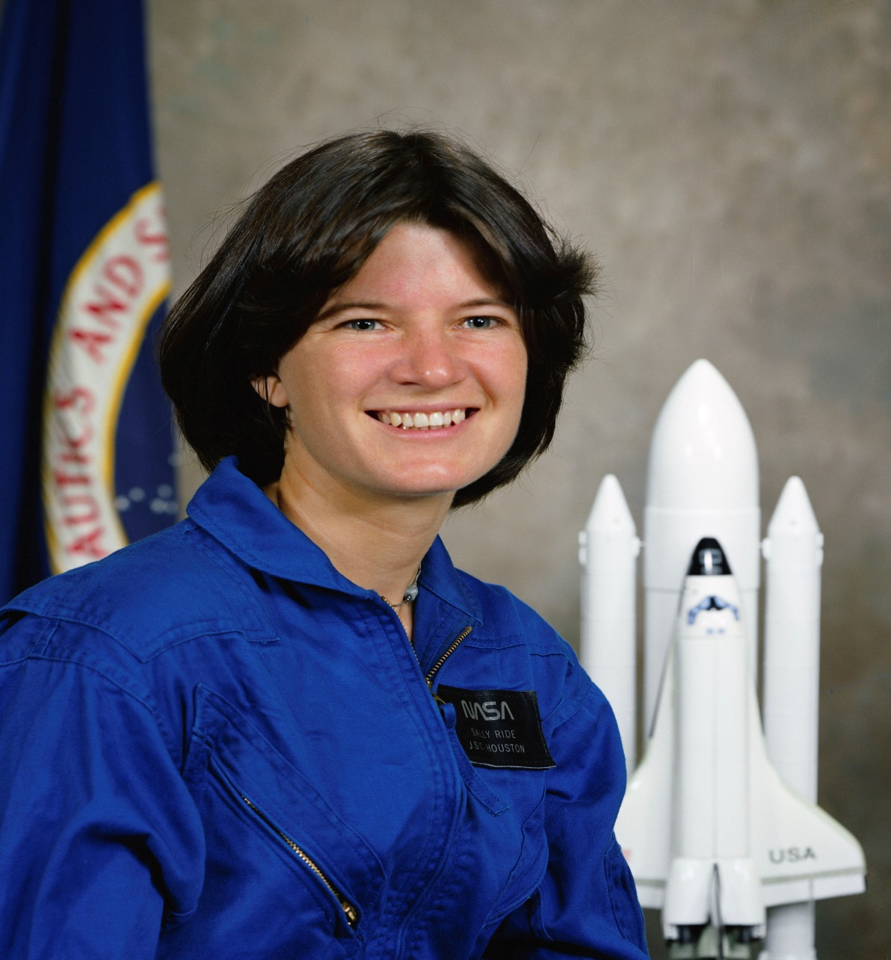
Space Program
First American Female Astronaut – Sally Ride

Slide 25
Technology
Over the past three decades, improved technology and media have brought about better access to communication and information for businesses and individuals in both urban and rural areas.
As a result, many more Americans have access to global information and viewpoints.

Slide 26
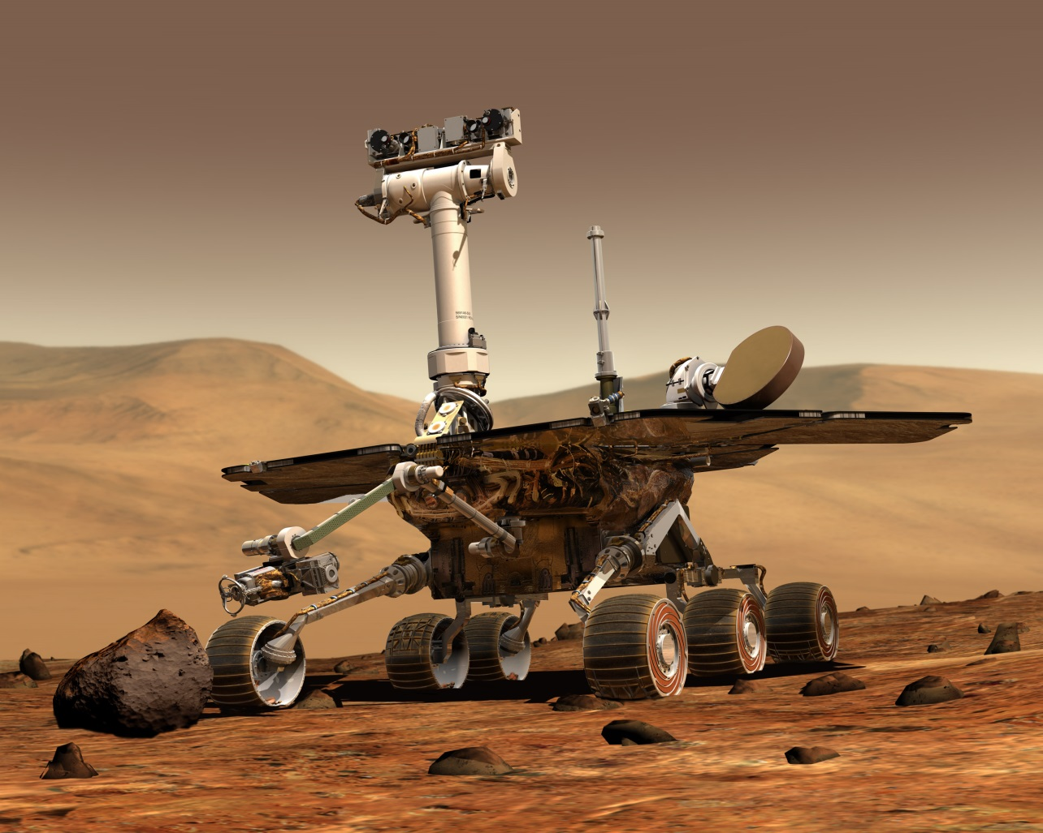
Examples of Technological Advances
Space exploration
Space shuttle
Mars rover
Voyager missions
Hubble telescope
Communications
Satellites
Global positioning system (GPS)
Personal communications devices
Robotics

Slide 27
Changes in work, school, and health care in recent decades
Telecommuting
Online course work
Growth of service industries
Breakthroughs in medical research, including improved medical diagnostic and imaging technologies
Outsourcing and offshoring

Slide 28
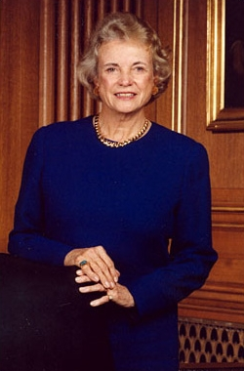
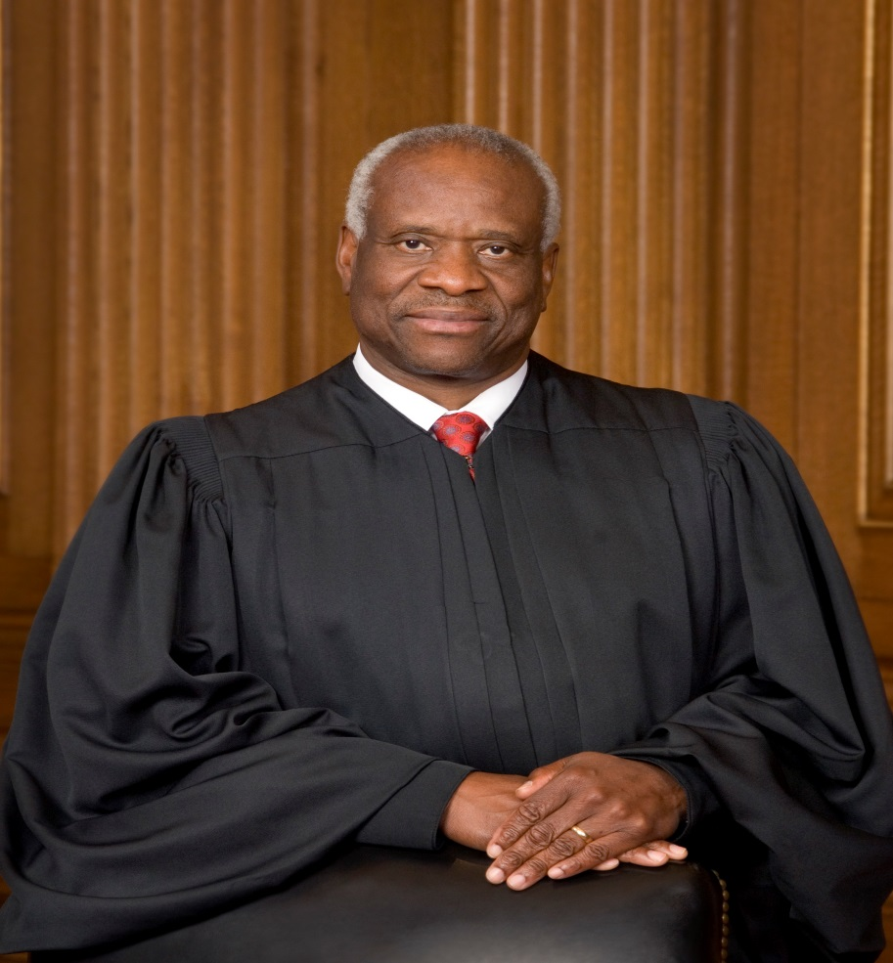
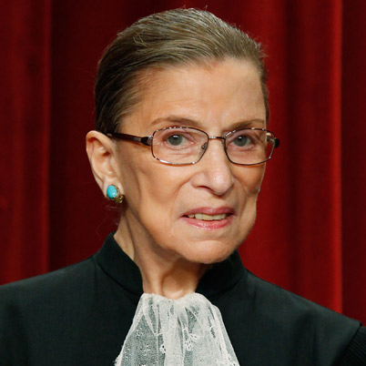
The United States Supreme Court
Women and Minority Members:
Sandra Day O’Connor
Ruth Bader Ginsburg
Clarence Thomas

Slide 29
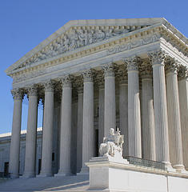
This United States Supreme Court
The civil rights movement of the 1940s, 1950s, and 1960s provided a model that other groups have used to extend civil rights and promote equal justice.

Slide 30
This United States Supreme Court
Protects the individual rights enumerated in the Constitution of the United States.

Slide 31
This United States Supreme Court
Identifies a constitutional basis for a right to privacy that is protected from government interference.

Slide 32
This United States Supreme Court
Invalidates legislative acts and executive actions that the justices agree exceed the authority granted to government officials by the Constitution of the United States.

Slide 33
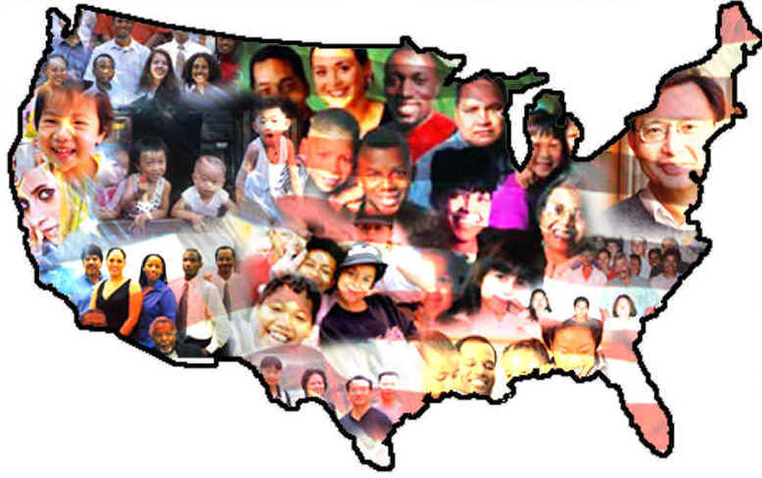
Immigration
Immigration to the United States has increased from many diverse countries, especially Asian and Latin American countries.
Reasons for immigration
Political freedom
Economic opportunity

Slide 34
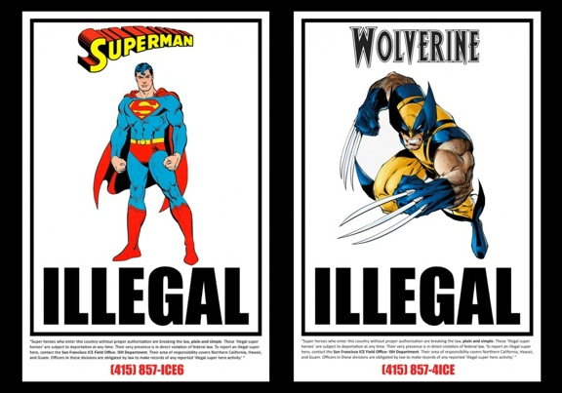
Immigration
Issues related to immigration policy
Strain on government services
Filling low-paying jobs in the United
States
Border issues
Pathway to citizenship
Bilingual education
Increasing cultural diversity

Slide 35
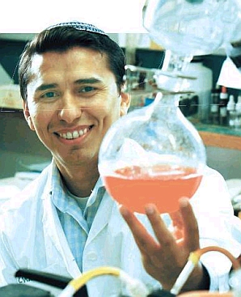
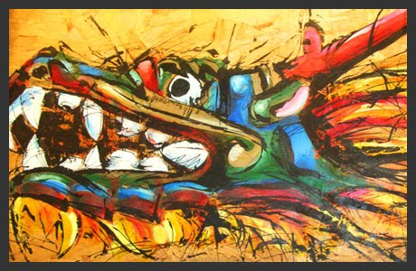
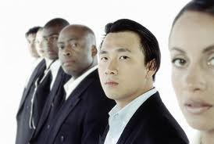
Immigration
Contributions of immigrants
Diversity in music, the visual arts, and literature
Roles in the labor force
Achievements in science, engineering, and other fields

Slide 36
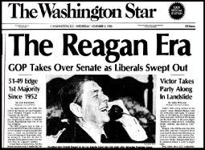
Reagan Revolution
President Reagan and conservative Republicans advocated for:
tax cuts
transfer of responsibilities to state governments
appointment of judges/justices who exercised judicial restraint
reduction in the number and scope of government programs and regulations
strengthening of the American military.

Slide 38
Reagan Revolution
Extended beyond his tenure in office with:
the election of his vice president, George H. W. Bush
the election of a centrist Democrat, William J. Clinton
the Republican sweep of congressional elections and statehouses in the 1990s
the election of George W. Bush as president.

Slide 39
The Role of the Government
Government promotes a healthy economy characterized by full employment and low inflation through the actions of:
The Federal Reserve: Monetary policy decisions control the supply of money and credit to expand or contract economic growth.
The president and Congress: Fiscal policy decisions determine levels of government taxation and spending; government regulates the economy.

Slide 41
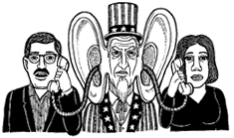
Terrorism
Heightened security at home (Patriot Act)
Diplomatic and military initiatives

