Slide 1
The American Revolution
VUS.4b,c,d

Slide 2
The War for Independence Begins
April 18th, 1775
British troops sent to destroy guns and ammunition stored in Concord, Massachusetts
John Hancock and Samuel Adams were also to be arrested

Slide 3
The War for Independence Begins
Paul Revere is sent to warn Hancock and Adams
“One if by land, Two if by sea”
A group of militiamen are at Lexington, ready to defend the town against the British
Minutemen

Slide 4
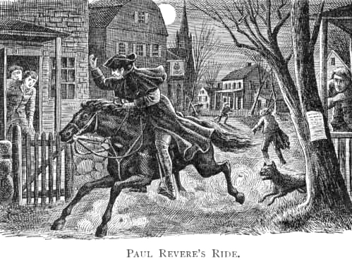
The British are Coming!

Slide 5
Although the men in Lexington were defeated, they gave the minutemen in Concord enough time to hide away most of the ammunition and weapons

Slide 6
The War for Independence Begins
As the British burned what they could find, local citizens and minutemen gathered
The British soldiers are attacked
73 British soldiers are killed, 174 wounded
49 Patriots are killed, 39 wounded

Slide 7
Second Continental Congress
13 colonies meet in Pennsylvania
Managed the Colonial war effort
Appointed George Washington as general of the Continental Army
Thomas Jefferson is asked to create the Declaration of Independence

Slide 8
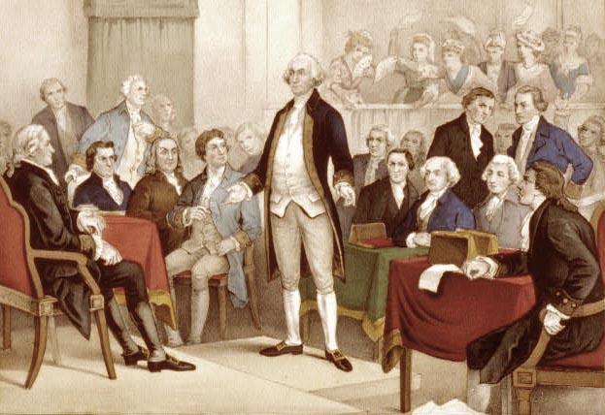
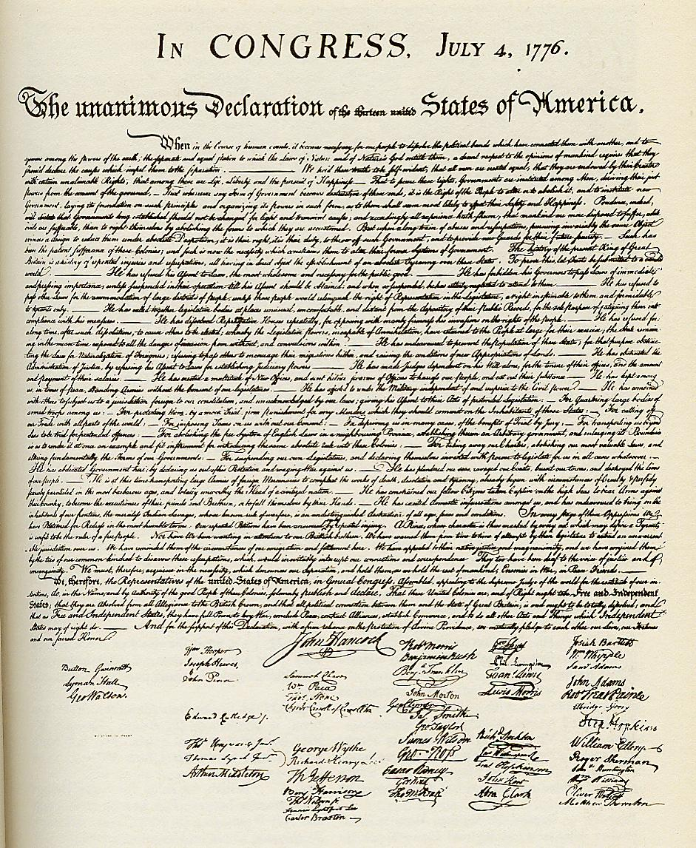

Slide 9
Declaration of Independence
Inspired by John Locke and Thomas Paine:
“We hold these truths to be self-evident, that all men are created equal, that they are endowed by their Creator with certain unalienable Rights, that among these are Life, Liberty, and the pursuit of Happiness”

Slide 10
Declaration of Independence
“That to secure these rights, Governments are instituted among Men, deriving their just powers from the consent of the governed.
That whenever any Form of Government becomes destructive of these ends, it is the Right of the People to alter or abolish it, and to institute new Government….”

Slide 11
Declaration of Independence
The key principles of the Declaration of Independence increased political, social, and economic participation in the American experience over a period of time.

Slide 12
Declaration of Independence
Political participation (equality)
Extending the franchise
Upholding due process of law
Providing free public education

Slide 13
Declaration of Independence
Social participation (liberty)
Abolishing slavery
Extending civil rights to women and other groups

Slide 14
Declaration of Independence
Economic participation (pursuit of happiness)
Regulating the free enterprise system
Promoting economic opportunity
Protecting property rights

