Slide 1
Reconstruction: Rebuilding and Deconstructing America

Slide 2
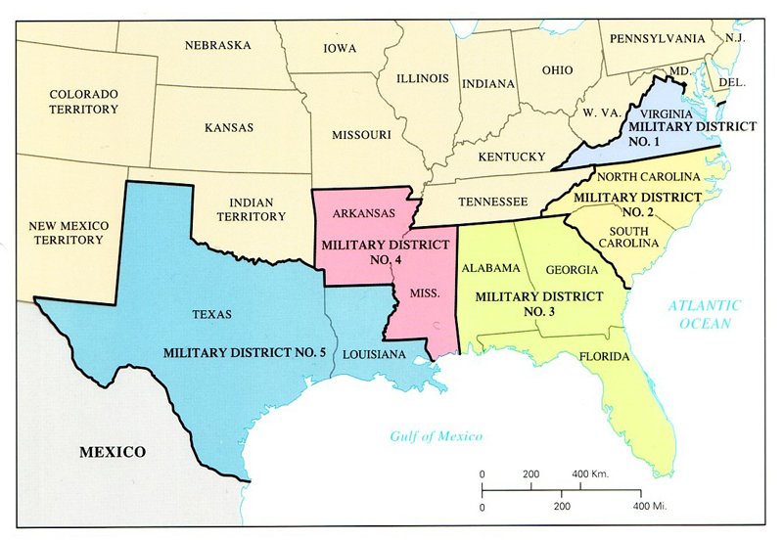
Post-Lincoln
The assassination of Lincoln just a few days after Lee’s surrender at Appomattox enabled Radical Republicans to influence the process of Reconstruction in a manner much more punitive towards the former Confederate states.
The states that seceded were not allowed back into the Union immediately, but were put under military occupation

Slide 3
Dates Allowed Back In
Alabama - July 13, 1868 | Arkansas - June 22, 1868
Florida - June 25, 1868 | Georgia - July 21, 1868 (Approved on 2nd attempt July 15, 1870)
Louisiana - July 9, 1868 | Mississippi - February 23, 1870
North Carolina - July 4, 1868 | South Carolina - July 9, 1868
Tennessee - July 24, 1866 | Texas - March 30, 1870
Virginia January 26, 1870

Slide 4
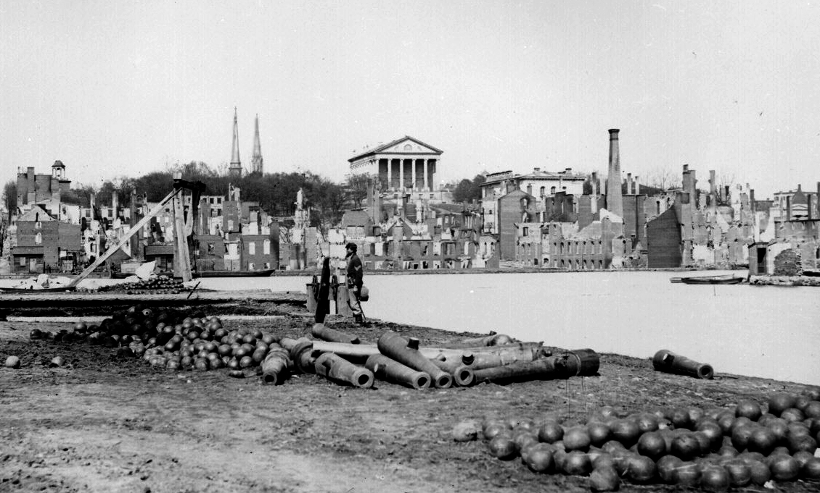
Southern Economic Impact
Farms, railroads, and factories had been destroyed throughout the South.
Confederate money was worthless
Richmond and Atlanta was in ruin
Source of labor was gone overnight

Slide 5
North Economic Impact
strong and growing industrial economies
The foundation for the sweeping industrialization of the nation (other than the South) in the next half-century
The emergence of the United States as a global economic power by the beginning of the 20th century

Slide 6
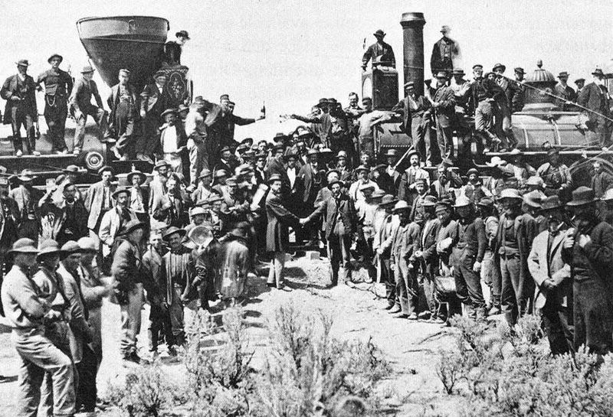
Transcontinental Railroad
Completion intensified the westward movement of settlers into the states between the Mississippi River and the Pacific Ocean.

Slide 7
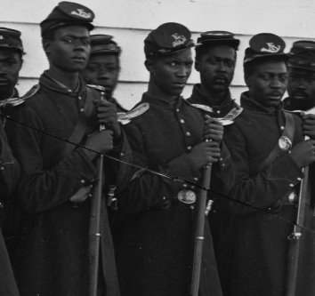
How did the war affect the freed slaves?
Emancipation Proclamation
Allowed the enlistment of African Americans

Slide 8
How did the war affect the common soldier?
Common Soldier
Warfare often involved hand-to-hand combat.
War time diaries and letters home record this harsh reality.
After the war, especially in the South, soldiers returned home to find homes destroyed and poverty.
Soldiers on both sides lived with permanent disabilities

Slide 9
How did the war affect women?
Managed homes and families with scarce resources
Often faced poverty and hunger
Assumed new roles in agriculture, nursing, and in war industries

Slide 10
Ulysses S. Grant Post-War
Urged Radical Republicans not to be harsh with former Confederates
Elected President and served during most of Reconstruction
Advocated rights for the freedman
Opposed retribution directed to the defeated South

Slide 11
Robert E. Lee Post-War
Urged Southerners to reconcile and rejoin the United States
Served as President of Washington College (Washington & Lee University today)
Emphasized the importance of education to the nation’s future

Slide 12
Frederick Douglass Post-War
Supported full equality for African Americans
Advocated for the passage of the 14thand 15th Amendments
Encouraged federal government actions to protect the rights of the freedmen in the South
Served as ambassador to Haiti and in the civil service

Slide 13
Radical Republicans
Favored guaranteeing voting and civil rights to freed slaves immediately and quickly
Wanted to punish the South for the war
Put under strict military rule
Forced to bow to the north in order to re-enter the Union

Slide 14
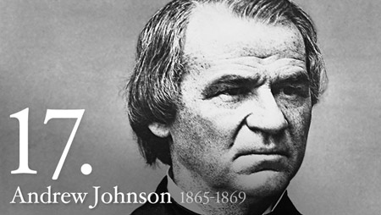
Andrew Johnson
Not a military hero
Democrat
Wanted to implement Lincoln’s plan for Reconstruction
First president impeached
Failed by 1 vote

Slide 15
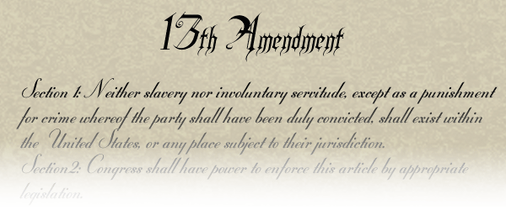
Civil War Amendments
13th Amendment – Permanently abolished slavery in the United States

Slide 16
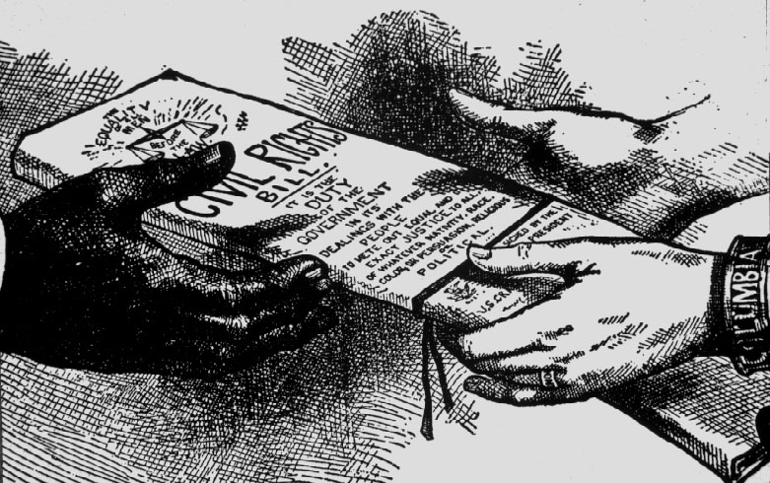
Civil War Amendments
14th Amendment - States were prohibited from denying equal rights under the law to any American

Slide 17
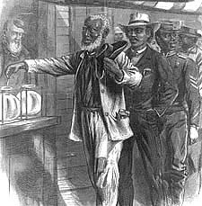
Civil War Amendments
15th Amendment: Voting rights were guaranteed regardless of “race, color, or previous condition of servitude” (former slaves).

Slide 18
End of Reconstruction
The Reconstruction period ended following the extremely close presidential election of 1876
In return for support in the electoral college vote from Southern Democrats, the Republicans agreed to end the military occupation of the South

Slide 19
Compromise of 1877
Former Confederates who controlled the Democratic Party to regain power
Began the Jim Crow Era
long period in which African Americans in the South were denied the full rights of American citizenship.

