Slide 1
Progressive Movement and the Gilded Age
Reconstruction through the early twentieth century was a time of contradictions for many Americans.
VUS.8d

Slide 2
Essential Understandings
Agricultural expansion was accomplished through wars against the Plains Indians, leading to new federal Indian policies.
Social problems in rural and urban settings gave rise to third-party movements and the beginning of the Progressive Movement.

Slide 3
Essential Understandings
Industrial development brought great fortunes to a few and raised the standard of living for millions of Americans, but also brought about the rise of national labor unions and clashes between industry and labor.

Slide 4
The Gilded Age
Period following the Civil War, roughly from the end of Reconstruction until the turn of the 20th century.
Coined by Mark Twain
A time of economic growth, shrouded by the common man being taken advantage of and various scandals

Slide 5
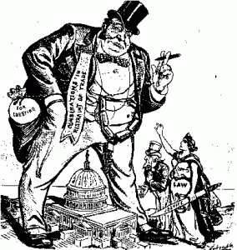
The Gilded Age

Slide 6
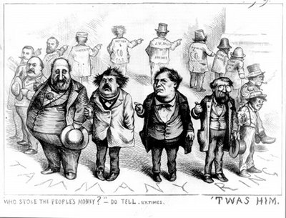
The Gilded Age

Slide 7
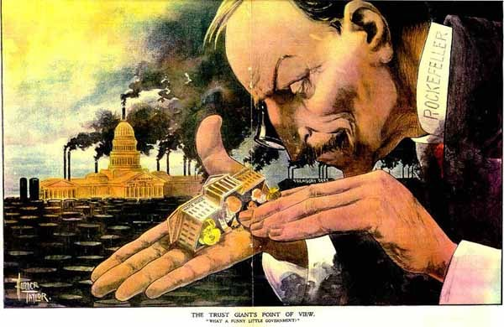
The Gilded Age

Slide 8
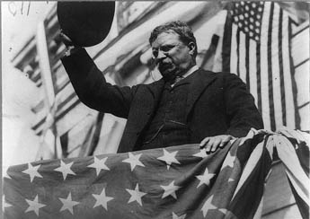
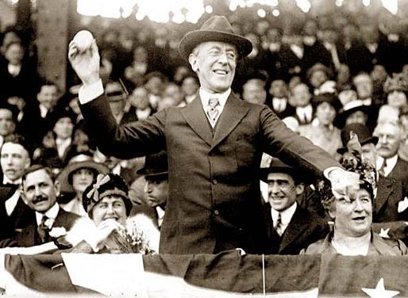
The Progressive Era
The Progressive Movement used government to reform problems created by industrialization (Theodore Roosevelt’s “Square Deal” and Woodrow Wilson’s “New Freedom”)

Slide 9
Causes of the Progressive Era
Excesses of the Gilded Age
Income disparity (lavish lifestyle)
Age of the robber barons
Working conditions for labor
Dangerous working conditions
Child labor
Long hours, low wages, no job security, no benefits
Company towns
Employment of women

Slide 10
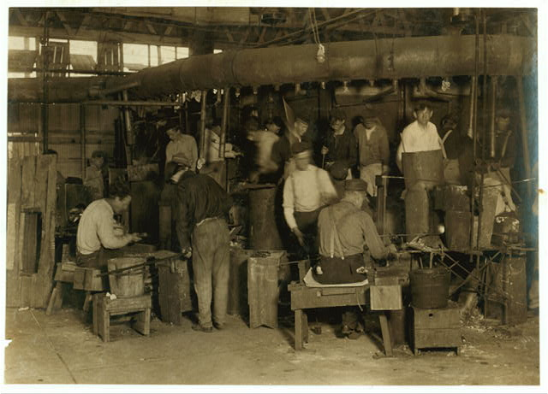

Slide 11
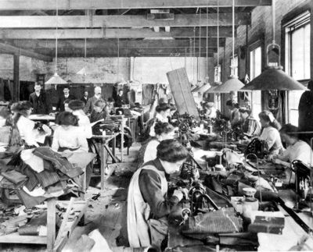

Slide 12
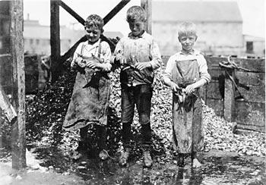

Slide 13
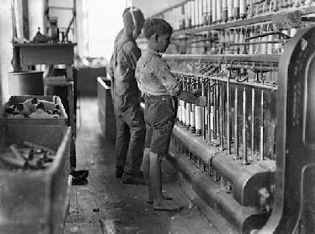

Slide 14
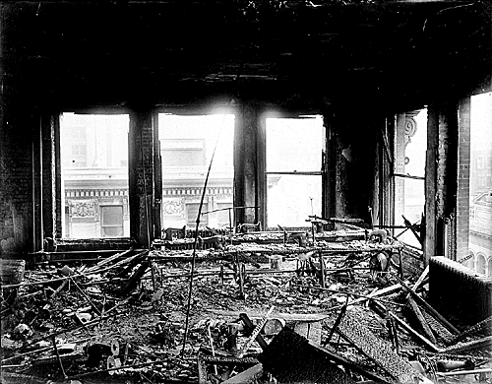

Slide 15
Goals of the Progressive Era
Government controlled by people
Guaranteed economic opportunities through government regulation
Elimination of social injustices

Slide 16
Progressive Accomplishments
Local Governments
New forms to meet needs of increasing urbanization (commission and council manager)

Slide 17
Progressive Accomplishments
State Governments
Referendum- Direct vote to accept or reject a proposal
Initiative- Petition signed can force a public vote
Recall- Vote to remove someone from political position

Slide 18
Progressive Accomplishments
In Elections
Primary elections
Direct election of U.S. Senators (17th Amendment)
Secret ballot

Slide 19
Progressive Accomplishments
In Child Labor
Muckraking literature describing abuses of child labor
“Bitter Cry of the Children” by John Spargo
Child labor laws

Slide 20
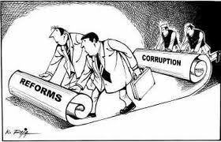
Lincoln Stephens
“The Shame of the Cities"
Link between big business and crooked politicians

Slide 21
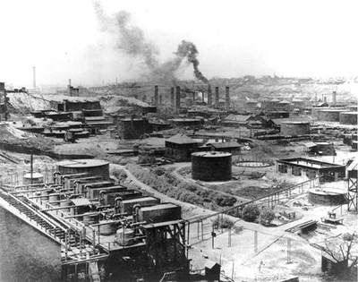
Ida Tarbell
"History of the Standard Oil Company“
Described the firms cutthroat methods of eliminating competition

Slide 22
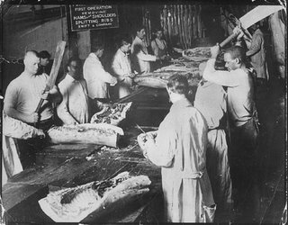
Upton Sinclair
“The Jungle”
Detailed the lives of stockyard workers and the meat packing industry

Slide 23
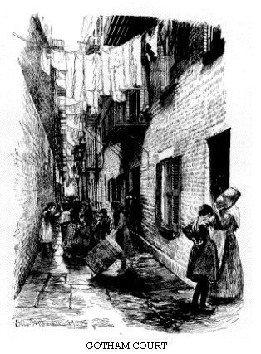
Jacob Riis
“How the Other Half Lives
A book of photographs about the wretched conditions in the cities and slums

Slide 24
Progressive Accomplishments
Impact of Labor Unions
Organizations
– Knights of Labor
– American Federation of Labor (Samuel Gompers)
– American Railway Union (Eugene V. Debs)
– International Ladies’ Garment Workers Union

Slide 25
Progressive Accomplishments
Impact of Labor Unions
Strikes
– Haymarket Square (Chicago)
– Homestead Strike (Pennsylvania)
– Pullman Strike (Nationwide)

Slide 26
Progressive Accomplishments
Impact of Labor Unions
Gains
– Limited work hours
– Regulated work conditions

Slide 27
Progressive Accomplishments
Antitrust Laws
Sherman Anti-Trust Act—Prevents any business structure that “restrains trade” (monopolies)
Clayton Anti-Trust Act—Expands Sherman Anti-Trust Act; outlaws price-fixing; exempts unions from Sherman Act

Slide 28
Progressive Accomplishments
Women’s Suffrage
Was a forerunner of modern protest movement
Benefited from strong leadership (e.g., Susan B. Anthony)
Encouraged women to enter the labor force during World War I
Resulted in 19th Amendment to the Constitution

