Slide 1
Prelude to War
VUS.4c

Slide 2
French and Indian War
The rivalry in North America between Britain and France led to the French and Indian War, in which the French were driven out of Canada and their territories west the Appalachian Mountains.

Slide 3
French and Indian War
As a result of the war, Britain took several actions that angered the American colonies and led to the American Revolution.

Slide 4
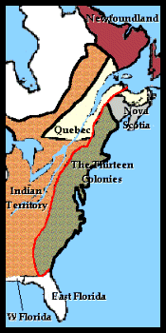
Proclamation of 1763
Prohibited settlement west of the Appalachian Mountains, a region that was costly for the British to protect.

Slide 5
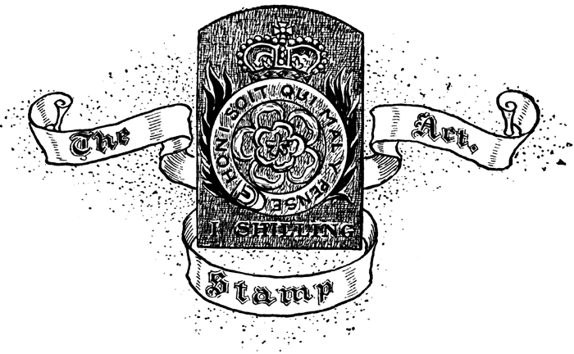
New Taxes on Legal Documents
The Stamp Act
Taxes on tea and sugar were used to pay costs incurred during the French and Indian War and for British troops to protect colonists.

Slide 6
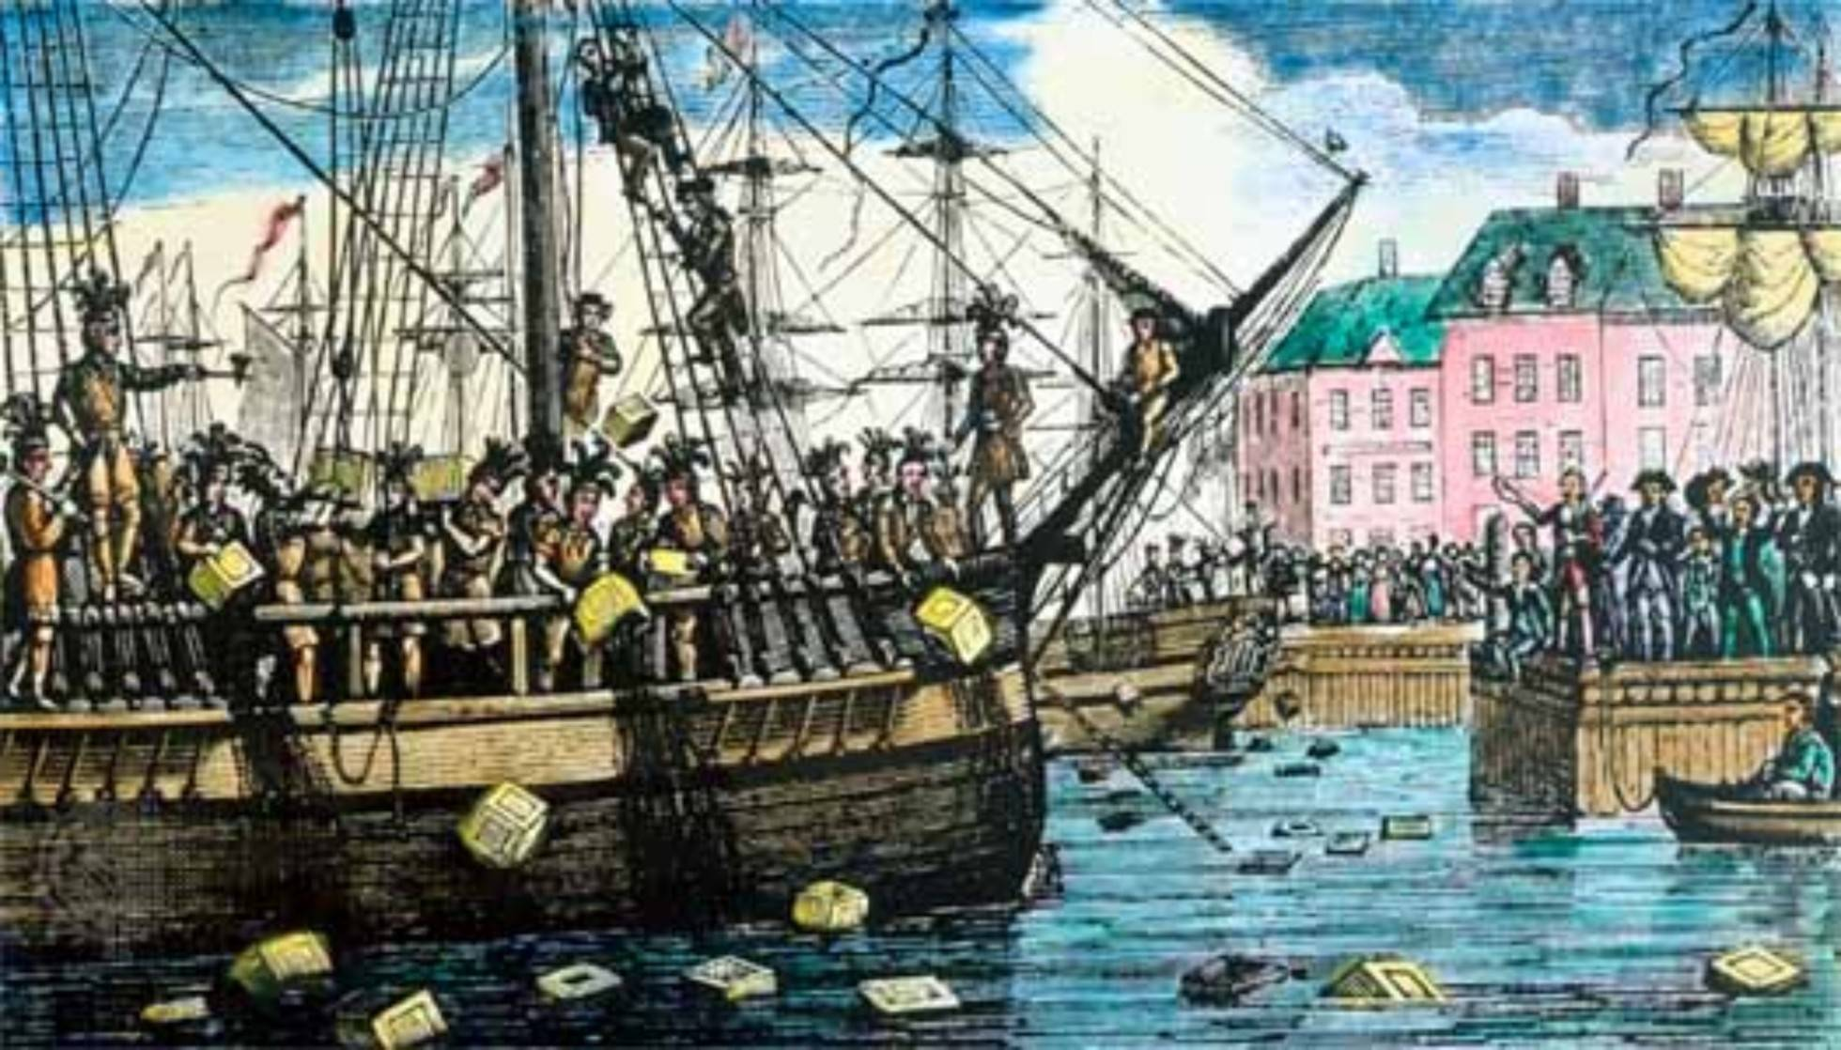
Beginnings of a Revolution
The Boston Tea Party
December 16, 1773
British ships bring tea into the Boston Harbor
Colonists, disguised as Native Americans, slip on board and dump the tea over the side of the boats

Slide 7
Intolerable Acts
Brought on by the Boston Tea Party
Closed the Boston Port
King appointed Massachusetts Governor
British soldiers on trial were sent to Britain
Quartering Act – Troops had housing provided for them by colonists
Denied elected legislative governments

Slide 8
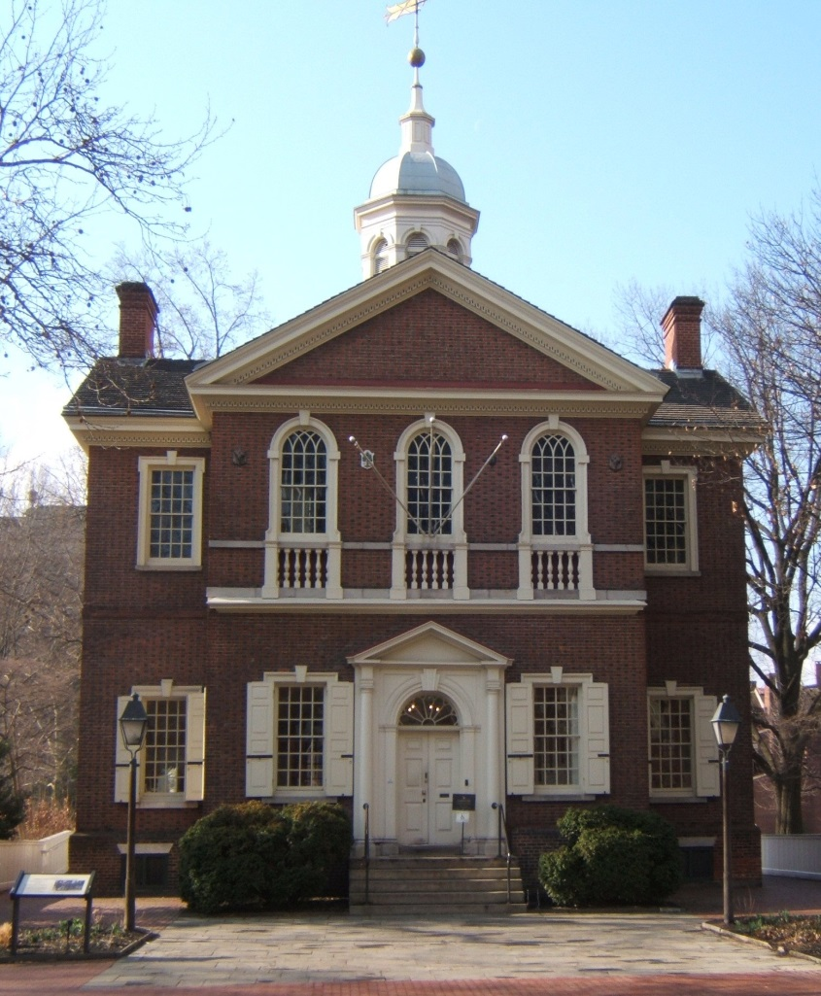
The First Continental Congress
All colonies, except Georgia, send representatives
First time most of the colonies have acted together
The colonies would refuse to buy goods from the British unless the Intolerable Acts were lifted

Slide 9
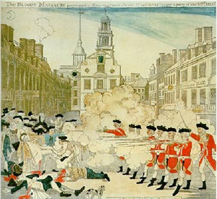
Boston Massacre
British troops fired on anti-British demonstrators
5 men were killed
Angered many Americans and furthered the anti-British sentiment

