Slide 1
Open Door Policy and Dollar Diplomacy

Slide 2
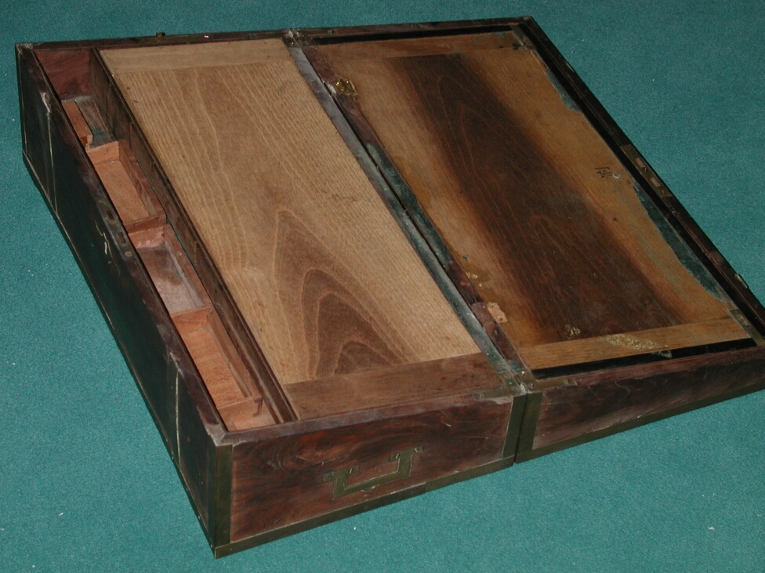
Brief Chinese Trade History
Chinese Trade to America:
Tea
Cotton
Silk
Porcelain
Furniture

Slide 3
Brief Chinese Trade History
Opium Wars
Forced China to open up all ports to trade for France, Britain, Russia, and the United States
Allowed foreigners into Beijing, a closed city, at the time

Slide 4
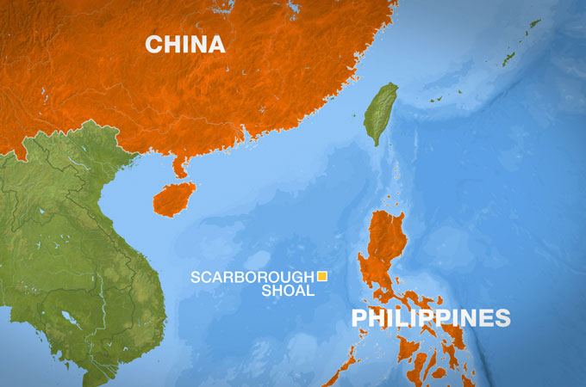
China
With the Philippines under control, the United States now has an Asian presence.
Wanted to further the political and economic interest in the area

Slide 5
Boxer Rebellion
Anti-foreign Chinese group attacks all foreigners they can find within China
June 1900 – Boxers invade Beijing
Killed over 200 foreign diplomats
Multinational Coalition meet up to help the Chinese government put an end to the rebellion
United States played a huge naval role in putting down the Rebellion (large base in the Philippines)

Slide 9
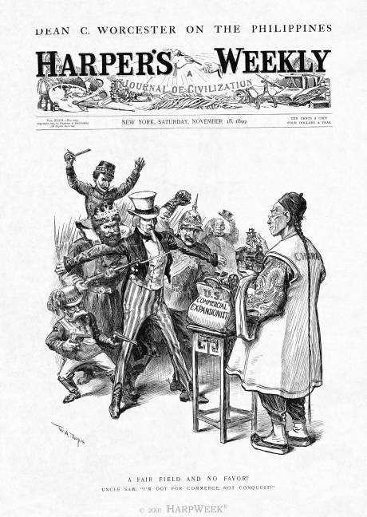
Open Door Policy
Deals with International trade
President McKinley stated his desire for the creation of “open door” that would allow all trading nations access to the Chinese market.

Slide 10
Open Door Policy
The goal was to safeguard American business opportunities in China
John Hay, the U.S. Secretary of State, sent notes to other major powers asking them to uphold Chinese territorial rights and to not interfere with the use of ports
All countries can enjoy equal access to the Chinese market.

Slide 12
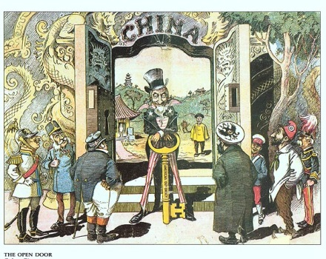
Open Door Policy
Spheres of Influence
Separate territories throughout China that major countries would control

Slide 13
Dollar Diplomacy – William Howard Taft
Government guarantee to corporations that would do business with countries in Latin America
If the companies would invest money into Latin American businesses, the government would protect those business interests with military aid if needed

Slide 15
Presidents Video
For Each President, write down 5 facts about their time in office
You should have AT LEAST 3 Progressive Moves done by Roosevelt
You should have AT LEAST 2 reasons why Taft’s Presidency was weak

