Slide 1
Movement Westward after the Civil War
VUS.8a

Slide 2
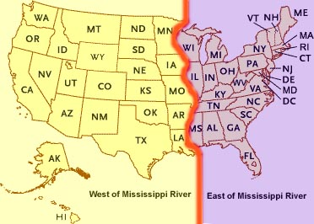
Westward Movement
Following the Civil War, there was a huge westward movement of settlers between the Mississippi River and the Pacific Ocean

Slide 3
Westward Movement
Era of the American Cowboy
Worked on long cattle drives for hundreds of miles over unfenced open land in the West

Slide 5
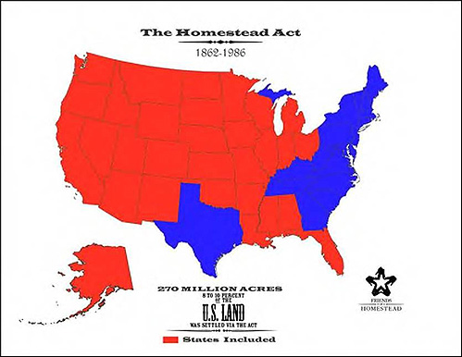
Westward Movement
Effects of the Civil War
Homestead Act
Gave free public land in western territories to settlers who would live on it and farm the land

Slide 6
Westward Movement
Homestead Act – Who took advantage?
Southerners whose homes were destroyed by the Civil War
African Americans moved west to see new opportunities

Slide 7
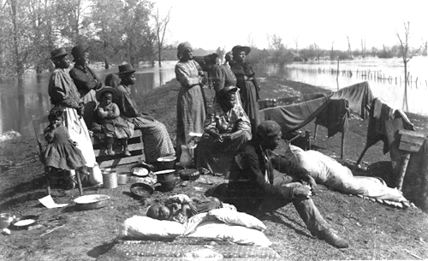
Southerners
Freed African
Americans

Slide 8
Westward Movement
New Technology
Railroads – Quickly opened up new lands in the west
Mechanical Reaper – Allowed for profitable farming
Both helped to increase efficiency of production

Slide 10
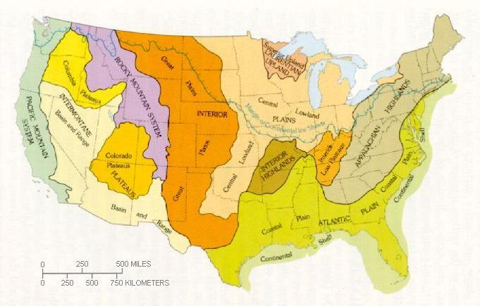
Westward Movement
By the turn of the century, the Great Plains and Rocky Mountains went from unsettled frontier to farms, ranches, and growing towns

Slide 11
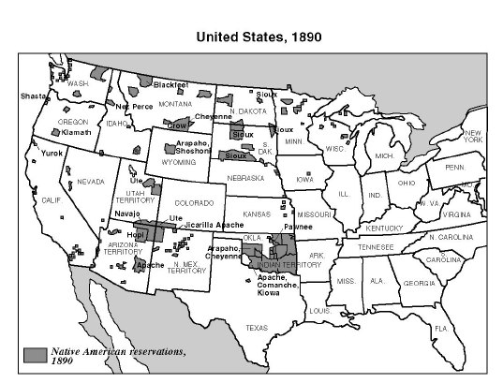
Consequences of Westward Movement
Native Americans
Forcibly removed from their land
Indian Reservations

Slide 12
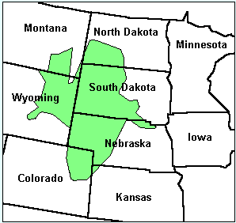
Battle of Little Bighorn
In 1868, the United States made a treaty with the Sioux nation that confined them to a reservation.
The Treaty of Fort Laramie promised that the Black Hills, which the Sioux considered sacred, would forever be part of their reservation and closed to white settlement.

Slide 13
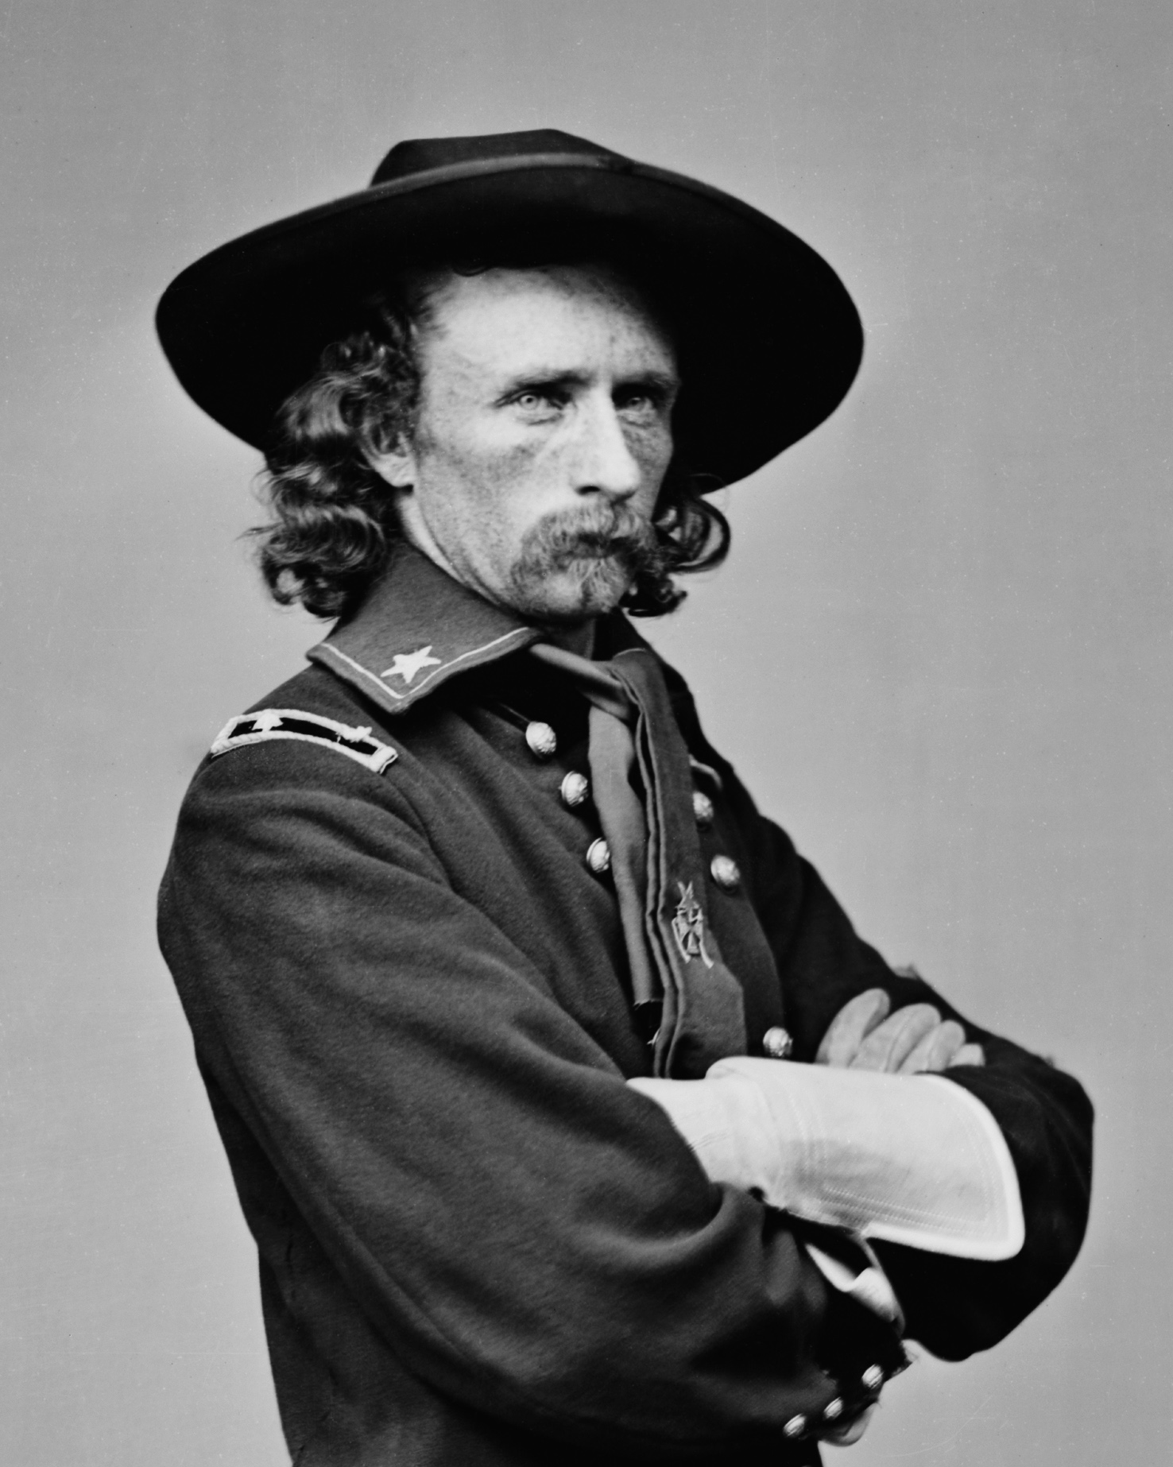
Battle of Little Bighorn
In 1874 Lieutenant Colonel George Armstrong Custer led an expedition that verified rumors of rich gold deposits Black Hills.
Prospectors quickly began to trespass on Indian land and stake illegal claims—then demand that the army protect them from Indian attacks.

Slide 14
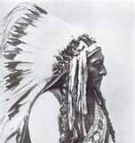
Battle of Little Bighorn
In the summer of 1876, the U.S. Army deployed troops to the Black Hills to trap a group of roaming Sioux and force them back to their reservation.
Sitting Bull, a Sioux leader, had foretold his people of a great victory to take place upon the Little Bighorn River.

Slide 15
Battle of Little Bighorn
George Custer and his 7th Calvary attacked Sitting Bull at the Little Bighorn River.
The battle was a massacre
Resulted in the death of around 80 Natives, but completely annihilated almost all of General Custer’s soldiers.
This marked the biggest Native American victory against the encroaching settlers

Slide 17
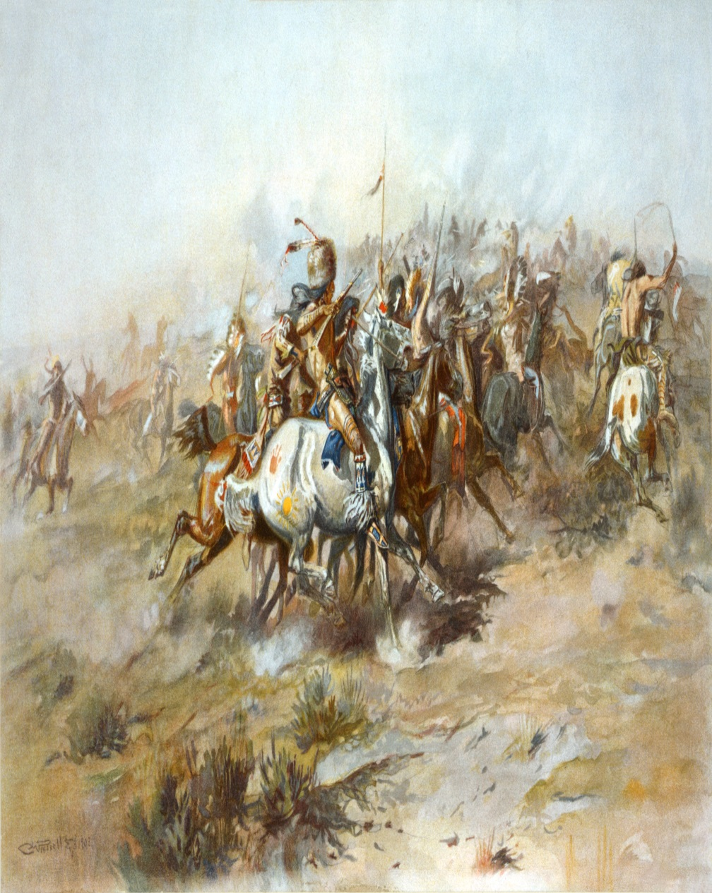
Battle of Little Bighorn
This victory encouraged Natives to keep fighting
The loss so outraged the U.S. government—and the public at large—that the army mounted a new offensive, crushing armed Sioux resistance

Slide 18
Massacre at Wounded Knee
Shortly after Little Bighorn, all major Native American victories came to a halt as U.S. military forces went in earnest to take all power from Native Tribes
Native leaders began to preach nonviolence as a way to establish peace between themselves and the “white” Americans
Natives began a “ghost dance”, a movement designed to promote Indian religions
Many Americans saw the ghost dance as a form of violent uprisings and demanded the Natives stop

Slide 20
Massacre at Wounded Knee
On the morning of December 29, 1890, the army demanded the surrender of all Sioux weapons. Amid the tension, a shot rang out, possibly from a deaf brave who misunderstood his chief's orders to surrender.
The Seventh Cavalry — the reconstructed regiment lost by George Armstrong Custer — opened fire on the Sioux. When the smoke cleared almost all of the 300 men, women, and children were dead. Some died instantly, others froze to death in the snow.

Slide 22
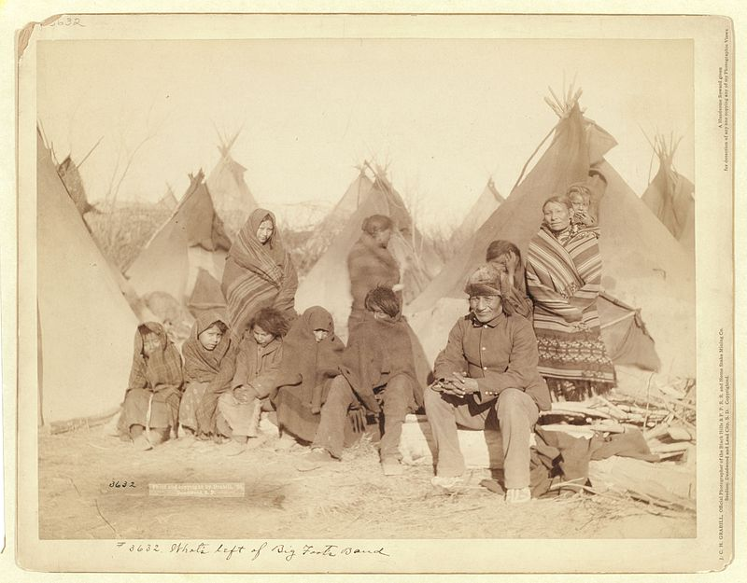
Massacre at Wounded Knee
This massacre marked the last showdown between Native Americans and the United States Army. It was nearly 400 years after Christopher Columbus first contacted the first Americans. The 1890 United States census declared the frontier officially closed.

