Slide 1
Leaders and Battles of the Civil War
Rorrer, the great and powerful

Slide 2
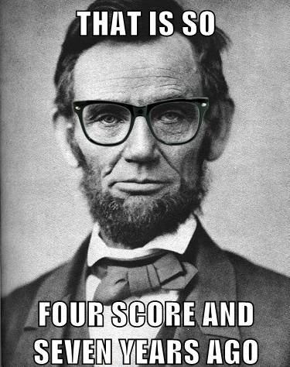
Abraham Lincoln
16th President of the United States
Insisted that the Union be held together, by force if necessary

Slide 3
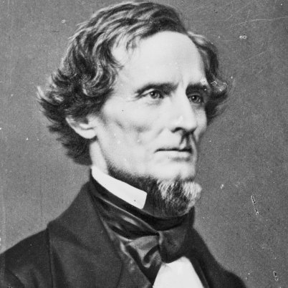
Jefferson Davis
Kentucky U.S. Senator who became President of the Confederate States of America
Indicted for treason, but never tried.

Slide 4
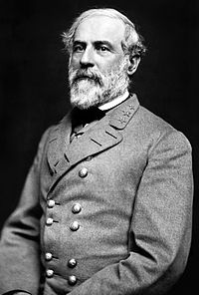
Robert E. Lee
Confederate general of the Army of Northern Virginia
Opposed secession, but did not believe that the Union should be held together by force
Eventually urged the South to accept defeat and unite as Americans again

Slide 5
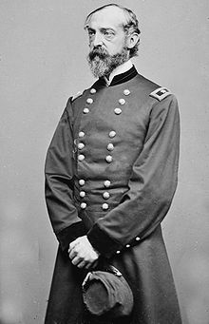
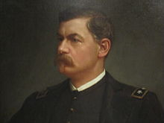
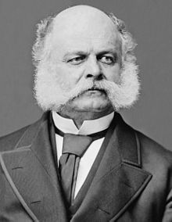
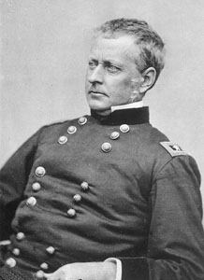
Failed Union Generals
George McClellan
Ambrose Burnside
Joseph Hooker
George Meade

Slide 6
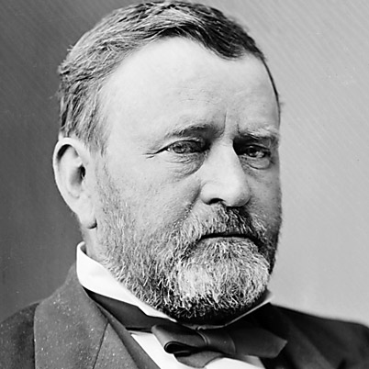
Ulysses S. Grant
Union military commander
Won victories over the South after several Union commanders had failed

Slide 7
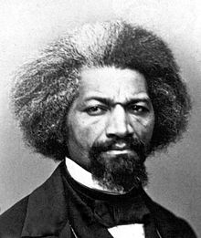
Frederick Douglass
Former enslaved African American
Became a prominent black abolitionist
Encouraged Lincoln to recruit former slaves to fight in the Union Army

Slide 8
Emancipation Proclamation
Freed those slaves located in “rebelling” states
Made the destruction of slavery a Northern war aim
Discouraged any interference of foreign governments
Allowed for the enlistment of African American soldiers in the Union Army

Slide 9
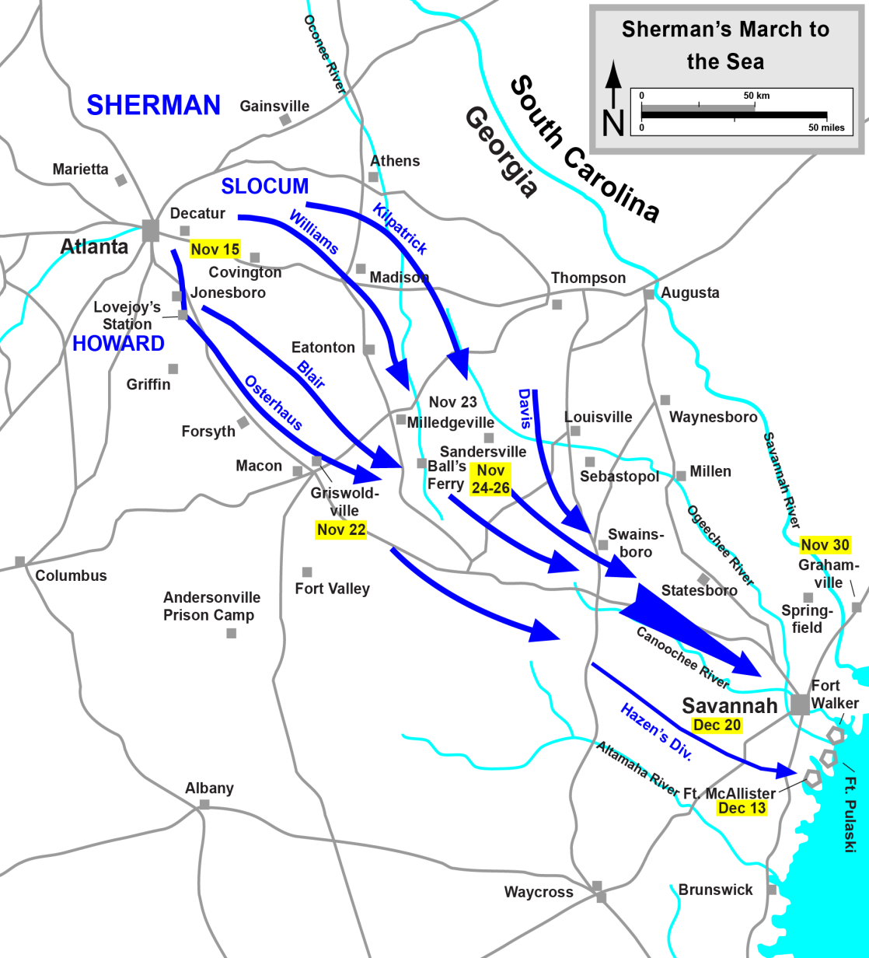
Sherman’s March to the Sea
Maj. Gen. William Tecumseh Sherman
Georgia Campaign
Scorched Earth warfare
Destroyed much of the South's physical and psychological capacity to wage war.

Slide 10
Gettysburg: The Turning Point
Confederate Gen. Robert E. Lee concentrated his army around Gettysburg, Pennsylvania
On July 1, Confederates drove Union defenders through Gettysburg to Cemetery Hill
The next day Lee struck the flanks of the Union line resulting in severe fighting

Slide 11
Gettysburg: The Turning Point
Southerners gained ground but failed to dislodge the Union host
On the morning of July 3rd, Lee attacked the Union center on Cemetery Ridge and was repulsed with heavy losses in what is known as Pickett’s Charge.
Lee's second invasion of the North had failed.

Slide 13
Gettysburg Address
Lincoln described the Civil War as a struggle to preserve a nation that was dedicated to the proposition that “all men are created equal” and that was ruled by a government “of the people, by the people, and for the people.”
Lincoln believed America was “one nation,” not a collection of sovereign states. Southerners believed that states had freely joined the union and could freely leave.

