Slide 1
Jacksonian Era and Sectional Tensions
VUS.6d&e

Slide 2
The Age of the Common Man
Changing character of American politics
Heightened emphasis on equality in the political process for adult white males
The rise of interest group politics and sectional issues
A changing style of campaigning
Increased voter participation

Slide 3
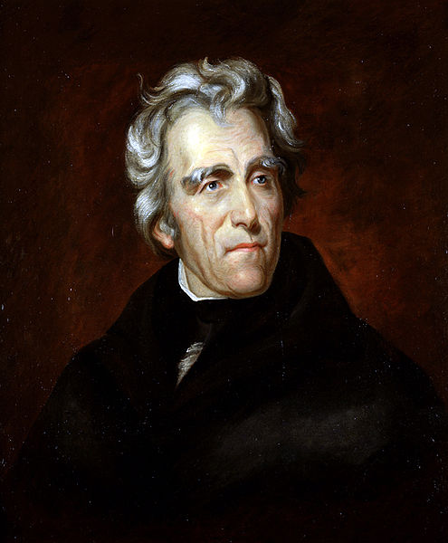
Andrew Jackson
Nicknamed “Old Hickory”
Fought in duels, sometimes fatal
Wealthy slaveholder

Slide 4
Andrew Jackson
Election of 1824
Received the most popular votes
Not enough electoral votes
House of Representatives decide President
Corrupt Bargain
Henry Clay dropped out of the election so that John Quincy Adams would win. Adams appointed Clay to Secretary of State

Slide 5
Andrew Jackson
Election of 1828
Formed the Democratic Party
Opponents of Jackson called him a jackass (democratic party symbol today)
Personal attacks by both sides
Wife was accused of adultery

Slide 6
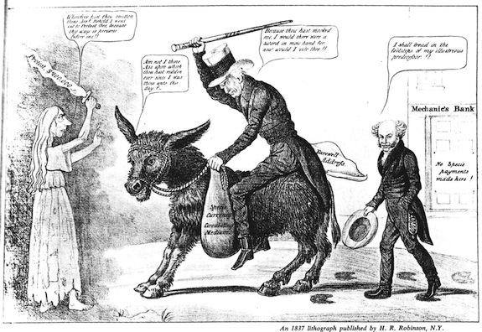

Slide 7
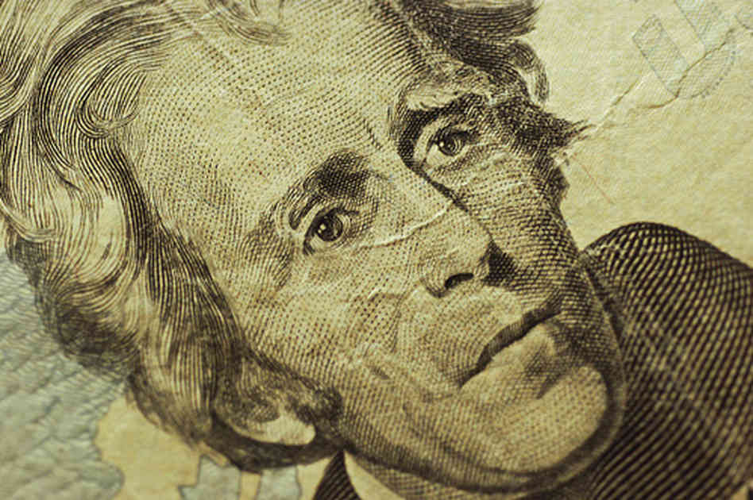
Federal Debt
Jackson was the first and only president to pay off the nation’s debt

Slide 8
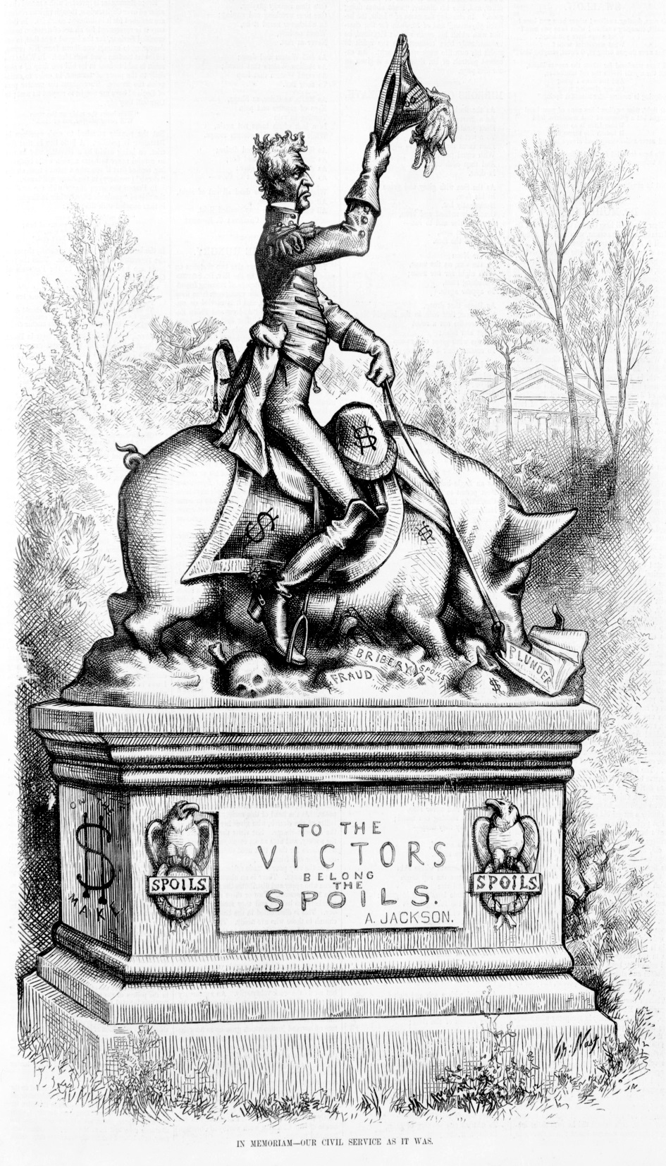
Spoils System
Andrew Jackson personified the democratic spirit of the age by challenging the economic elite and rewarding campaign supporters with public office positions
Supporters who may not have had any prior experience were put into office

Slide 9
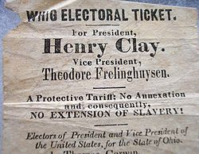
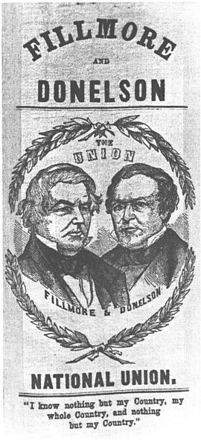
Parties Change
The Federalist Party disappeared, and new political parties we organized in opposition to the Democratic Party
Whigs
Know-Nothings

Slide 10
Sectional Tensions
Competing Economic Interests
The industrial North favored high protective tariffs to protect Northern manufactured goods from foreign competition.
The agricultural South opposed high tariffs that made the price of imports more expensive.

Slide 11
Sectional Tensions
Westward Expansion
As new states entered the Union, compromises were reached that maintained the balance of power in Congress between “free” and “slave” states.

Slide 12
Sectional Tensions
Westward Expansion
Missouri Compromise
drew an east-west line through the Louisiana Purchase, with slavery prohibited above the line and allowed below, except that slavery was allowed in Missouri, north of the line.

Slide 14
Sectional Tensions
Westward Expansion
Compromise of 1850
California entered as a free state, while the new Southwestern territories acquired from Mexico would decide on their own

Slide 16
Sectional Tensions
Westward Expansion
Kansas-Nebraska Act
Repealed the Missouri Compromise line, giving people in Kansas and Nebraska the choice whether to allow slavery in their states or not (popular sovereignty)

Slide 18
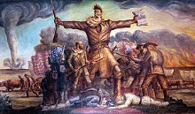
Kansas-Nebraska Act
This law produced bloody fighting in Kansas as pro- and anti-slavery forces battled each other. It also led to the birth of the Republican Party that same year to oppose the spread of slavery.

Slide 19
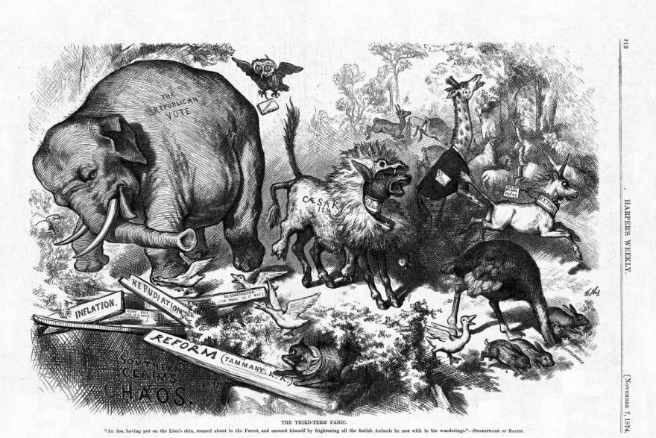

Slide 20
Sectional Tensions
Nature of the Union
Tariff of 1832 and the Nullification Crisis
A union that allowed state governments to invalidate acts of the national legislature could be dissolved by states seceding from the Union in defense of slavery
President Jackson threatened to send federal troops to collect tax revenues

Slide 21
Sectional Tensions
Slavery
Slave revolts in Virginia, led by Nat Turner and Gabriel Prosser, fed white Southerners’ fears about slave rebellions and led to harsh laws in the South against fugitive slaves. Southerners who favored abolition were intimidated into silence.

Slide 22
Sectional Tensions
Slavery
William Lloyd Garrison (Northerner)
Publisher of The Liberator
Viewed the institution of slavery as a violation of Christian principles and argued for its abolition.
Southerners grew alarmed by the growing force of the Northern response to the abolitionists.

Slide 23
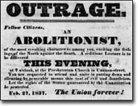
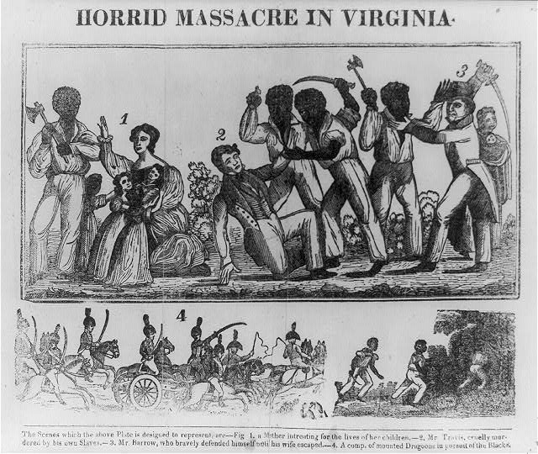
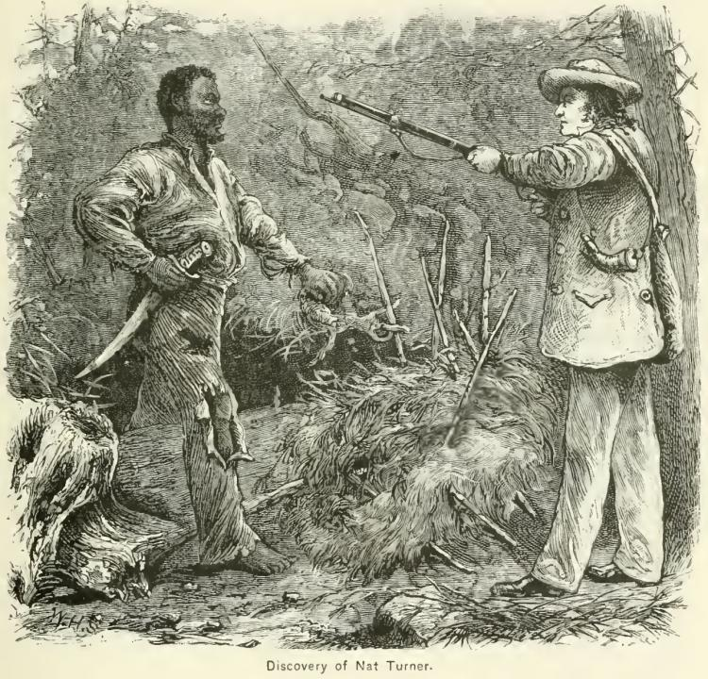

Slide 24
Sectional Tensions
Slavery
Fugitive slave events pitted Southern slave owners against outraged Northerners who opposed returning escaped slaves to bondage.

