Slide 1
Innovations and Leaders
During the period from the Civil War to World War I, the United States underwent an economic transformation that involved a developing industrial economy, the expansion of big business, the growth of large-scale agriculture, and the rise of national labor unions and industrial conflict.
VUS.8b

Slide 2
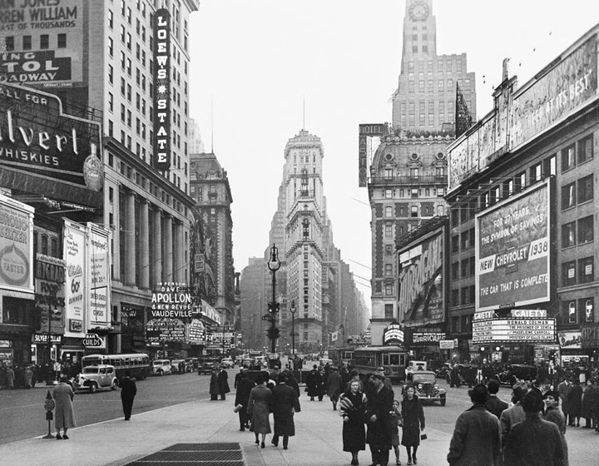
The Beginning of Technological Change
Technological change spurred growth of industry primarily in northern cities.

Slide 3
Inventions/Innovations
Corporation (Limited Liability)
Large number of shareholders
Shares can be traded without consent of others
Considered a legal person

Slide 4
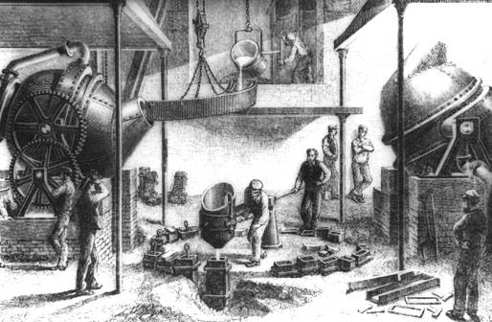
Inventions/Innovations
Bessemer Steel Process
Inexpensive way to remove impurities from steel

Slide 5
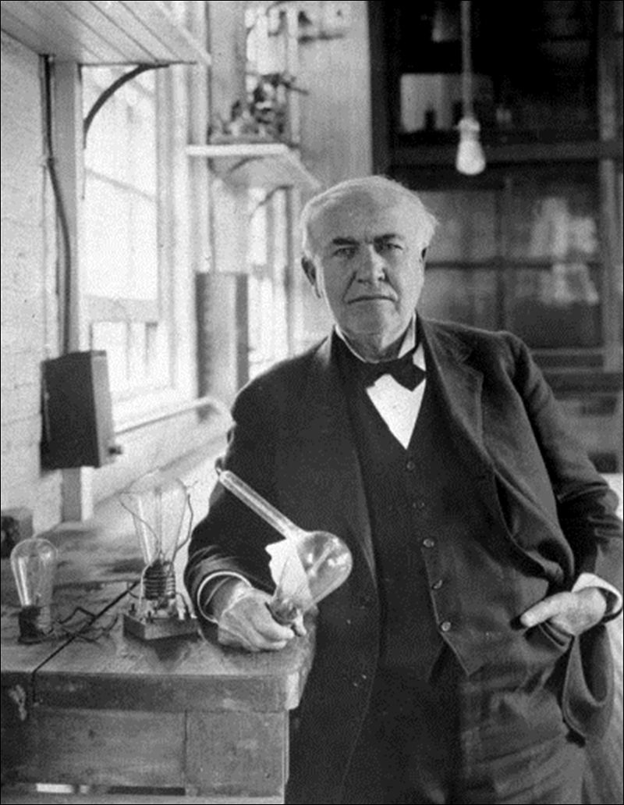
Inventions/Innovations
Light Bulb (Thomas Edison)
Electricity as a source of power and light

Slide 6
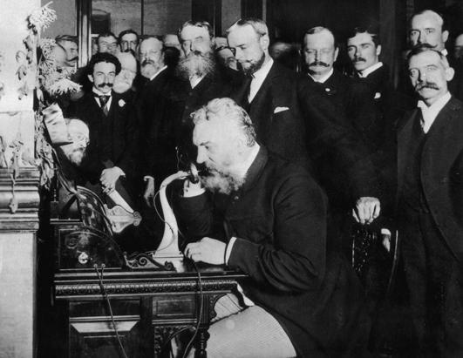
Inventions/Innovations
Telephone (Alexander Graham Bell)

Slide 7
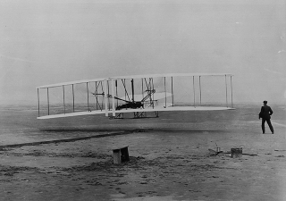
Inventions/Innovations
Airplane (Wright Brothers)

Slide 8
Inventions/Innovations
Assembly Line Manufacturing (Henry Ford)

Slide 9
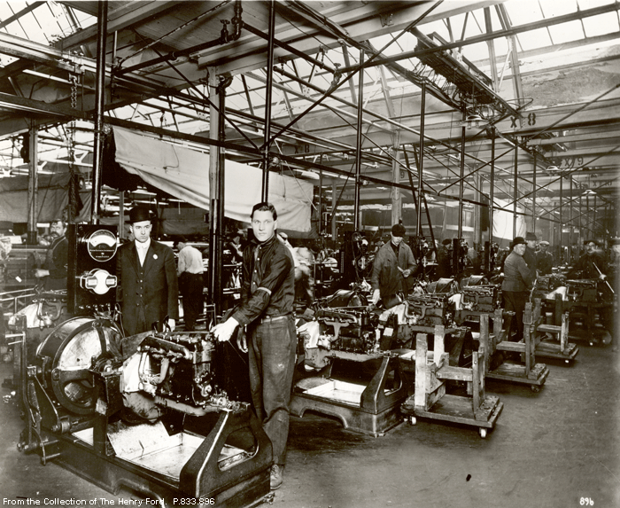

Slide 11
Industrial Leaders
Andrew Carnegie (steel)
J.P. Morgan (finance)
John D. Rockefeller (oil)
Cornelius Vanderbilt (railroads)

Slide 12
Reasons for Economic Transformation
Laissez-faire capitalism and special considerations (e.g., land grants to railroad builders)
The increasing labor supply (from immigration and migration from farms)
America’s possession of a wealth of natural resources and navigable rivers

