Slide 1
Immigrants Flock to America
VUS.8a

Slide 2
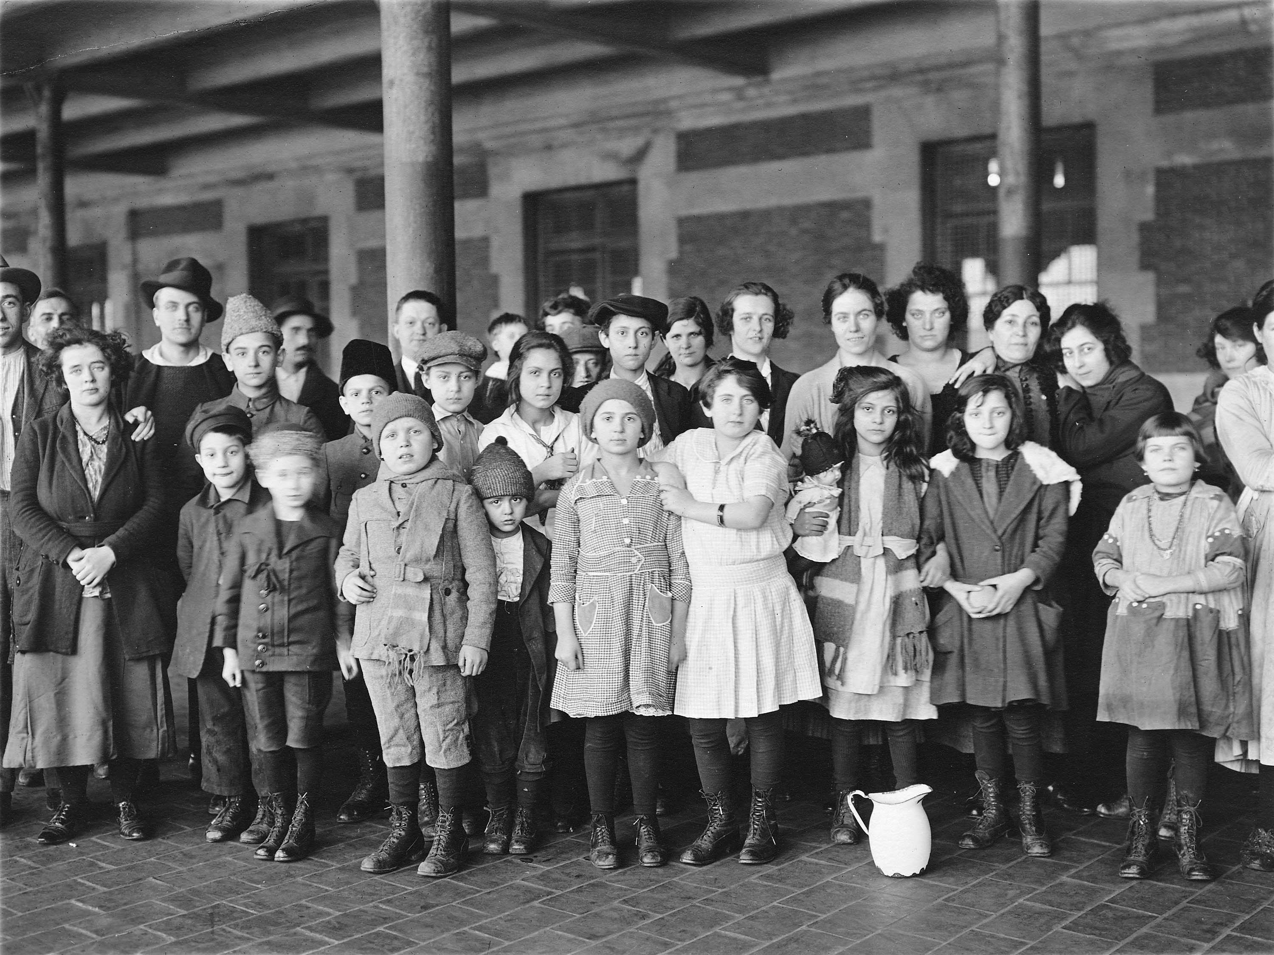
Prior to 1871
Most Immigrants came from Northern and Western Europe
Germany
Great Britain
Ireland
Norway
Sweden

Slide 4
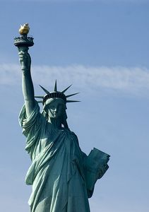
1871-1921
Southern and Eastern Europe
Italy
Greece
Poland
Russia
Present-day Hungary and Yugoslavia
Asia
China
Japan

Slide 6
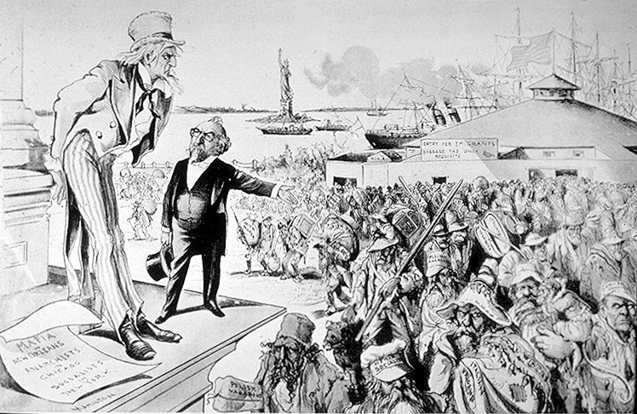
Why Did They Come?
Like earlier immigrants, these immigrants came to America seeking freedom and better lives for their families

Slide 7
Contributions
Immigrants made valuable contributions to the dramatic industrial growth of America during this period.
They often worked for very low pay and in dangerous working conditions to help build the nation’s industrial strength.

Slide 8
Various Jobs
Immigrants worked in textile and steel mills in the Northeast, the clothing industry in New York City
Chinese workers helped to build the Transcontinental Railroad.
Slavs, Italians, and Poles worked in the coal mines of the East.

Slide 9
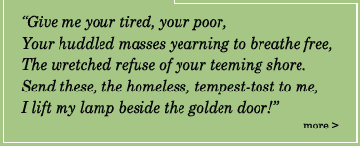
Ellis Island
During this period, immigrants from Europe entered America through Ellis Island in New York harbor.
Their first view of America was often the Statue of Liberty, standing nearby, as their ships arrived following the voyage across the Atlantic.

Slide 10
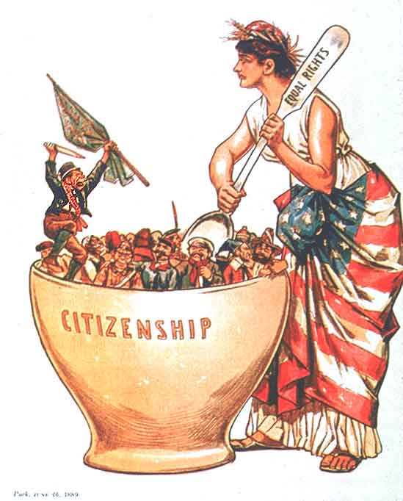
Assimilation
Immigrants began
the Process of
Assimilation into
what was termed
the American
“melting pot.”

Slide 11
Assimilation
While often settling in ethnic neighborhoods in the growing cities, they and their children worked hard to learn English, adopt American customs, and become American citizens.
The public schools served an essential role in the process of assimilating immigrants into American society.

Slide 12
Inequality
Despite the valuable contributions immigrants made to building America during this period, immigrants often faced hardship and hostility
There was fear and resentment that immigrants would take jobs for lower pay than American workers
There was prejudice based on religious and cultural differences

Slide 13
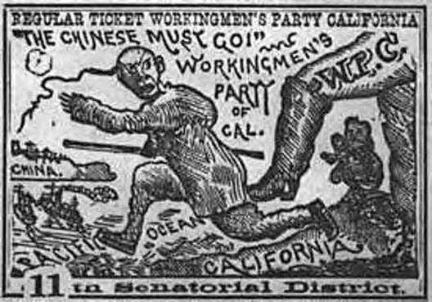
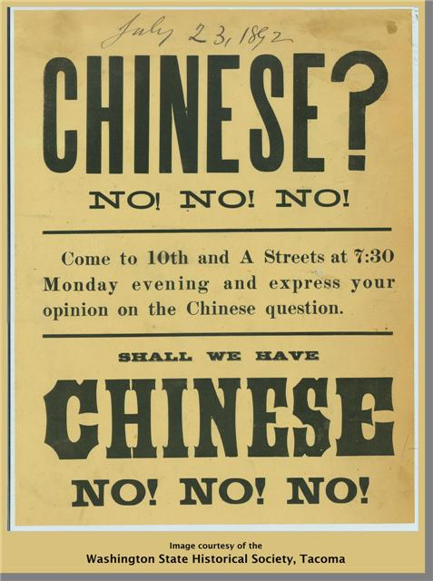
Legal Issues
Mounting resentment led
Congress to limit
immigration, through the
Chinese Exclusion Act of
1882 and Immigration
Restriction Act of 1921.

Slide 14
Lasting Effects
These laws effectively cut off most immigration to America for the next several decades
The immigrants of this period and their descendants continued to contribute immeasurably to American society.

Slide 15
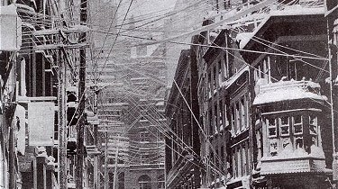
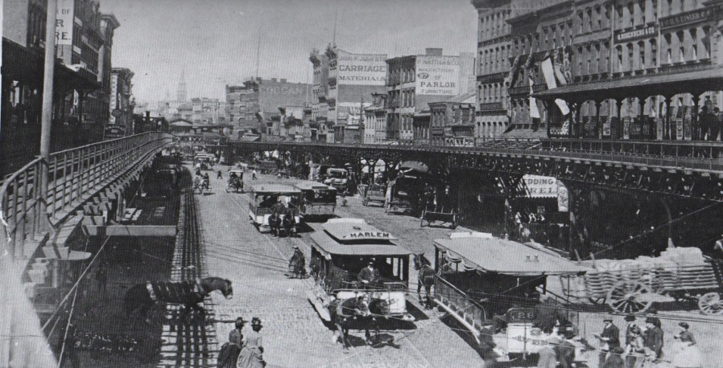
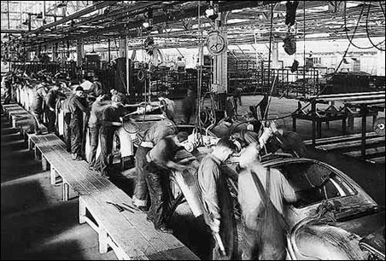
Growth of Cities
As the nation’s industrial
growth continued, cities
such as Chicago, Detroit,
Cleveland, Pittsburgh, and
New York grew rapidly as
manufacturing and
transportation centers
became central to the
American way of life

Slide 16
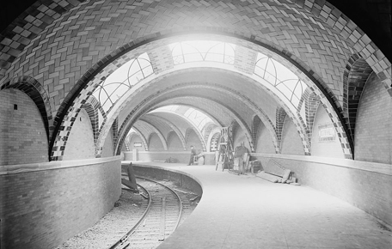
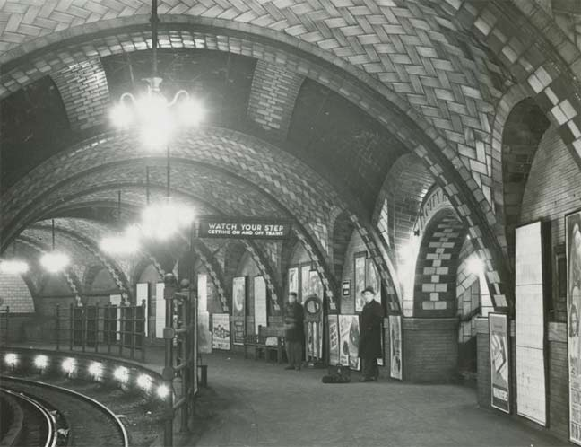
Growth of Cities
Factories in the large cities provided jobs, but workers’ families often lived in harsh conditions crowded into tenements and slums.
The rapid growth of cities caused housing shortages and the need for new public services, such as sewage and water systems and public transportation.
New York City began construction of the nation’s first subway system around the turn of the 20th century, and many cities built trolley or streetcar lines.

Slide 17
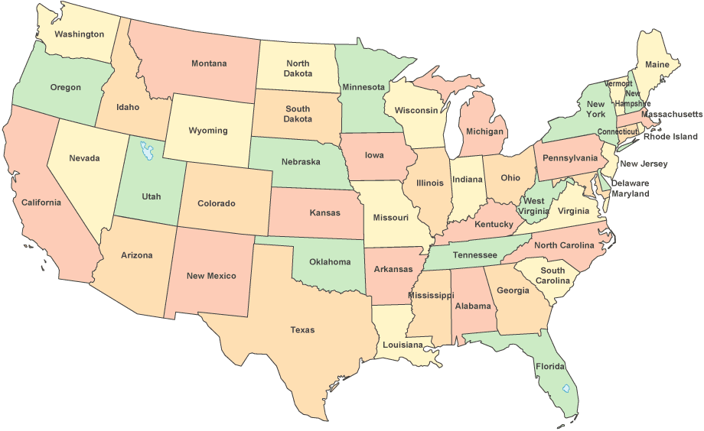
Admission of New States
As the population moved westward, many new states in The Great Plains and Rocky Mountains were added to the Union.
By the early 20th century, all the states that make up the continental United States, from Atlantic to Pacific, had been admitted.

