Slide 1
Formation of Political Parties
VUS.6a&b

Slide 2
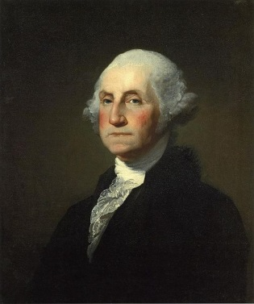
George Washington
1st President of the United States
Elected unanimously
Would only be called “Mr. President”, not King or other title
Refused to run a third term (set precedent)
Remained neutral in world affairs
Warned against forming political parties
Recommended staying out of permanent alliances

Slide 3
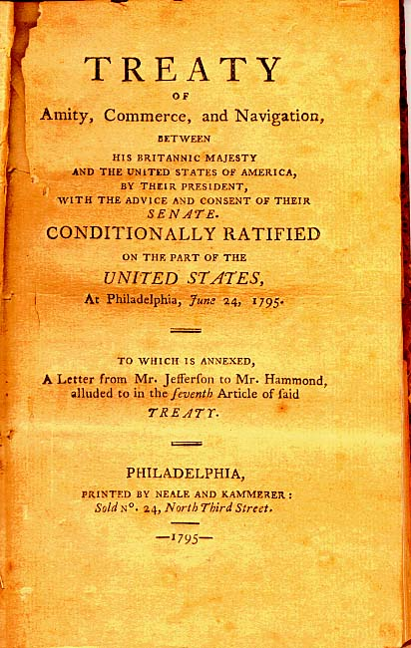
Jay Treaty
Between Great Britain and America
Created by John Hamilton and John Jay
Supported by President Washington
Britain would pull out of many forts in North America
America would agree to pay back certain debts
Trade with Britain would become prosperous

Slide 4
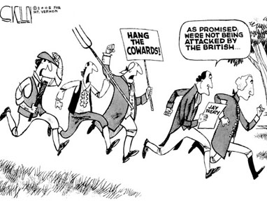
Jay Treaty
Thomas Jefferson was very against the treaty
His followers believed that the treaty would prove to favor the upper class
Would also undermine the friendship of France

Slide 5
Bank of the United States
Alexander Hamilton believed a national bank was necessary to improve the nation’s credit
Thomas Jefferson and James Madison oppose the bank
Think it is unconstitutional
Believe it will only support the upper class

Slide 6
First Political Parties
The Federalists
led by John Adams and Alexander Hamilton
believed in a strong national govt and industrial (commercial) economy
received support from bankers and business interests in the Northeast.
supported the Bank of the U.S., the Jay Treaty, and the undeclared war on France
The Democratic-Republicans
Led by Thomas Jefferson and James Madison
believed in a weak national government and an agricultural economy
supported by farmers, artisans, and frontier settlers in the South.

Slide 7
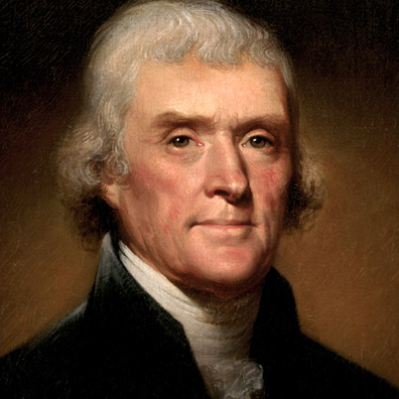
Election of 1800
Thomas Jefferson became president
First American presidential election in which power was peacefully transferred from one political party to another

Slide 8
Louisiana Purchase
Thomas Jefferson purchased the Louisiana Territory in 1803 from France (doubled the size of the U.S. overnight)
He authorized the Lewis and Clark expedition to explore the new territories that lay west of the Mississippi River.
Sacajawea served as their guide and translator.

Slide 9
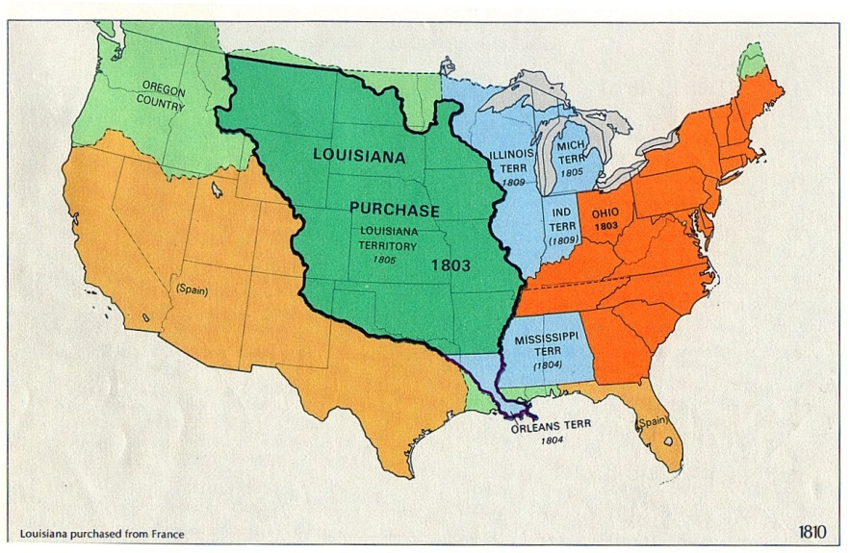
Louisiana Purchase

