Slide 1
Famous Court Cases
VUS.5e

Slide 2
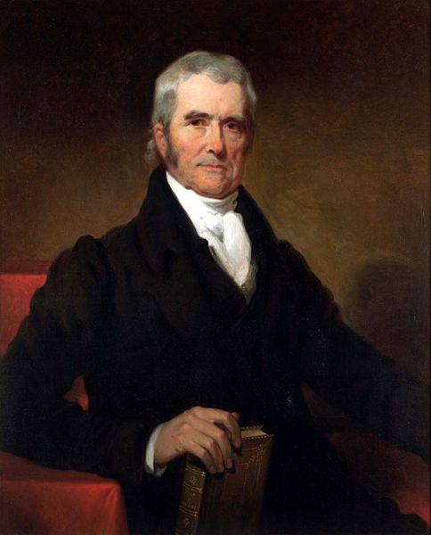
Chief Justice John Marshall
Virginian
Longest-serving Chief Justice
His court oversaw many important decisions relating to federalism

Slide 3
Chief Justice John Marshall
Credited with building up the power of the Judicial branch of the American Government
Strongly in favor of the Constitution

Slide 4
Marbury v. Madison (1803)
Legislative and Executive actions are set up for judicial review by the Judicial Branch
Whenever a case of whether something is legal that Congress or the President is trying to do arises, the Courts decides the answer
Prime example of checks and balances

Slide 5
McCulloch v. Maryland (1819)
Congress is allowed implied powers
Powers implied by a written document but not expressly stated
States cannot override any act of the Constitution

Slide 6
Gibbons v. Ogden (1824)
Congress is given the ability to regulate interstate commerce

Slide 7
Famous Cases
These cases are the foundation blocks of the Supreme Court’s authority to mediate disagreements between branches of government, levels of government, and competing business interests

