Slide 1
Expansion
VUS.6b

Slide 2
Monroe Doctrine
The American continents should not be considered for future colonization by any European powers.
Nations in the Western Hemisphere were inherently different from those of Europe—i.e.,
They were republics by nature rather than monarchies.

Slide 3
Monroe Doctrine
The United States would regard as a threat to her own peace and safety any attempt by European powers to impose their system on any independent state in the Western Hemisphere.
The United States would not interfere in European affairs.

Slide 4
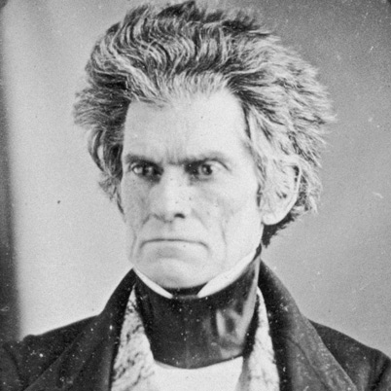
Monroe Doctrine
Basically, you stay out of our business, we’ll stay out of yours.

Slide 5
Westward Movement
American settlers streamed westward from the coastal states into the Midwest, Southwest, and Texas
Seeking economic opportunity in the form of land to own and farm.

Slide 6
Westward Movement
The growth of railroads and canals helped the growth of an industrial economy and supported the westward movement of settlers.

Slide 7
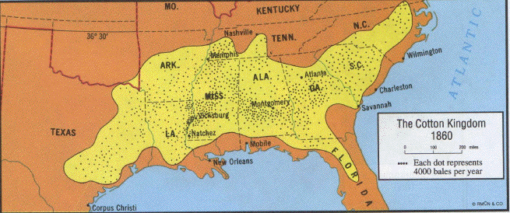
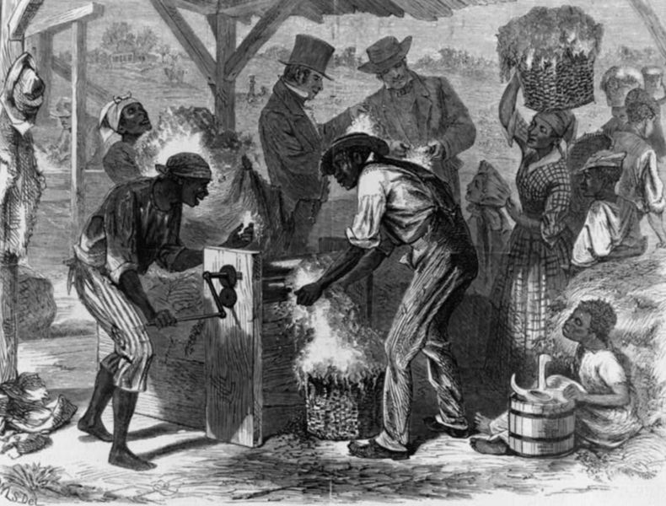
Eli Whitney
Inventor of the Cotton Gin
Spread of slavery-based “Cotton Kingdom” in the Deep South

Slide 8
Manifest Destiny
Widely held belief that American settlers were destined to expand across the continent
1. The special virtues of the American people and their institutions;
2. America's mission to redeem and remake the world in the image of America
3. A divine destiny under God's direction to accomplish this wonderful task

Slide 9
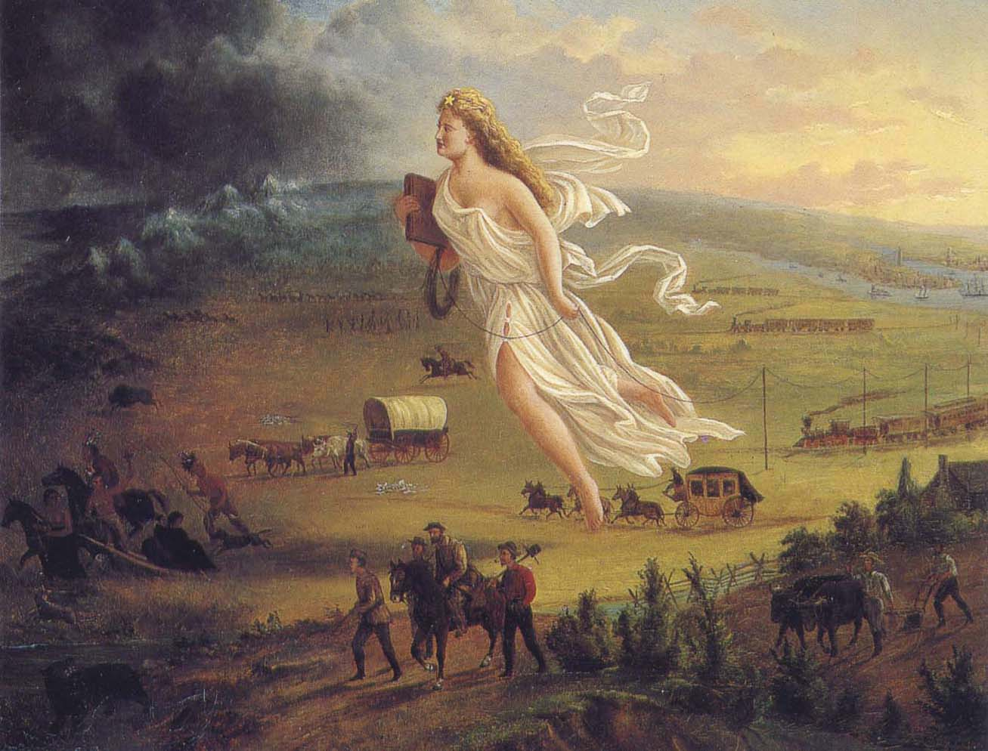

Slide 10
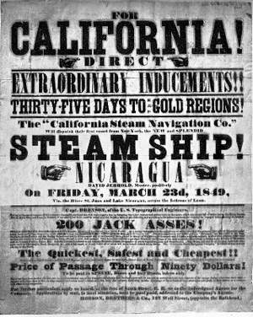
Manifest Destiny
The idea of Manifest Destiny provided political support for territorial expansion

Slide 11
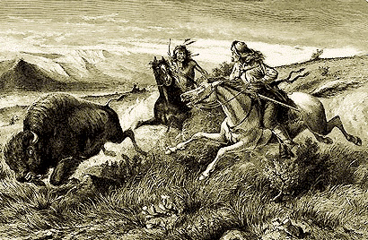
Native Americans
During this period of westward migration, American Indians were repeatedly defeated in violent conflicts with settlers and soldiers and forcibly removed from their ancestral homelands.

Slide 12
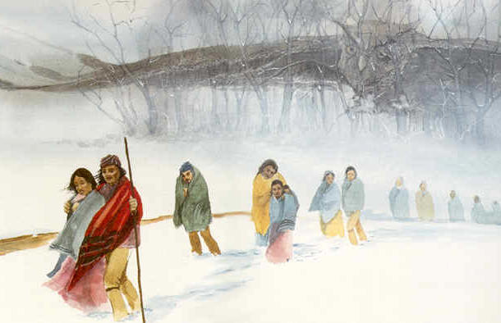
Native Americans
Trail of Tears
Forced relocation of many Native Americans to Oklahoma
Many suffered from disease, starvation, and even death on the trip

