Slide 1
End to the fighting
I think a name if supposed to go here, but who really knows in this crazy mixed up world of ours.

Slide 2
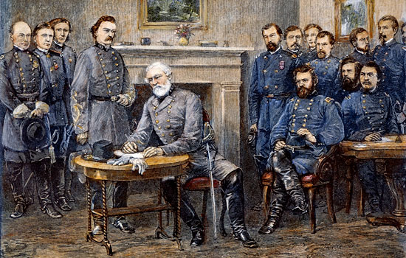
Surrender
April 9, 1865
Gen. Robert E. Lee determined to make one final attempt to reach his supplies at Lynchburg
Became surrounded on 3 sides
A Confederate horseman could be seen galloping towards the Union line waving a white flag
Marked the end of fighting in Virginia
"Then there is nothing left for me to do but to go and see General Grant and I would rather die a thousand deaths."

Slide 3
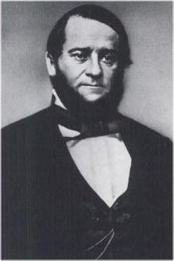
Place of Surrender
Wilmer McClean’s house

Slide 4
Why was this Different?
Grant let the defeated General choose the place of surrender
Lee was dressed in his best uniform
Grant was dressed in a muddy and torn uniform
Lee and his men would not be arrested
Allowed to bring their horses and mules home with them for the summer harvest

Slide 5
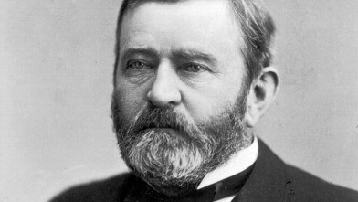
"The Confederates were now our countrymen, and we did not want to exult over their downfall."

Slide 6
Political Effects
Lincoln’s view that the United States was one nation indivisible had prevailed.
Lincoln believed that since secession was illegal, Confederate governments in the Southern states were illegitimate and the states had never really left the Union
He believed that Reconstruction was a matter of quickly restoring legitimate state governments that were loyal to the Union in the Southern states.

Slide 7
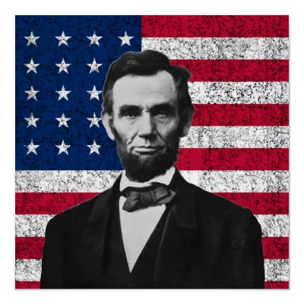
Lincoln’s Feelings on the South
Lincoln also believed that once the war was over, to reunify the nation the federal government should not punish the South but act “with malice towards none, with charity for all… to bind up the nation’s wounds….”

Slide 8
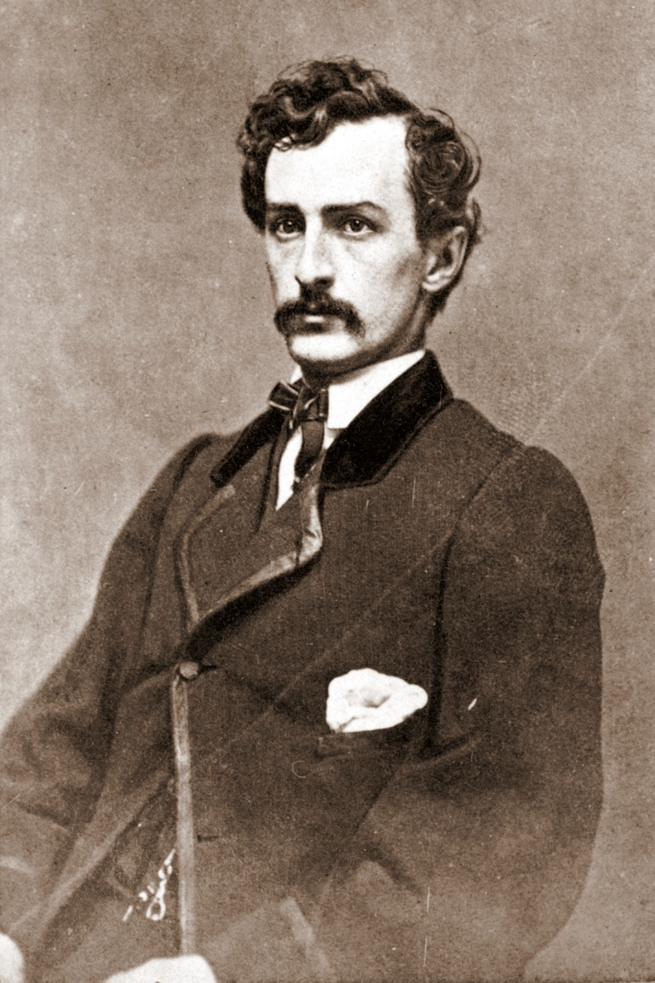
Assassination of Lincoln
April 14th, 1865
Days after Lee’s surrender
Ford’s Theater
Our American Cousin
John Wilkes Booth
Actor (very well known for his day)
Sic Semper Tyrannis! The South is Avenged!

