Slide 1
Constitutional Influences
VUS.5c&d

Slide 2
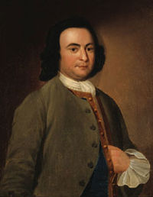
Virginia Declaration of Rights
Created by George Mason
Reiterated the fact that basic human rights should not be violated by governments

Slide 3
Virginia Declaration of Rights
All power is derived from the people
Separation of Powers
Frequent, Certain, and Free elections

Slide 4
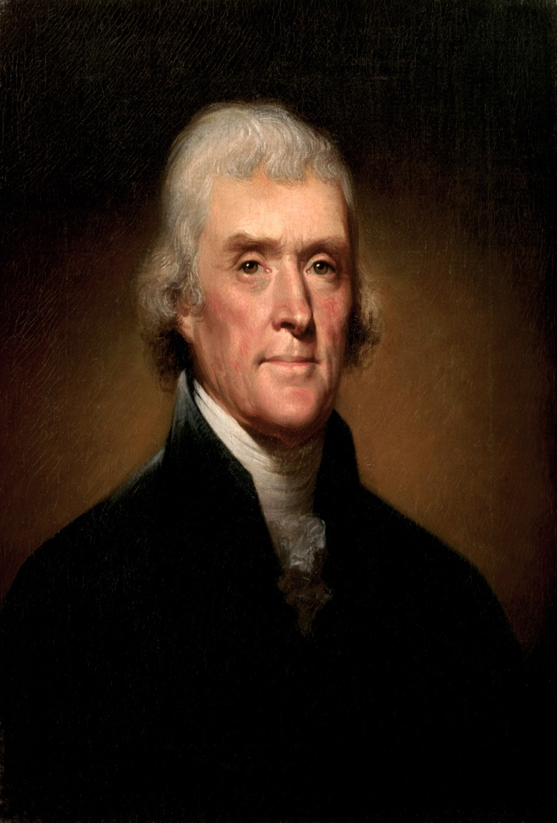
Virginia Statute of Religious Freedom
Written by Thomas Jefferson
Outlawed and established church
The practice of the government supporting one religion over the other

Slide 5
Bill of Rights
James Madison (Father of the Constitution)
First 10 Amendments to the United States Constitution
Guaranteed certain rights to American citizens
Outlines what the Government can NOT do

Slide 6
Federalists vs. Anti-Federalists
Federalists
Wanted a strong central government
Would promote economic development and public improvements
George Washington and James Madison

Slide 7
Federalists vs. Anti-Federalists
Anti-Federalists
Feared a strong central government
Rights of the individual would be destructive
States would have to adhere to the federal government
Patrick Henry and George Mason

