Slide 1
Constitutional Era
VUS.5a&b

Slide 2
A Country Anew
American political leaders, fearful of a powerful central government like Britain’s, created the Articles of Confederation, adopted at the end of the war

Slide 3
Weaknesses of the Articles of Confederation
Provided a weak national government
Congress, the legislative body of government
No power to tax or regulate commerce between states
No common currency

Slide 4
Weaknesses of the Articles of Confederation
Each state is given one vote, regardless of size
No executive or judicial branches

Slide 5
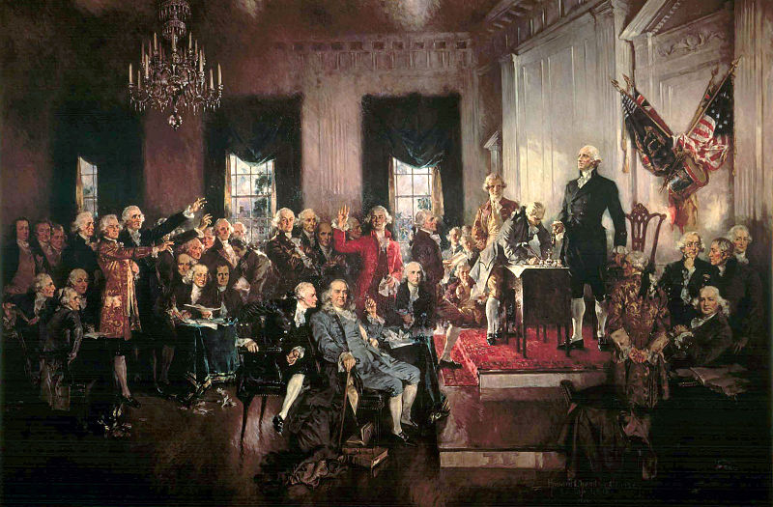
Constitutional Convention
Philadelphia, Pennsylvania
Intended to revise the Articles of Confederation
George Washington elected to preside over the Convention

Slide 6
Constitutional Convention
Key Leaders
George Washington, President of the Convention
Although seldom participating in the debates, his prestige meant a lot to the people there
James Madison, “Father of the Constitution”
Virginian Philosopher. Kept the best records of the Constitution
Author of the Virginia Plan
Authored much of the Bill of Rights

Slide 7
Constitutional Convention
Although the intention of the Convention was to rework the Articles of Confederation, members eventually through everything out and began drafting a new idea for the American government

Slide 8
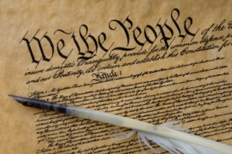
Key Issues in the Convention
Made federal law the supreme law of the land when constitutional
Gave the states considerable leeway to govern themselves

Slide 9
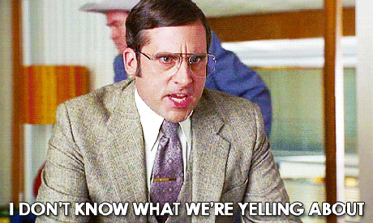
Key Issues in the Convention
Arguments over Representation
What state gets the most representation?
Big?
Small?
Equal?

Slide 10
Key Issues in the Convention
Virginia Plan (James Madison)
Representation decided by population
New Jersey Plan
Representation would be equal

Slide 11
Key Issues in the Convention
Connecticut Compromise (Great Compromise)
Bicameral Legislature (2 houses)
Senate – 2 representatives per state
House of Representatives – representatives decided by population

Slide 12
Key Issues in the Convention
House of Representatives
South wants to count slaves in their population to determine representation
Three-fifths Compromise
Each slave would count as 3/5s of a person

Slide 13
Central Government
Could not be too powerful
3 co-equal branches
Executive
Legislative
Judicial
Each branch had checks and balances over each other branch

Slide 15
Central Government
Limited the powers of the Federal government to those identified in the Constitution

