Slide 1
Characteristics of the Colonies
VUS.3

Slide 2
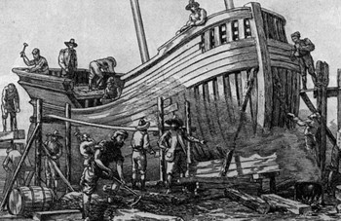
Economic Characteristics
New England Colonies
Shipbuilding
Fishing
Lumbering
Small-scale subsistence farming
Eventually, manufacturing

Slide 3
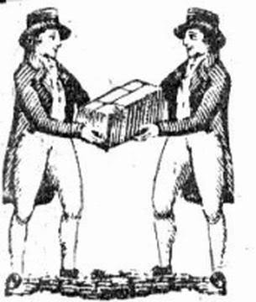
Economic Characteristics
Middle colonies of New York, New Jersey, Pennsylvania, and Delaware
Shipbuilding
Small-scale farming
Trading

Slide 4
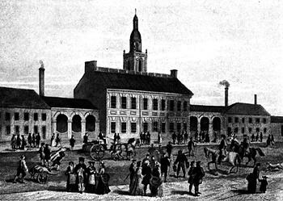
Economic Characteristics
Cities such as New York and Philadelphia began to grow as seaports and/or commercial centers.

Slide 5
Economic Characteristics
Southern Colonies
Large Plantations that grew cash crops
Tobacco
Rice
Indigo
Further Inland:
Small-scale subsistence farming
Hunting
Trading

Slide 6
Economic Characteristics
A strong belief in private ownership of property and free enterprise characterized colonial life everywhere

Slide 7
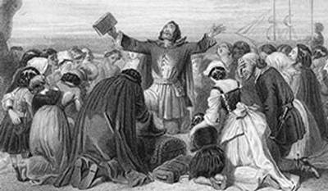
Social Characteristics
New England
Religion!
Puritans were intolerant to dissenters who challenged the Puritan belief in the connection between religion and government

Slide 8
Social Characteristics
New England
Religion!
Rhode Island was founded by dissenters fleeing persecution by Puritans in Massachusetts

Slide 9
Social Characteristics
The Middle Colonies
Multiple religious groups who generally believed in religious tolerance
Quakers in Pennsylvania
Huguenots and Jews in New York
Presbyterians in New Jersey

Slide 10
Social Characteristics
The Middle Colonies
These colonies had more flexible social structures and began to develop a middle class of skilled artisans, entrepreneurs (business owners), and small farmers

Slide 11
Social Characteristics
Virginia and Southern Colonies
Social structure based on family status and the ownership of land
Large landowners in the eastern lowlands dominated colonial government and society
Allegiance to the Church of England and Britain

Slide 12
Social Characteristics
Virginia and Southern Colonies
In the mountains and valleys further inland
Characterized by small subsistence farmers, hunters, and traders of Scots-Irish and English descent

Slide 13
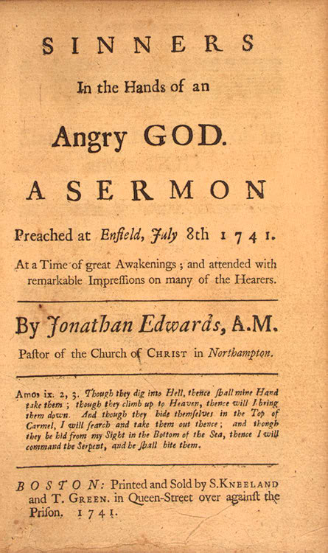
The Great Awakening
Religious Movement
Led to the growth of evangelical religions
Methodist and Baptist
Challenged the established religious and governmental orders

Slide 14
Political life in the colonies
New England – Town Meetings
Middle Colonies – Multiple ideas that gave the rights of Englishmen
Southern Colonies – People from Britain played a leading role

Slide 15
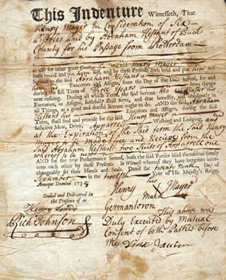
Indentured Servants
Poor persons from England, Scotland, or Ireland who agreed to work on plantations for a period of time in return for their passage from Europe or relief from debts.

Slide 16
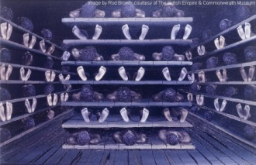
Middle Passage
Africans that were forcibly brought to the southern colonies

