Slide 1
America’s Home Front During WWI

Slide 2
Citizens Get Involved
The entire population and economy were involved in World War I in some way
Soldiers
Food Supplies
Munitions
Money

Slide 3
Committee on Public Information
Created to influence U.S. public opinion on the American participation in World War I
Newspapers
Posters
Radio
Telegraphs
Movies
Four Minute Men – volunteers who spoke about the war at social events

Slide 7
http://www.youtube.com/watch?v=rRpuOZoMtLc

Slide 8
U.S. Food Administration
Launched by Herbert Hoover
Taught Americans how to budget the way they ate their food
Grew “victory gardens”
“Gasless” Sundays
“Fueless” Mondays
“Meatless” Tuesdays
“Wheatless” Wednesdays

Slide 12
Women
Began taking over the traditional role of men because they were off fighting in Europe
Worked on assembly lines
Produced tanks and munitions
African American women begin working in department stores

Slide 14
Women
Learned how to manage a household under the Food Administration
Began huge work the American Red Cross

Slide 15
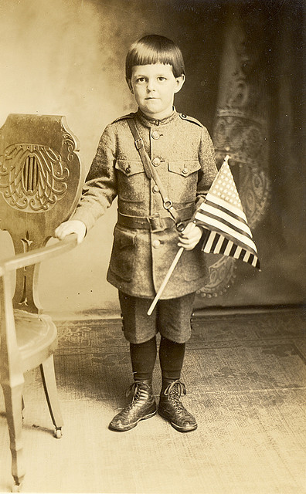
Children
As men are sent off to war, children are often left without fathers and older brothers
Mothers and sisters are working in factories
Children have to learn how to take care of themselves

Slide 16
Children
Groups such as the Boy Scouts were instructed to collect money for war bonds and stamps
Took mandatory patriotism and nationalism classes multiple times a week

Slide 17
Group Exercise…
Scenario:
Aliens have landed on Earth! These aliens are not dangerous, but in order to protect U.S. citizens, the government has issued laws to stop the aliens from being able to harm the fearful public.
Your groups are to come up with a set of laws/rules to govern the new Alien citizens.
5 laws/rules with an explanation for why and how you came up with your options. Each explanation should include why you chose this law and what the repercussions may be (so a paragraph per law)
Discuss each law within your group and make sure you have an understanding of why these laws are needed to protect all Americans!

Slide 18
German Citizens
Required to register with the U.S. Government and carry a registration card at all times
Accusations of spying or supporting the Germans would lead to imprisonment

Slide 19
Civil Liberties
The Sedition Act of 1918
Forbids any disloyal comments about the United States government, the flag, or armed forces
If convicted could go to jail from 5 to 20 years

Slide 20
End of World War I

Slide 21
America Enters World War I
At Americans entered the battlefields of France, Allied armies enthusiastically welcomed them
Came in at 10,000 troops a day
Germans could not match these reinforcements
The boost in numbers and morale was just enough to push the war to an end with an Allied Victory

Slide 22
November 11, 1918
An armistice (cease fire) is signed with Germany and the Allied Powers
"the eleventh hour of the eleventh day of the eleventh month“

Slide 23
Woodrow Wilson’s 14 Points
Self-Determination of Countries (self-rule)
Freedom to navigate the seas
Mandate System (control of land from one country to another)
The League of Nations should be formed

Slide 24
League of Nations
A collection of many different countries designed to keep peace between each of them
Any disagreements among countries would be brought to this League and the dispute would be settled diplomatically instead of with war

Slide 25
League of Nations
In America, the idea of the League was very popular with the public, but not with the Republican Congress
The fear was that America would be put into an expensive organization where American interests may be lost
Even though it was the President of the United States that came up with the League, America would not join it
The League would be doomed to fail

Slide 27
Treaty of Versailles
The French and English demanded harsh punishment for Germany
This would lead to a massive depression for Germany
The anger felt by Germans would lead to World War II
The League of Nations would be created here, but never gain much power
Many new countries are created after the war

