Slide 1
America Enters World War I
Wilson Notes 4

Slide 2
Wilson’s Attempt
For the first two and a half years of World War I President Woodrow Wilson had successfully kept America away from World War I
Neutrality – Not supporting either side in a conflict
Americans wanted no part in a European war

Slide 3
Neutrality Begins to Suffer
Many Americans cheered for the British due to ancestry
The German Empire increasingly becomes seen as the villain
Invasion of Belgium angers Americans

Slide 4
Neutrality Begins to Suffer
Lusitania
German U-Boats (Submarines) begin using torpedoes to sink any ships suspected of bringing the Allied Powers any war materials (guns, ammo, food)
UNRESTRICTED SUBMARINE WARFARE
Germany will take down any ships they see, regardless of country or alliance

Slide 7
Neutrality Begins to Suffer
Lusitania – Giant luxury ship that also carried Government cargo from America to Europe
German U-Boats sink the ship, killing several Americans on board

Slide 9
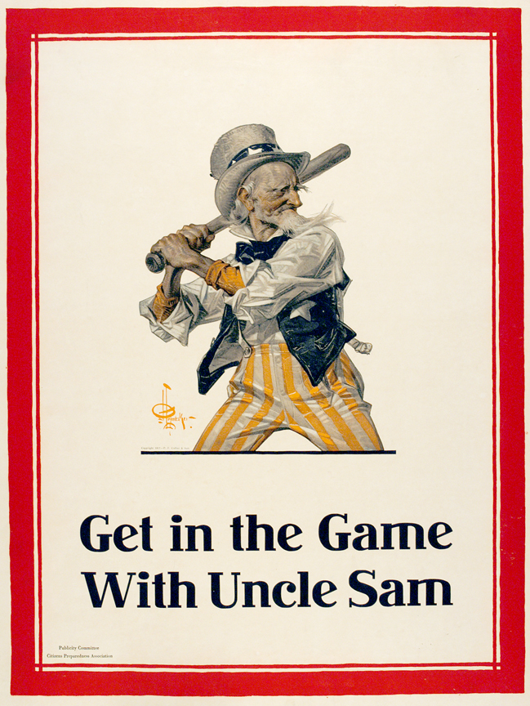
Neutrality Begins to Suffer
Nationalism
While most Americans still wanted to be pacifist (against violence), The idea that the war would leave a mark on history made some want War
Americans felt a lack of respect for the U.S. military

Slide 10
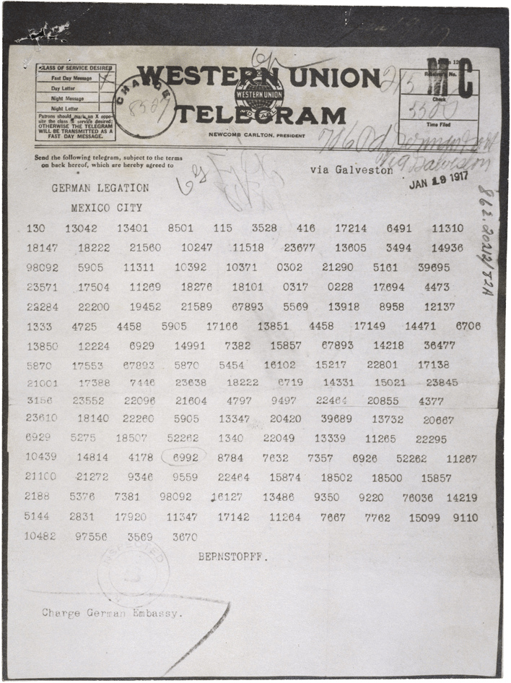
Neutrality Begins to Suffer
Zimmerman Telegram
Germany offers Mexico entry into the Central Powers
If the U.S. entered WWI with the Allies, then Mexico would invade America.
Mexico should get Japan to join the Central Powers

Slide 11
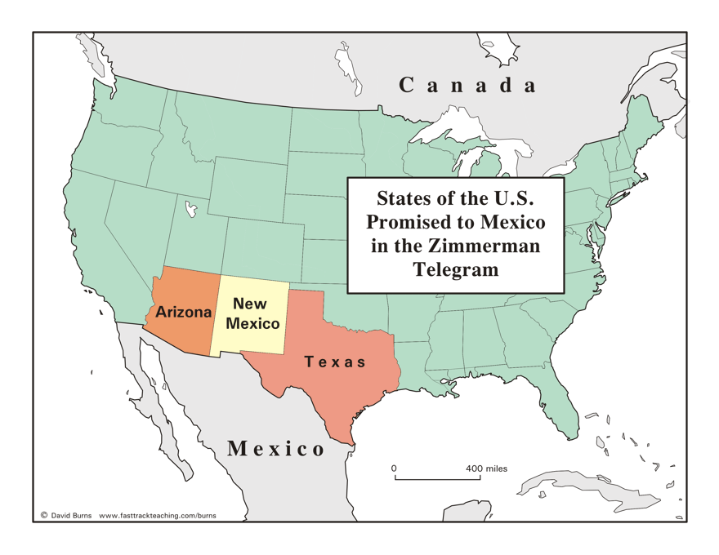
Neutrality Begins to Suffer
Zimmerman Telegram
After World War I, Germany claims that they will make sure Mexico gains back land lost to the U.S.

Slide 12
Neutrality Begins to Suffer
Zimmerman Telegram
Mexico ignores the telegram because they know they can not compete with the American military
Britain intercepts the note and sends it to America
Americans are furious with German Aggression

Slide 13
Neutrality Begins to Suffer
Zimmerman Telegram
Mexico ignores the telegram because they know they can not compete with the American military
Britain intercepts the note and sends it to America
Americans are furious with German Aggression

Slide 14
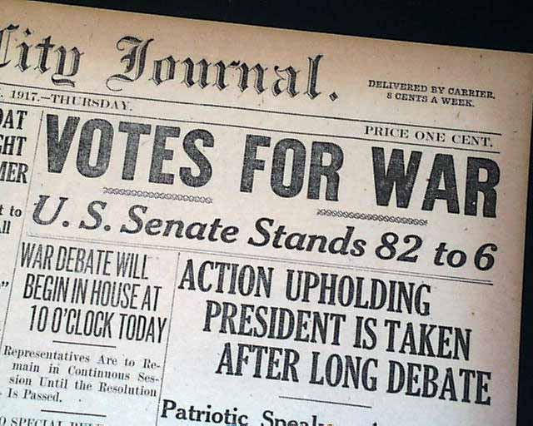
Declaration of War
On April 2, 1917, Woodrow Wilson asks Congress to declare war on the German Empire
America will “Make the world safe for democracy”
“This will be a war to end war”

Slide 15
Propaganda in WWI

Slide 17
What is Propaganda?
The deliberate spreading of ideas, facts, or rumors to help ones own cause and to harm the opponents cause.

Slide 19
What is Propaganda?
It urges people to agree with one side of an issue and to take action about it.
information designed to affect public opinion about an issue.
created to persuade the public to do or believe something.

Slide 21
What is Propaganda?
It may be used in any mass-media form that reaches the general public.
printed text or images, video, radio, or be Internet based.

Slide 22
What is Propaganda?
Propaganda usually does not give all of the important facts.
usually gives only one point of view on an issue. Its not balanced.

Slide 24
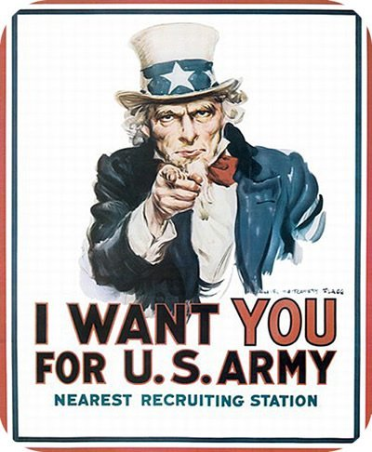

Slide 26
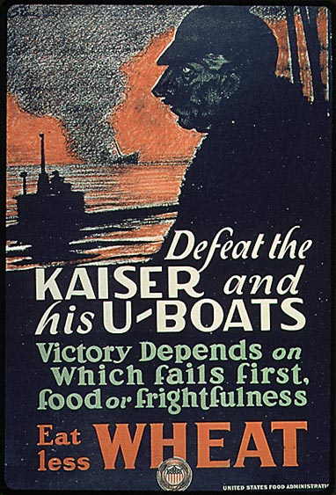

Slide 27
Propaganda Assignment
You will create a propaganda poster for one of the World War topics mentioned on the next slide. The poster must be drawn on an 8 ½ x 11 sheet of paper and will be graded on your use of color, images and words. Neatness will also factor into the final grade.

Slide 28
Propaganda Assignment
Enlistment and recruitment
Financing the war
The role of women
Food Administration
Fuel Administration
War Industries Board
Committee on Public Information
Aiding our allies

