Slide 1
Age of Reason
WHII.6f

Slide 2
The Age of Reason
The 16th, 17th, and 18th centuries brought many changes in the arts, literature, and political philosophy
The Age of Reason witnessed inventions and innovations in technology that stimulated trade and transportation
Notes:
The 16th, 17th, and 18th centuries brought many changes in the arts, literature, and political philosophy.

Slide 3
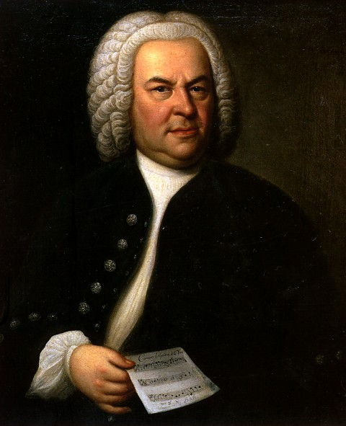
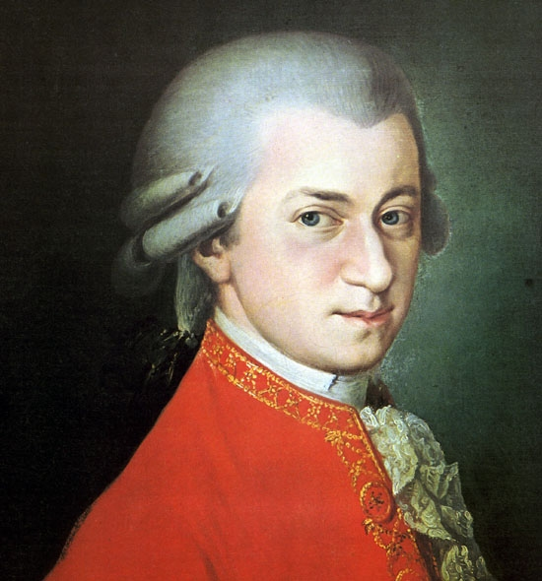
Key People
Johann Sebastian Bach
Baroque composer
Wolfgang Amadeus Mozart
Classical composer
http://www.capricorn-astrology-software.com/example_reports/mozart/wolfgang-amadeus-mozart.jpg
http://www.jsbach.net/bass/elements/bach-hausmann.jpg
Notes:
*Find and play a clip of Bach or Mozart!

Slide 4
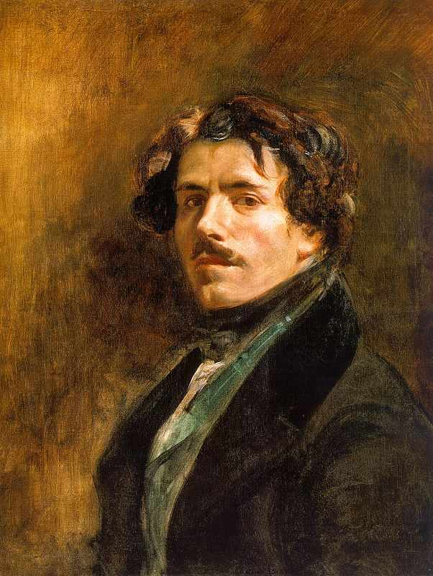
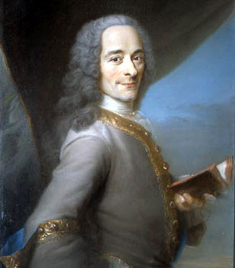
Key People
Eugene Delacroix:
Romantic School Painter
Painted classical subjects, public events, natural scenes, and living people (portraits)
Voltaire
Philosopher
http://bastrix.files.wordpress.com/2009/08/eugene-delacroix.jpg
http://web.jjay.cuny.edu/~ehanlon/voltaire.jpg

Slide 5
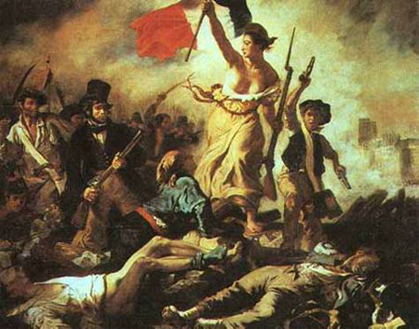
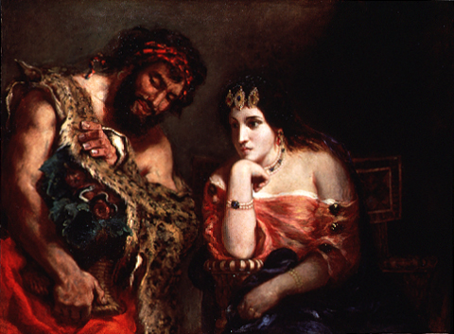
Art by Delacroix
http://www.unc.edu/courses/2005spring/engl/012/051/gtimmons/Images/delacroix-lg.jpg
http://www.tcp.com.mt/arc_files/image005.jpg

Slide 6
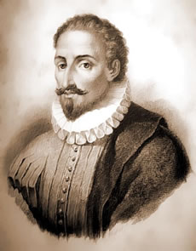
Key People
Miguel de Cervantes
Novelist
Don Quixote
http://www.utsa.edu/today/images/graphics/cervantes.jpg

Slide 7
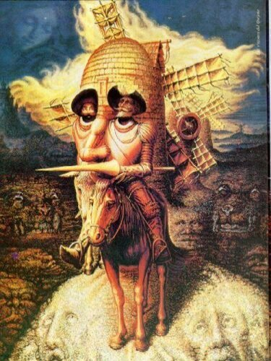
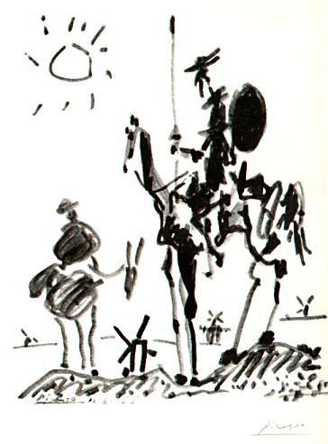
Literature- “Don Quixote”
http://z.about.com/d/puzzles/1/0/x/R/004.jpg
http://www.depts.drew.edu/engl/events/marathon/PicassoDonQuixoteSancho.jpg

Slide 8
Technologies
All-weather roads improved year round transport and trade.
New designs in farm tools increased productivity (agricultural revolution).
Improvements in ship design lowered the cost of transport.

