Slide 1
The Age of Napoleon (1799-1815) & Unification
WHII.8a

Slide 2
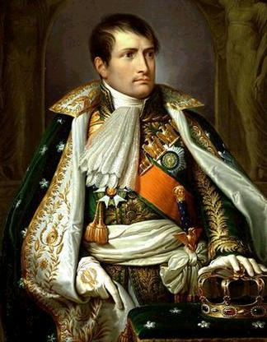
Who is Napoleon?
Brought order out of chaos!
Only 5’ 2” tall
Great military leader
http://samuelatgilgal.files.wordpress.com/2009/01/napoleon_bonaparte_1175088533032877.jpg
Notes:
Many people wanted stability after the years of chaos. Others were simply afraid to protest.
Supporters of Napoléon wanted France to be stable because they feared losing the property and power they had gained during the Revolution. Four of the five directors that made up the Directory were fired and those who stayed turned the government over to Napoléon and his fellow plotters. This was known as a coup d'état (seizure of power by force) this made Napoléon a dictator.
Napoleon’s genius lay in his ability to move troops rapidly to the most critical point on the battlefield. His opponents’ tactics were older and slower. Under Napoleon, he reconciled the Sardinians, he defeated Austria four times, and gained control of northern Italy.

Slide 3
Main Ideas
The French Revolution left a powerful legacy for world history: secular society, nationalism, and democratic ideas.
Napoleon’s attempt to unify Europe under French domination was unsuccessful.
The Congress of Vienna attempted to restore Europe as it had been before the French Revolution and Napoleonic conquests.

Slide 4
Legacy of Napoleon
Napoleon reorganized and centralized the government to give himself unlimited power.
The Consulate
First five years of Napoleon 's rule
First Consul
Notes:
Napoleon supported many of the changes brought by the Revolution. He respected the ideals of the Declaration of the Rights of Man and did not restore any feudal practices. Napoleon reorganized and centralized the government to give himself unlimited power.
He established the Consulate: first five years of Napoleon’s rule; this is the executive branch of government where Napoleon was First Consul. He commanded the army and navy and only allowed a plebiscite vote (yes or no, no suggestions/changes).
The rise of nationalism was a powerful force behind European politics during the nineteenth century.

Slide 5
Legacy of Napoleon
Napoleonic Code (French law)
Unsuccessful attempt to unify Europe under French domination
Awakened feelings of national pride and growth of nationalism
Nationalism: love of one’s country
Notes:
While Napoleon is remembered most for his military leadership, his work in government had a more lasting effect. Under Napoloen’s direction scholars organized all French law into a system called the Napoleonic Code.
Nationalism: love of one’s country

