Slide 1
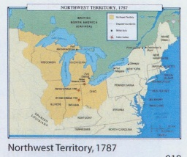
Land Ordinance of 1785

Slide 2
Land Ordinance of 1785
Authorized the surveying of the Northwest Territory
Divided the Northwest Territory into townships six miles square, each composed of 36 “sections” of 640 acres

Slide 3
Land Ordinance of 1785
Stipulated that surveyed land would be sold at auction, starting at a dollar an acre.
Provided for the proceeds from the sale of one section to be used to fund public education.

Slide 4
Shays’ Rebellion (1786)
The American economy was in deep depression in the 1780s.
The shortage of currency made it difficult for people to pay their debts and taxes.
Farmers feared foreclosure (i.e., seizure of mortgaged property by a bank if payments are not made).

Slide 5
Shays’ Rebellion (1786)
In 1786, a group of farmers in western Massachusetts, under the leadership of Daniel Shays, blockaded the courthouse to keep it from doing business and then attacked the federal arsenal in Springfield, Massachusetts.
The inability of the central government to put down this rebellion convinced many people that a stronger central government was needed.
This was one factor that led to the Constitutional Convention.

Slide 6
The Northwest Ordinance of 1787

Slide 7
The Northwest Ordinance of 1787
Authorized the creation of three to five states out of the Northwest Territory
Authorized the admittance of new states as full equals to the original 13 states

Slide 8
The Northwest Ordinance of 1787
Set up stages that an area would go through on its way to statehood:
Congress would appoint a governor and a council to rule until the population reached 5,000.
At that point, settlers could elect an assembly to pass laws until the population reached 60,000.
At that point, settlers could adopt their own constitution and petition Congress for statehood.

Slide 9
The Northwest Ordinance of 1787
protected civil liberties, made provision for public education, and prohibited slavery within the Northwest Territory.

