Slide 1
African Americans after the Civil War
Discrimination and segregation against African Americans intensified and took new forms in the late nineteenth century and early twentieth century.
African Americans disagreed about
how to respond to the developments.
VUS.8c

Slide 2
Discrimination and segregation against African Americans
Laws limited African American freedoms.
After reconstruction, many Southern state governments passed “Jim Crow” laws forcing separation of the races in public places.

Slide 3
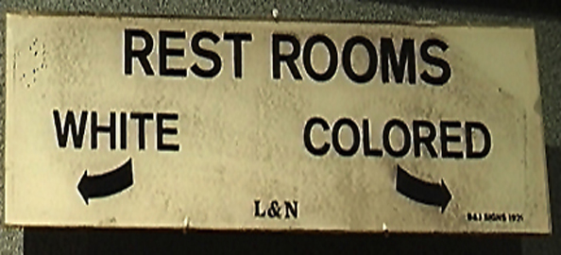
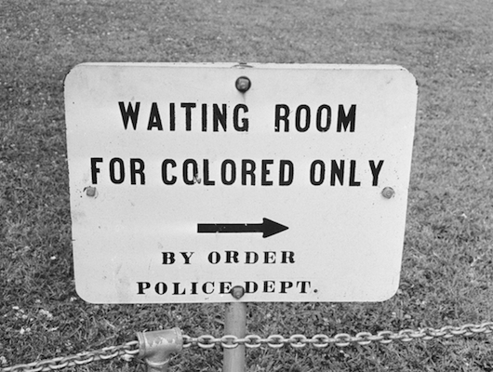

Slide 4
Discrimination and segregation against African Americans
Intimidation and crimes were directed against African Americans (lynchings).

Slide 5
Discrimination and segregation against African Americans
African Americans looked to the courts to safeguard their rights.
In Plessy v. Ferguson, the Supreme Court ruled that “separate but equal” did not violate the 14th Amendment, upholding the “Jim Crow” laws of the era.

Slide 6
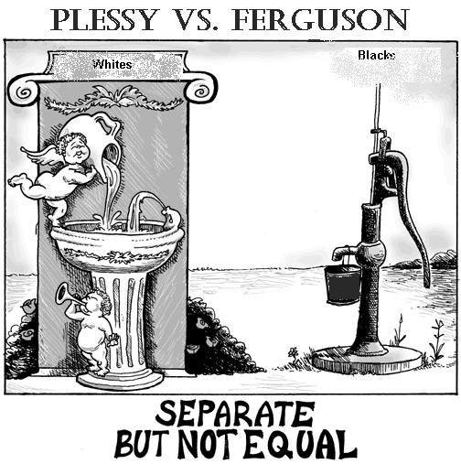

Slide 7
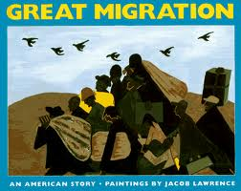
Great Migration
During the early 20th century, African Americans began the “Great Migration”
to Northern cities in search of jobs and to escape poverty and discrimination in the South

Slide 8
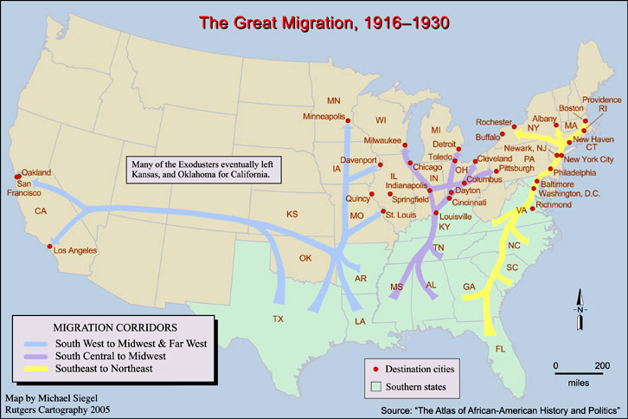

Slide 9
African American Responses
Ida B. Wells led an anti-lynching crusade and called on the federal government to take action.

Slide 10
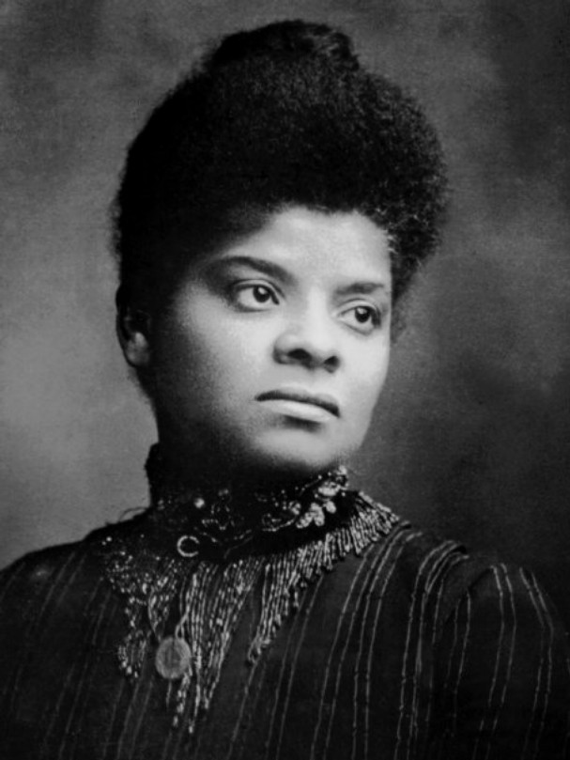

Slide 11
African American Responses
Booker T. Washington believed the way to equality was through vocational education and economic success; he accepted social separation

Slide 12
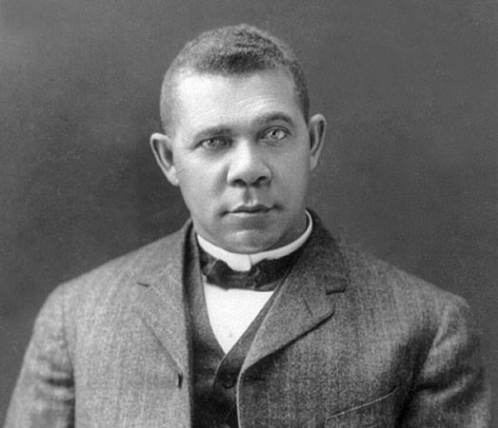

Slide 13
African American Responses
W.E.B. Du Bois believed that education was meaningless without equality. He supported political equality for African Americans by helping to form the National Association for the Advancement of Colored People (NAACP).

Slide 14
