Slide 1
A World Power?
VUS.9a

Slide 2
World Power
What do you think it means to be a world power?
What would your responsibilities be?
Discuss with your group the definition that you came up with. What did you all agree on? What is the group’s consensus on a world power and its responsibilities?

Slide 3
World Power
Should the United States be a World Power today?
Provide examples of things America does today to make them a world power
Do you agree that we should be doing these things?

Slide 4
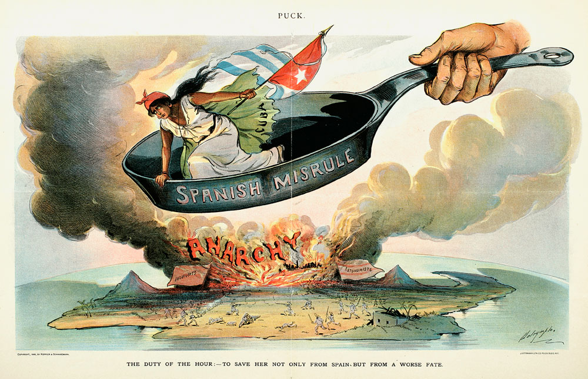
Spanish-American War - Causes
Cuban Revolt against Spain
Ended in a brutal and deadly victory with Spain
President McKinley: “[The Cuban Revolt] was not civilized warfare, but extermination.”

Slide 6
Spanish-American War - Causes
America’s Response to Cuban Revolt
Americans are outraged at the actions of the Spanish
Joseph Pulitzer and William Randolph Hearst – Journalists
Realized the potential for great headlines and stories this could cause

Slide 7
Describe the Following Photo
In a few sentences, describe and explain the event portrayed in the following photograph
The description must be appropriate to share with the class!

Slide 9
The Meaning
This photo was taken in the 1970s
Anti-War protestors on a college campus
Shot at by police
Peaceful demonstration turns deadly

Slide 11
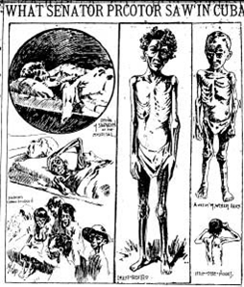
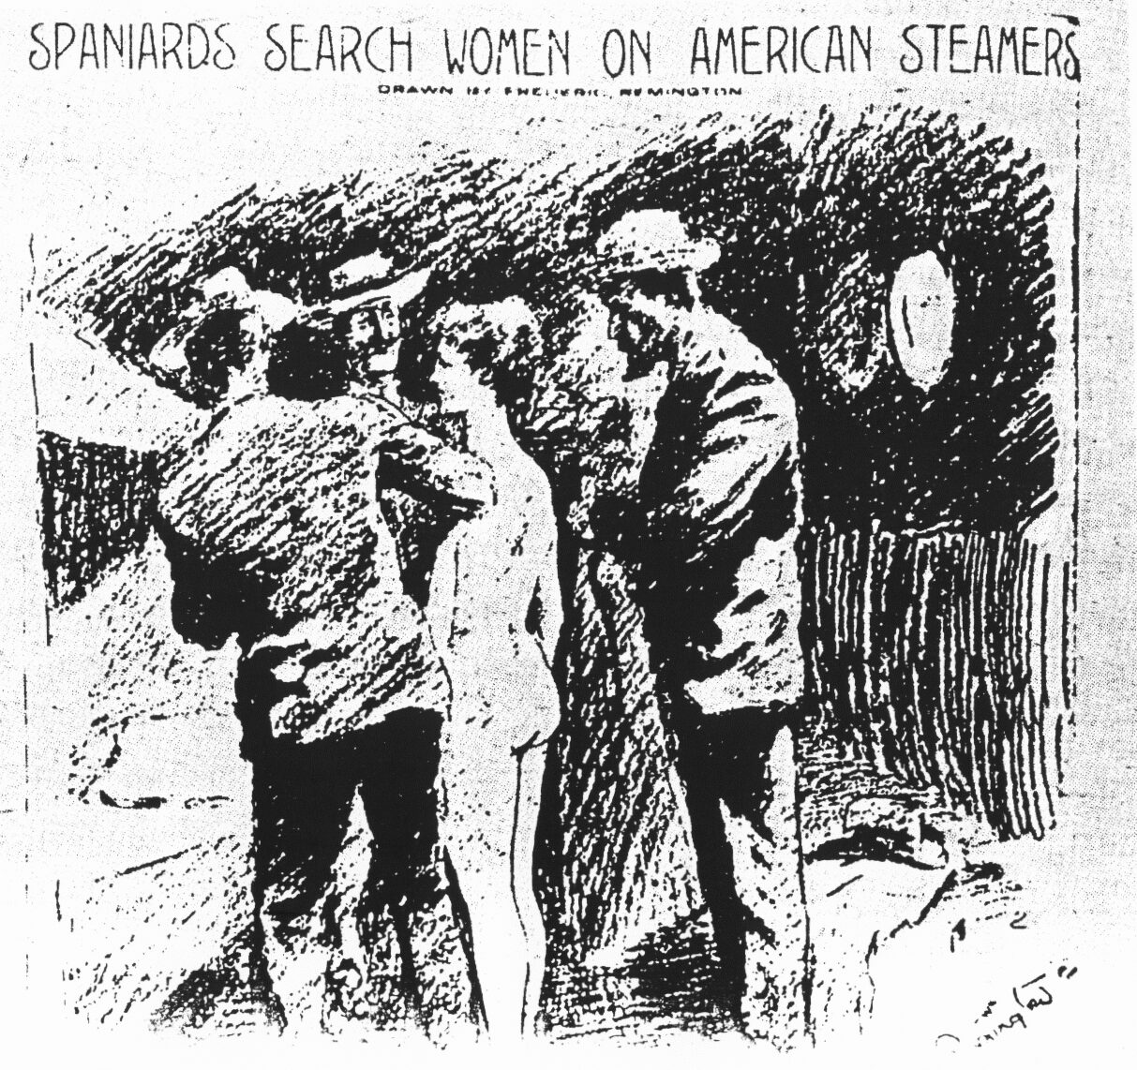
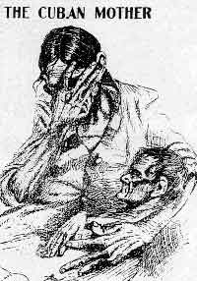
Spanish-American War - Causes
Joseph Pulitzer and William Randolph Hearst created yellow journalism
Little to no researched or legitimate news
Uses catchy headlines or shocking pictures to sell newspapers
This will be called the first “media-driven war”

Slide 12
Spanish-American War - Causes
American Economic Interests
Shipping firms relied on Cuban trade
Companies invested in sugar industry

Slide 13
Spanish-American War - Causes
USS Maine
Small riot erupts in Cuba
McKinley sends ship to ensure the safety of Americans
February 1898 – the warship explodes in Havana Harbor

Slide 14
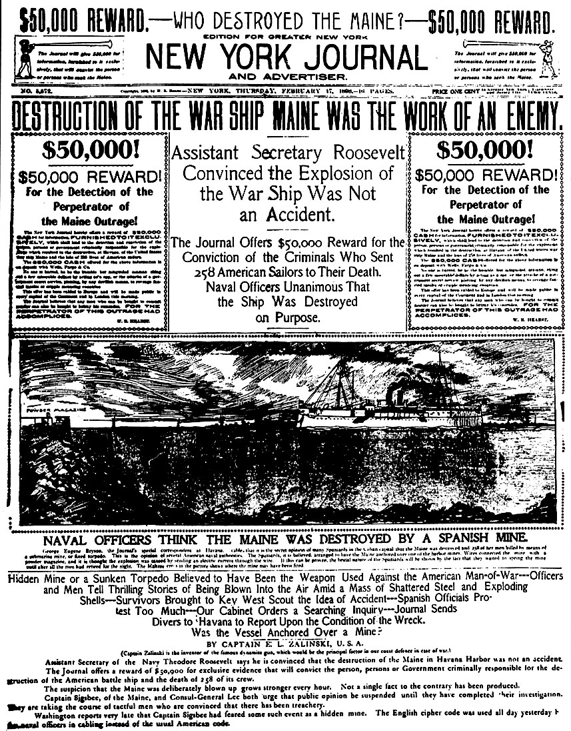
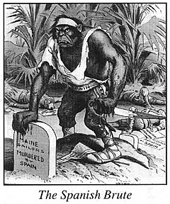
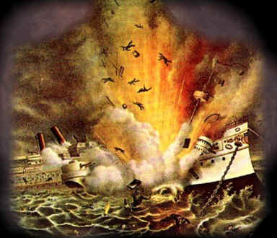
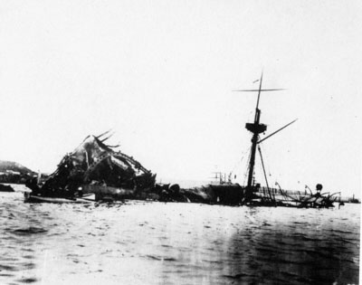
Spanish-American War - Causes
USS Maine
McKinley tries to calm the public down
Cause of explosion was unknown
American people cry out for revenge

Slide 15
Spanish-American War - Declaration
McKinley formally asks Congress for a declaration of war
Teller Amendment – U.S. would not annex Cuba, but would leave control of it to it’s people
Spain cuts off all ties with the U.S.
U.S. sets up a blockade around Cuba
Spain and America officially declare war on one another

Slide 16
Spanish-American War - Declaration
United States Military
Navy – Ready for war
Army – Short on men. They wanted 50,000 new men
220,000 signed up

Slide 18
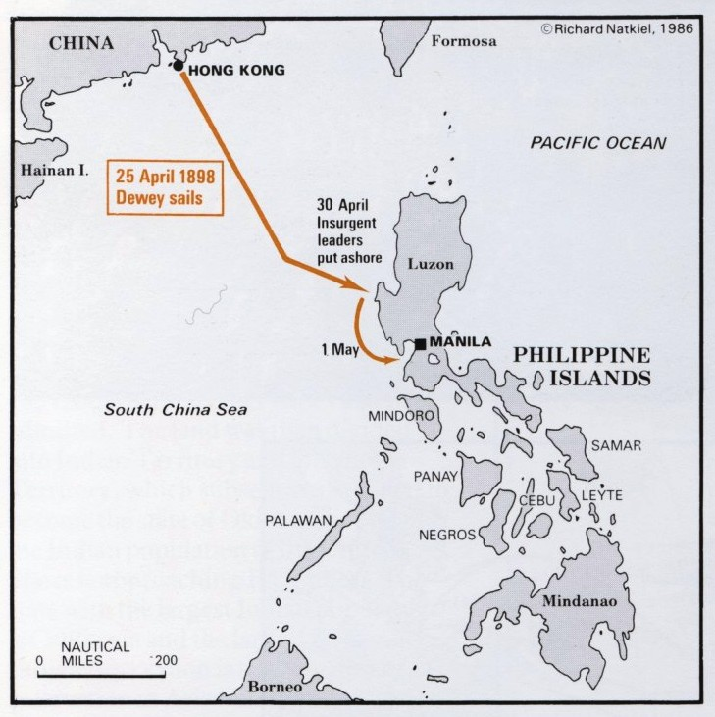
"You may fire when you are ready…”
First Battle of The Spanish-American War takes place in the Philippines
U.S. Commodore George Dewey defeats Spanish squadron in Manila Bay

Slide 19
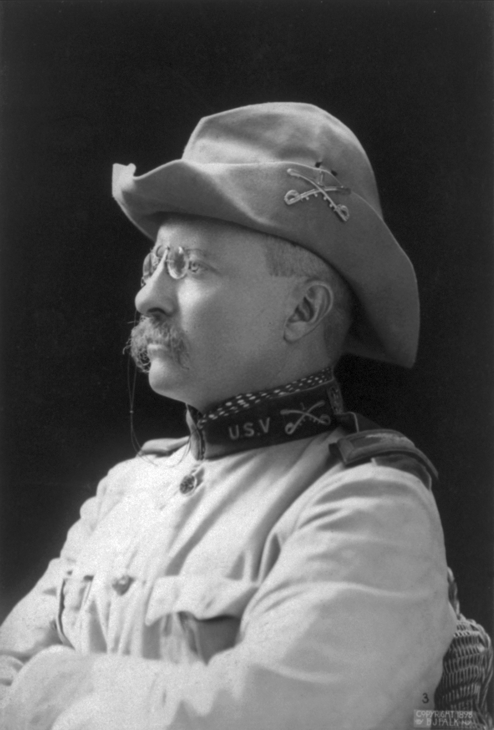
Theodore Roosevelt
Assistant Secretary of the Navy
Helped to prepare the Navy for the upcoming war
On the day war is declared, Roosevelt resigns from his office and joins the army on a volunteer basis

Slide 20
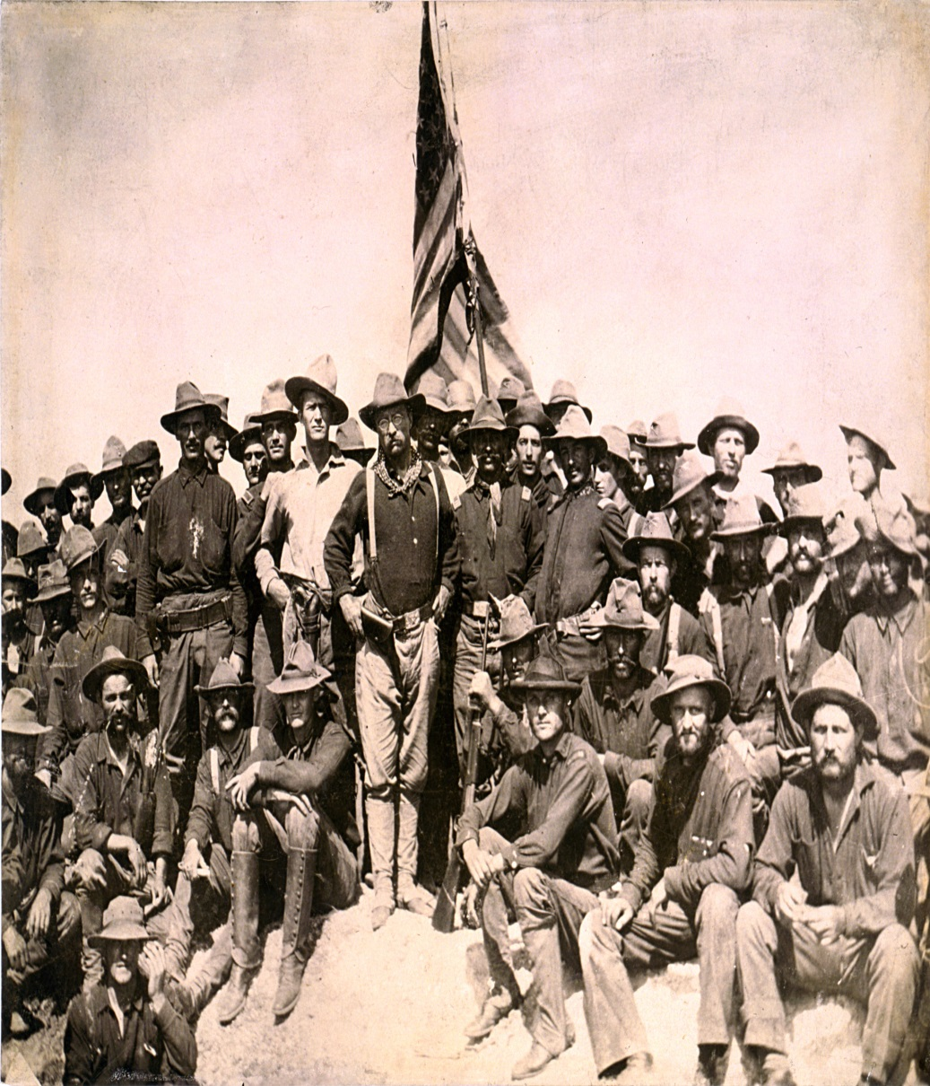
Rough Riders
All volunteer regiment created by Theodore Roosevelt
Made up of cowboys from the west
Extremely Diverse group
Rich, poor, Indian, black, white
Ordered to Cuba by the military

Slide 21
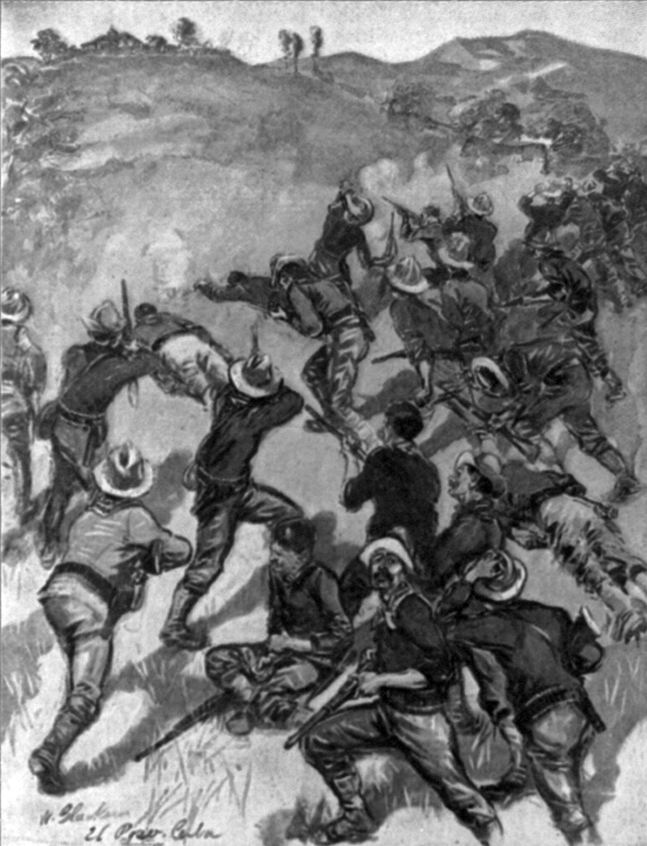
Battle of San Juan Hill
Bloodiest and most famous battle of the war
500 Spanish defenders vs. 8,000 Americans
Rough Riders are instrumental in American victory
Rushed up hill with inferior weapons, but still took over the hill
Led by Teddy Roosevelt

Slide 22
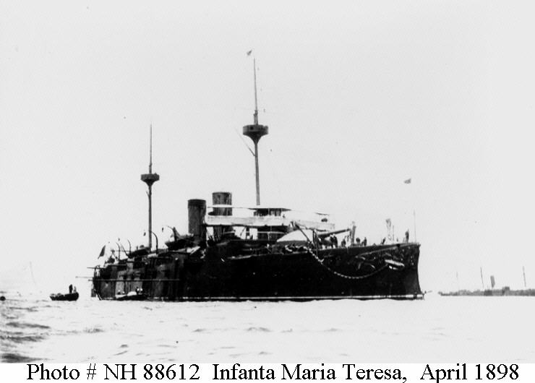
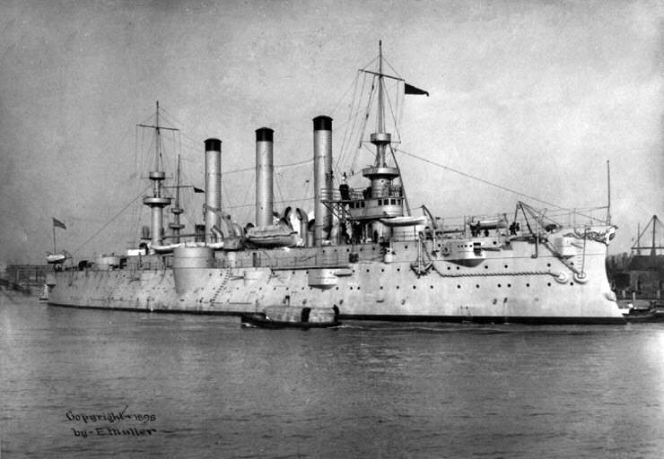
Santiago Bay
Largest Naval Battle of the war
Almost entire Spanish fleet is destroyed
End of Spanish Navy’s presence in the world
Last major battle

Slide 23
Treaty of Paris
Representatives from Spain and America meet in France
United States gets Puerto Rico, Guam, and the Philippines (must pay $20 million)
Cuba is given it’s independence
End of the Spanish Empire in North America
Beginning of the age of United States colonial power

Slide 24
Video
Write down 5 facts you learned from the video clip.
2 should be about why America would go to war (American perspective)
2 should be about why Spanish would go to war (Spanish perspective)
The final fact can be student choice!
http://www.youtube.com/watch?v=0hdTzlvYRdM

