Slide 1
1920s and 1930s
USV10.a-D

Slide 2
Essential understandings
The United States emerged from World War I as a global power. The stock market boom and optimism of the 1920s were generated by investments made with borrowed money. When businesses failed, the stocks lost their value, prices fell, production slowed, banks collapsed, and unemployment became widespread.

Slide 3
Mass Media and Communications
Radio - broadcast jazz and Fireside Chats
Movies - provided escape from Depression-era realities
Newspapers and magazines - shaped cultural norms and sparked fads

Slide 4
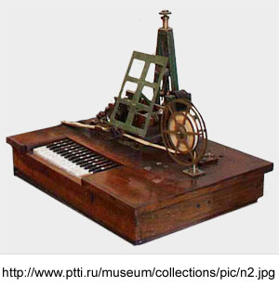
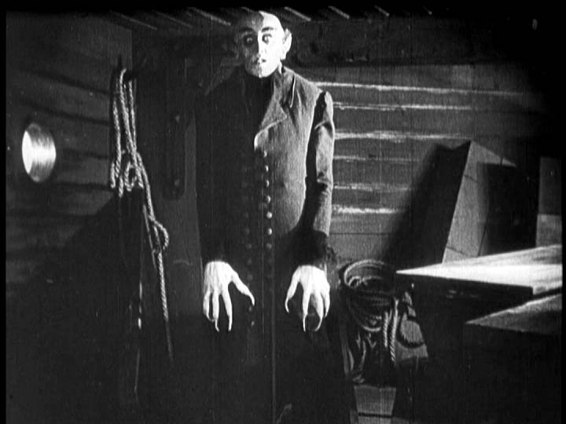
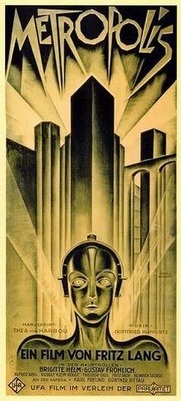

Slide 5
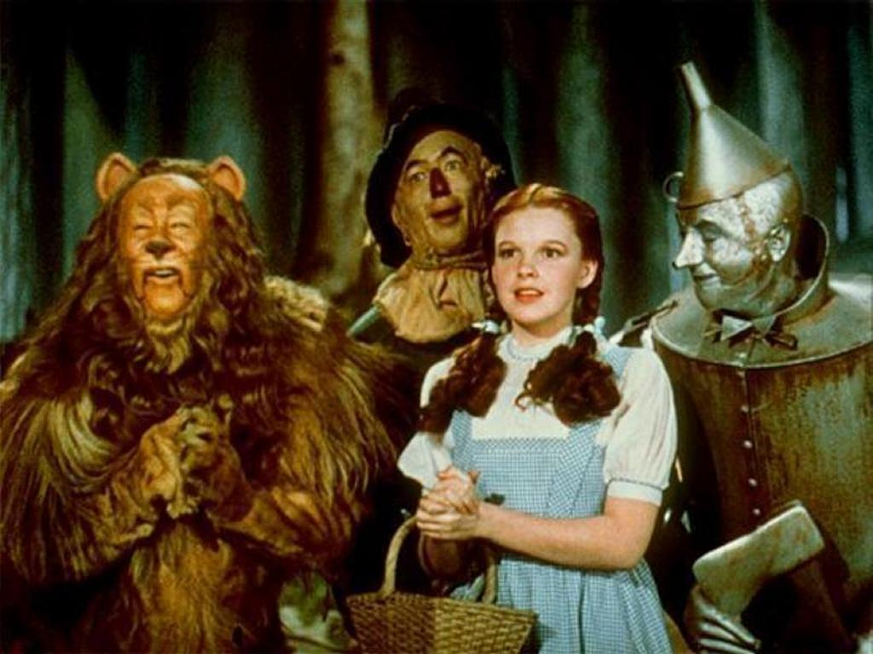
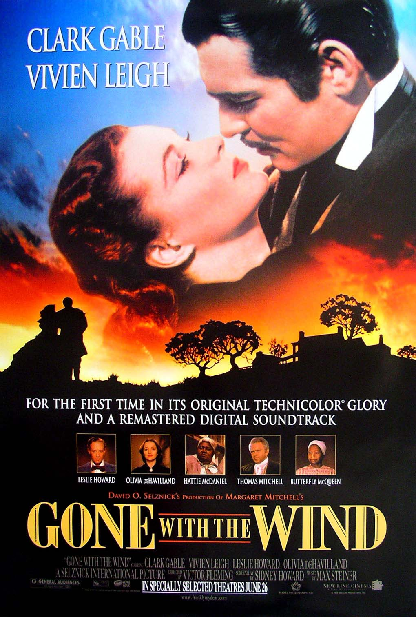
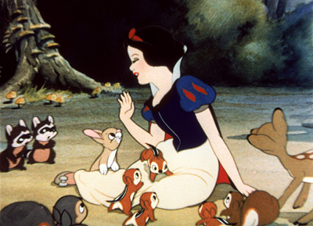

Slide 6
Challenges to Traditional Values
Traditional religion - Darwin’s Theory and Scopes Trial
Traditional Role of Women -
Flappers, 19thAmendment
Open Immigration - Rise of new KKK
Prohibition - Smuggling alcohol and speakeasies

Slide 7
Scopes
1925 – It is illegal to teach the theory of evolution in Tennessee
John Scopes, a high school teacher, taught it anyways

Slide 8
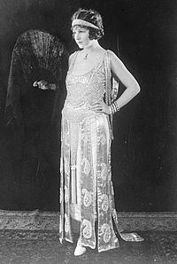
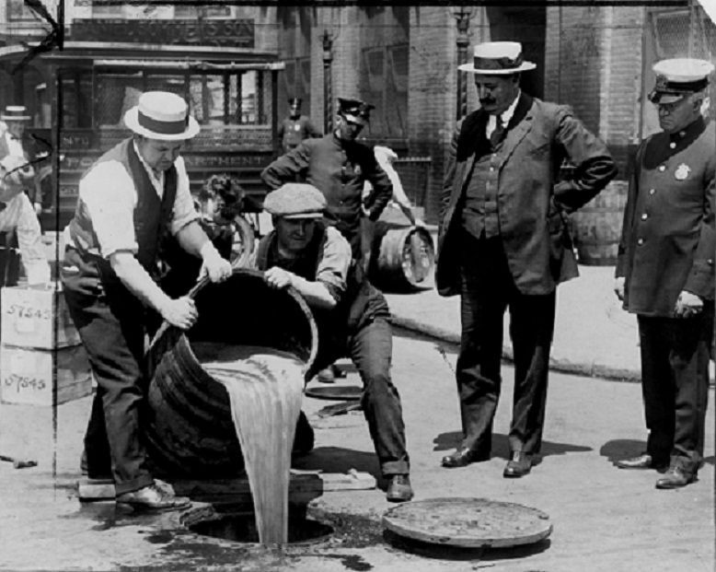

Slide 9
Stock Market crash of 1929
Business was booming, but investments were made with borrowed money (over speculation)
Excessive expansion of credit
Business failures led to bankruptcies
Bank deposits were invested in the market
When the market collapsed, the banks had no money

Slide 10
Consequences of the stock market crash
Clients panicked, attempting to withdraw their money from the banks, but there was nothing to give them
No new investments

Slide 11
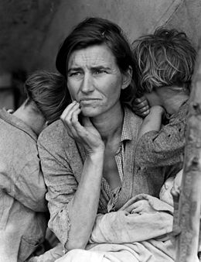
Causes of the great depression
Stock market crashed in 1929 and stock prices collapsed

Slide 12
Causes of the great depression
Federal Reserve’s failure to prevent widespread collapse of the nation’s banking system in the late 1920s and early 1930s, leading to severe contraction in the nation’s supply of money in circulation

Slide 13
Causes of the great depression
High protective tariffs that produced retaliatory tariffs in other countries, strangling world trade (Tariff Act of 1930, popularly called the Hawley-Smoot Act)

Slide 14
Impact of the great depression
Unemployment and homelessness
Collapse of financial system (bank closings)
Demand for goods declined
Political unrest (growing militancy of labor unions)
Farm foreclosures and migration

Slide 15
